Slide 1
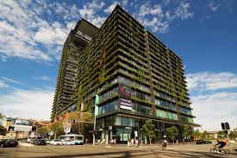



s
cost-benefit calculation in
green buildings
Oussama BenNaadja

Slide 2

Summary
01
Introduction
07
Challenges and Cost-Benefit Analysis of
Green Buildings
02
Definition of green buildings
08
Principles of Cost-Benefit Analysis
(CBA)
03
benefits of green building
How to do Cost Benefit Analysis
09
04
Financial Benefits of Green
Buildings
10
Steps Cost-Benefit Analysis CBA
05
Key Advantages of Green
Buildings
11
a case study in Kathmandu, Nepal
06
Definition CBA of green buildings
12
Conclusions

Slide 3
Introduction
Nowadays, everyone is looking for a solution to reduce the environment
pollution, from home to office .
The green office building is a way to reduce this CO2 emission to the
environment as well as increase the property value as well.
This green building practice is a big step to save
the world.

Slide 4
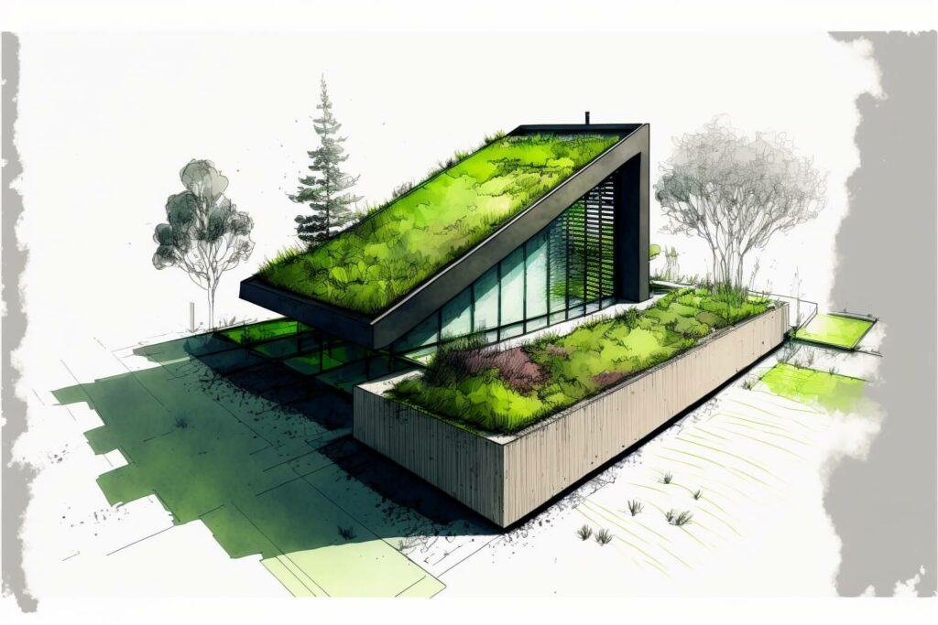
Definition of green buildings
green building is efficient in energy
consumption, environment friendly and
structurally sustainable throughout the
building life cycle

Slide 5
benefits of green building
With varying benefits of green building in multiple domains, it may be easier to group them under 3 categories
01
Economic Benefits
Social Benefits
Environmental Benefits
02
03
1/ Energy saving
2/ Reducing maintenance costs
3/ Increasing property value
1/ Improving population health
2/ Increasing productivity
3/ Providing better living spaces
1/ Preserving natural resources
2/ Improving air and water quality
3/ Reducing carbon emissions

Slide 6
Financial Benefits of Green Buildings
Lower operating costs
Green buildings lead to higher return on investments
Marketability of green buildings
Alfredo Torres
Adora Montminy
The ability of green buildings to attract and retain corporate and government tenants
Green buildings reduce liability and risk

Slide 7
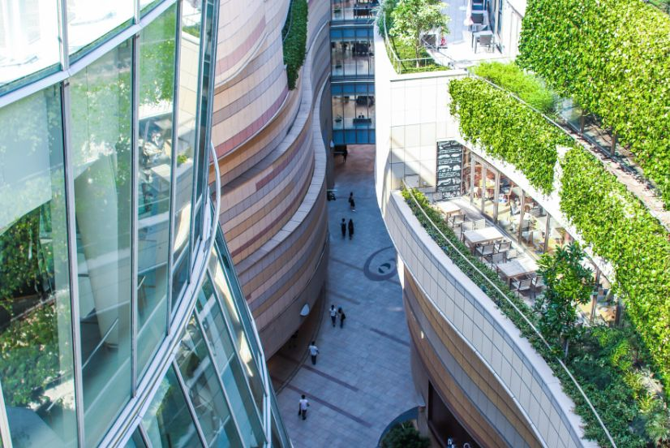
Key Advantages of Green Buildings
01
Lower building maintenance and operation cost
02
Reduced Energy Use
03
Improved indoor environment quality
04
Improved water efficiency
05
Material efficiency
06
Reduces strain on local resources

Slide 8

Home
Service
About Us
Contact
Definition CBA of green buildings
cost-benefit analysis is an approach used to determine a project’s costs and benefits, including architectural projects that apply the green building concept. Through the application of cost-benefit analysis, it can be seen how much additional costs must be incurred as well as how many additional benefits from an architectural project if implementing the green building concept

Slide 9

Challenges and Cost-Benefit Analysis of
Green Buildings
01
Higher initial design and certification costs.
Extended payback periods, sometimes up to
20 years
02
03
Difficulty quantifying intangible benefits such
as productivity gains.

Slide 10
Principles of Cost-Benefit Analysis (CBA)
Cost-Benefit Analysis (CBA) is a method for evaluating a project's economic feasibility by comparing its societal benefits and costs. It prioritizes social welfare over monetary aspects, using money as a measure of welfare. CBA assesses the value generated by a project against the sacrificed goods, incorporates social opportunity costs, and measures benefits through producer and consumer surplus changes. It excludes sunk costs and transfer payments, aggregates and discounts all costs and benefits, and focuses on comparing scenarios with and without the project to identify interventions that maximize social welfare

Slide 11
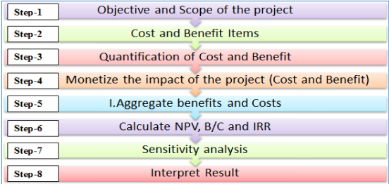
Steps Cost-Benefit Analysis )CBA(

Slide 12
Home
Service
About Us
Contact
How to do Cost Benefit Analysis?
When doing the cost-benefit analysis, there are two main methods of arriving at the overall results. These are Net Present Value (NPV) and the Benefit-Cost Ratio (BCR)
1 - Net Present Value Model
The NPV of a project refers to the difference between the present value of the benefits and the present value of the costs. If NPV > 0, then it follows that the project has economic justification for going ahead.
It is represented by the following equation:
NPV = ∑ Present Value of Total Future Benefits - ∑ Present Value of Total Future Costs

Slide 13
Home
Service
About Us
Contact
How to do Cost Benefit Analysis?
2 - Benefit-Cost Ratio
On the other hand, the Benefit-Cost provides value by calculating the ratio of the sum of the present value of the benefits associated with a project against the sum of the present value of the costs associated with a project :
BCR = ∑ Present Value of Total Future Benefits / ∑ Present Value of Total Future Costs

Slide 14

Home
Service
About Us
Contact
a case study in …

Slide 15
a case study in Kathmandu, Nepal
Home
Service
About Us
Contact
Step 1: Objective and Scope of the Project :
The project consists of rehabilitating the existing building with photovoltaic (hybrid) solar panels on its roof. for energy efficiency and to install rainwater harvesting (RWH) technology to improve the water efficiency of the building. In this study, the installation
period is considered as one year, and it is assumed that the project will generate cash flow after one year.
The objective of the project is :
reduce the operating costs of public buildings
reduce greenhouse gas emissions.

Slide 16
a case study in Kathmandu, Nepal
Home
Service
About Us
Contact
Step 2: Cost and Benefit Items :
The cost and benefit items of solar PV and rainwater harvesting, which were identified within the scope of the study, are private cost.
1/ Capital Cost
The capital cost is the initial installation cost for a PV solar panel and rainwater harvesting facilities.
The office building will be retrofitted with :
40 kW of solar panel and 8 units of rainwater harvesting tank
so, the installation
cost of a solar panel for this study is $1,728.70/ Kw
cost of rainwater harvesting for this study is $625.6/unit.

Slide 17
a case study in Kathmandu, Nepal
Home
Service
About Us
Contact
Step 2: Cost and Benefit Items :
2/ Operating & Maintenance Cost : In this study, energy cost and water consumption cost has been considered as the operating cost.
annual power consumption is 43.52 kWh/Sqm.
annual water consumption is considered as 459.5 liters/m2
3/ Benefits
Power saving from PV solar panels
water-saving for rainwater harvesting
reduction in CO2 emission

Slide 18
a case study in Kathmandu, Nepal
Home
Service
About Us
Contact
Step 2: Cost and Benefit Items :
3/ Benefits
The average annual power output per kW of PV solar panel is 153.89 kWh
The water collected from the rainwater harvesting system is calculated by using the rational method V=A×P×C
A = 275 m2 / P = 90 mm/hr / C = 0.9
The annual amount of water harvested is 334,125 liters
The CO2 emission from energy and water consumption is 7.07*10^-4 ton/kWh and 0.35 kg/1000 liters respectively
.

Slide 19
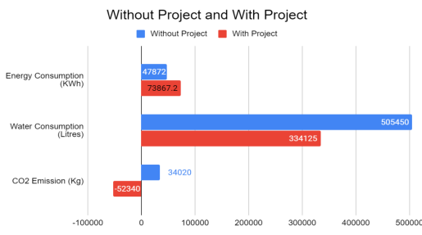
a case study in Kathmandu, Nepal
Home
Service
About Us
Contact
Step 3: Analyse the impacts of the project (costs and benefits) :
.

Slide 20
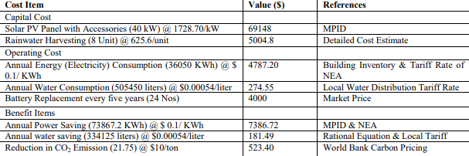
a case study in Kathmandu, Nepal
Home
Service
About Us
Contact
Step 4: Monetize the Impacts :

Slide 21
a case study in Kathmandu, Nepal
Home
Service
About Us
Contact
Step 5: Aggregate Benefits and Costs :
Since the life of PV solar panel and rainwater harvesting is 20 years, the time horizon for CBA is set at 20 years from the start of the installation
The social discount rate is calculated from the Social rate of time preference (SRTP)
The SRTP is calculated as a maximum of Development Bond and Treasury Bill.
As per the central bank of Nepal
The interest rate on development bond is 5% for 15 years
4.28% for the treasury bill over 364 days
so,
the social discount rate is considered as 5%

Slide 22
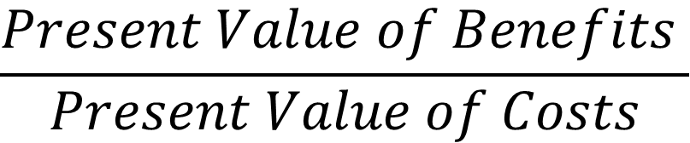
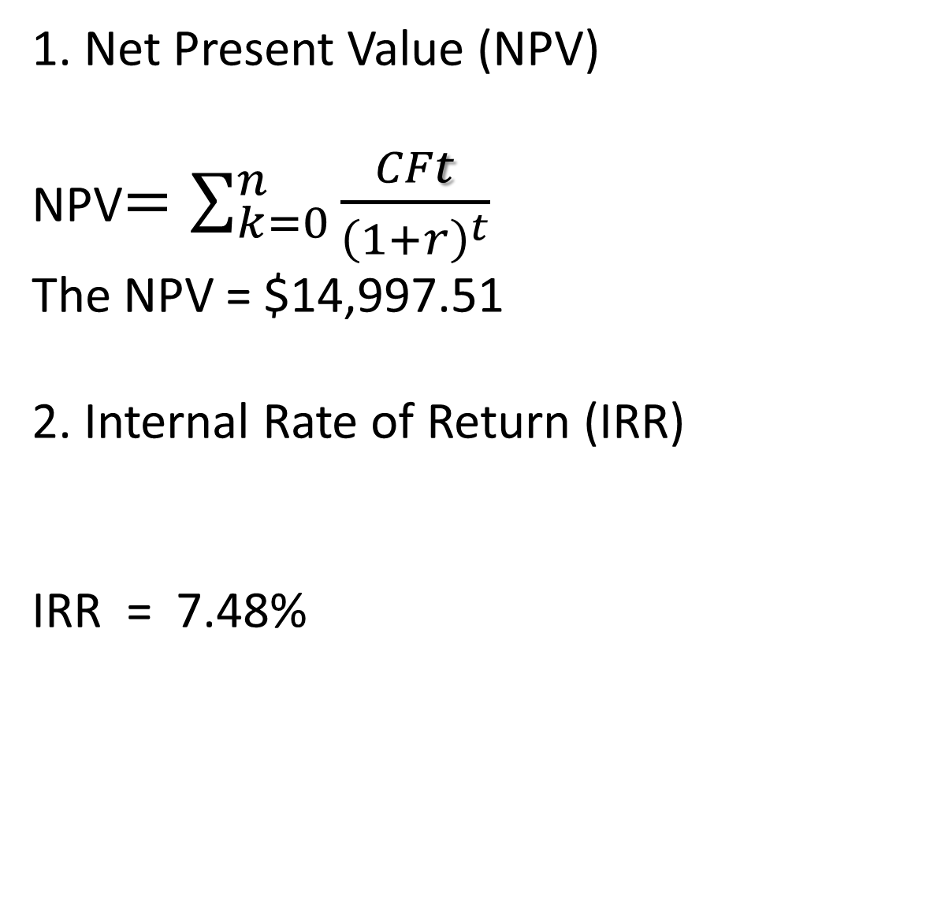
a case study in Kathmandu, Nepal
Home
Service
About Us
Contact
Step 6: Calculate NPV, IRR, and B/C ratio :
1. Net Present Value (NPV)
NPV$=\sum_{k=0}^{n}{\frac{CFt}{{\left(1+r\right)}^{t}}}$
The NPV = $14,997.51
2. Internal Rate of Return (IRR)
IRR = 7.48%
3. Benefit-Cost (B/C) Ratio
$$\frac{Present Value of Benefits }{Present Value of Costs}$$
𝑥=
B/C ratio of the project are 1.252

Slide 23
a case study in Kathmandu, Nepal
Home
Service
About Us
Contact
Step 7: Sensitivity Analysis :
Three factors are considered for scenario analysis : SDR , net benefits , and date as follows
1/ Social Discount Rate:The effect of SDR on NPV is observed by varying discount rates from 2% (Low) to 10% (High).
2/Net Benefits : the monetary value of predicted benefits is varied by -10%, -20%, and, -
30% to study its impact on project feasibility.
3/ Date (i.e base year) ) when the green building project is undertaken: The effect on cost
and benefits of delaying the investment in green building by 5, 10, 15, and 20 years is examined.
The project generates positive cash flow until the discount rate is 7.48%. The project
generates $ 41801.27 at a discount rate of 2%, and -$10862.63 at a discount rate of 10% As explained above, there are chances of the fluctuation in power output If the power output
decreases by 20%, then the project will not generate positive cash flow;

Slide 24
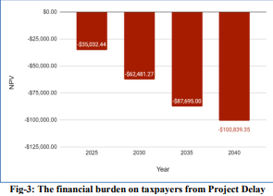
a case study in Kathmandu, Nepal
Home
Service
About Us
Contact
Step 7: Sensitivity Analysis :

Slide 25
a case study in Kathmandu, Nepal
Home
Service
About Us
Contact
Step 8: Interpret the result and make a decision:
Over a period of 20 years, the initial installation cost of solar panels & rainwater harvesting
is $74,152.80t.
The NPV of $14,997.51 / the IRR 7.48% which is higher than the discount rate
the project is economically viable. The payback period is calculated
as 11.15 years ;The results of the cost-benefit analysis demonstrate the installation of solar panel & rainwater harvesting as a favorable investment option.
New Town Project Office will decrease its life cycle cost of building by $14,997.51 over a period of 20years.

Slide 26

Conclusions
Green building is a response to a demand for energy and resource efficiency. Nowadays the green building is much more than the energy efficiency. Now designers understand that fresh air, improved indoor environment, and water savings is also important

Slide 27
Home
Service
About Us
Contact
Thank You

