Slide 1
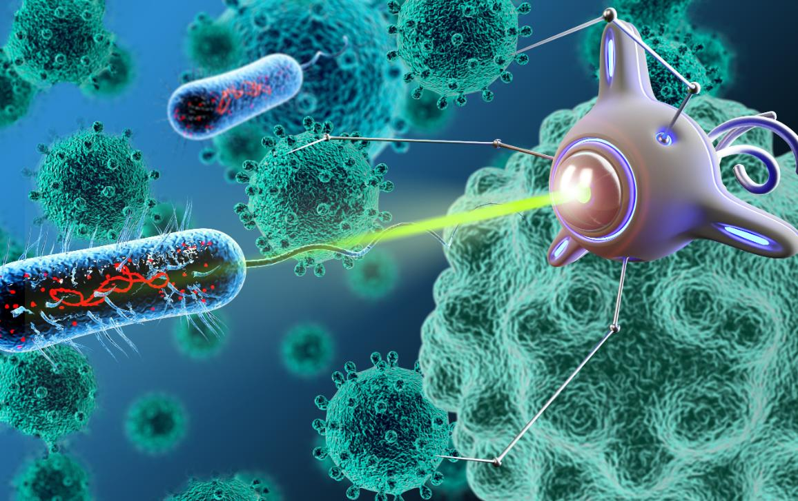
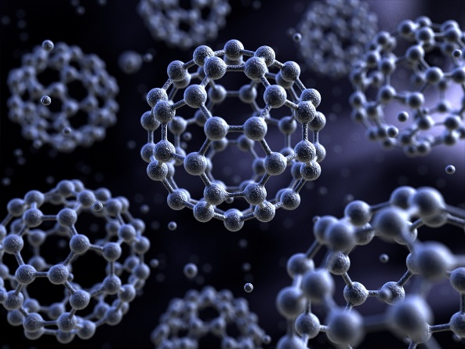

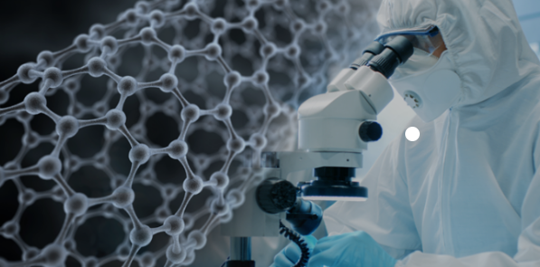

Slide 2
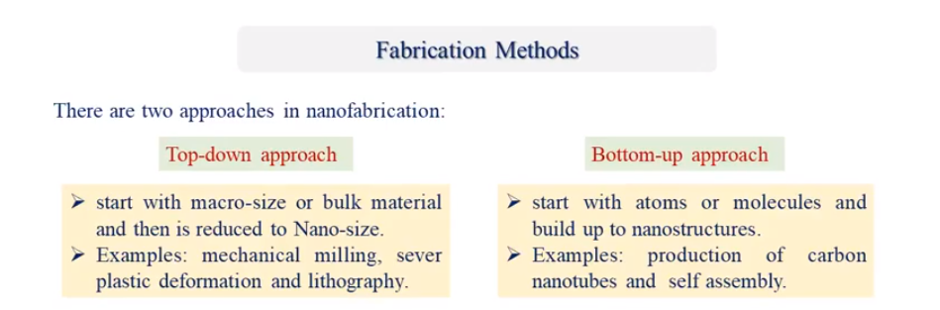
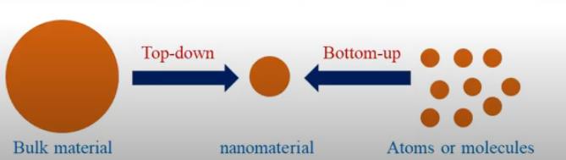
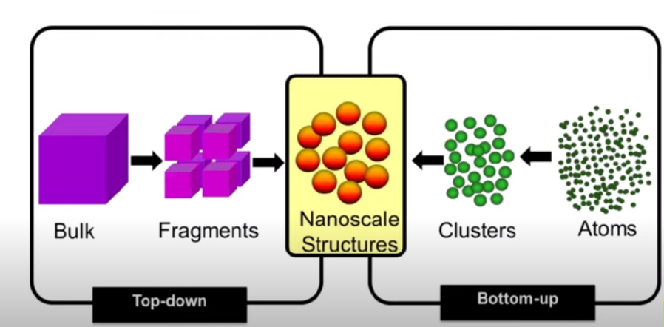
these two approaches are called the

Slide 3
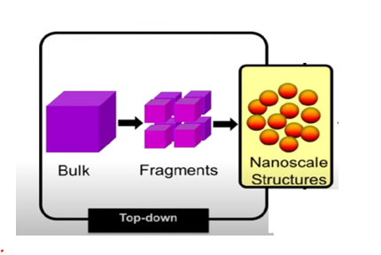


Slide 4
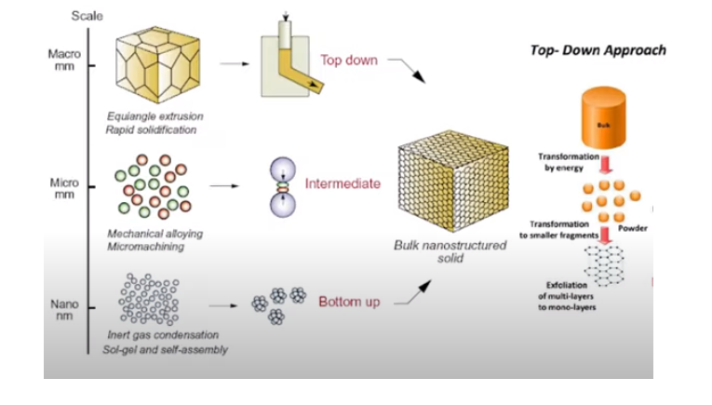
Method Top-Down Approach
The method of producing nanomaterial is by using the technique of minimizing the sizes of large objects and their powders, whose sizes may reach several millimeters or a few centimeters, and reaching dimensions of no more than 100 nanometers. This method is considered the most common and used, due to its ability to produce large quantities of powders and granules. Nanomaterial of various types and classes. It includes the technology of minimizing granules and down to Nano-scale dimensions in several ways.

Slide 5
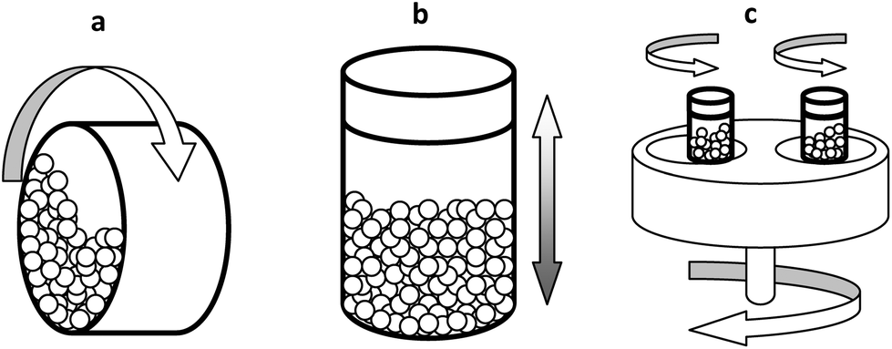
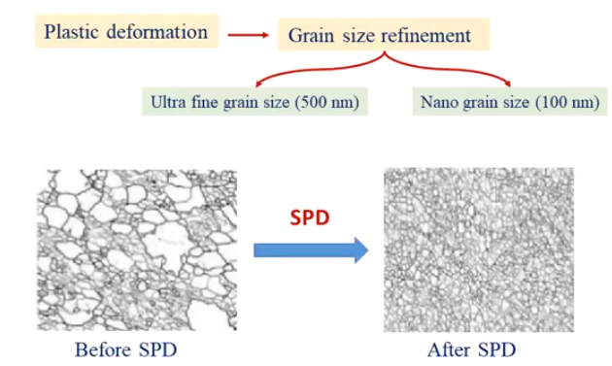
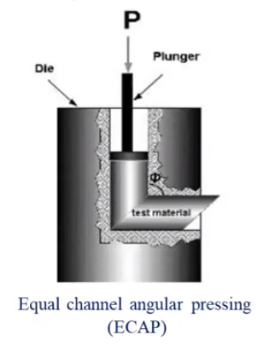
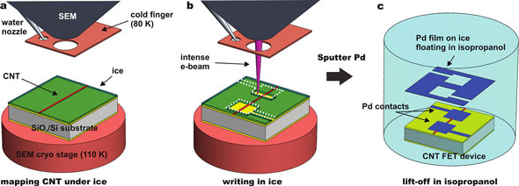
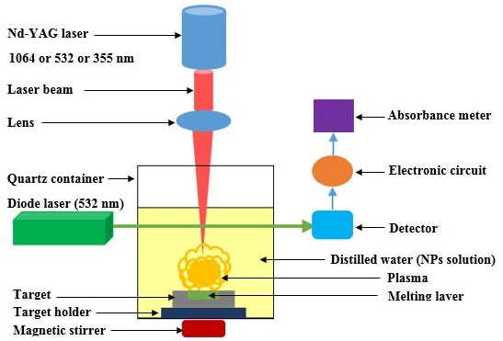
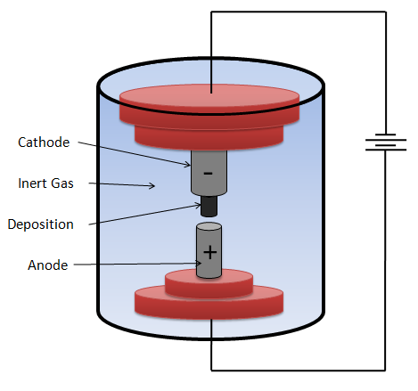
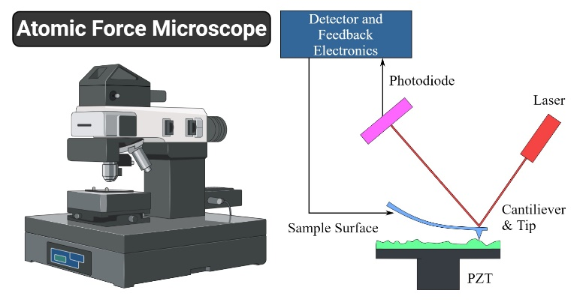
types of methods Top-Down Approach
The technology of minimizing granules and reducing their scales to Nano dimensions includes several methods, including:
Mechanical milling.
Sever Plastic Deformation (SPD).
Lithography.
Laser Ablation.
Arc Discharge.
Atomic Force Microscopes (AFM)
Scanninge Probe Microscopes (SPM)

Slide 6
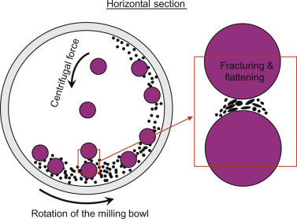
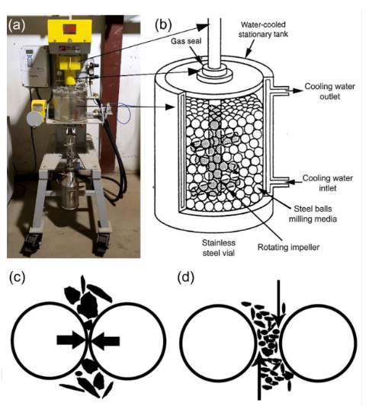
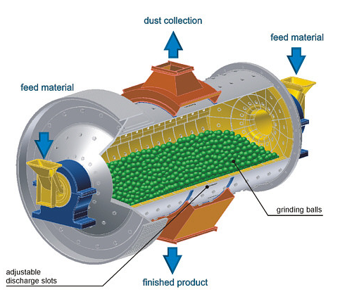
Mechanical milling
Mechanical grinding is carried out using a drum or bowl in which the raw material to be ground is placed to convert it into nanomaterial. This bowl contains balls of steel or carbide that are used to grind the raw material. It also contains a rotating part that moves the balls in all directions. The cutting and grinding process results in nanoparticles. During grinding the powder particles get stuck between the colliding balls and deform or break, which determines their final structure. The nature of these processes depends on the mechanical behavior of the powder components, phase equilibrium and grinding stress condition. This method is economical and low cost.

Slide 7
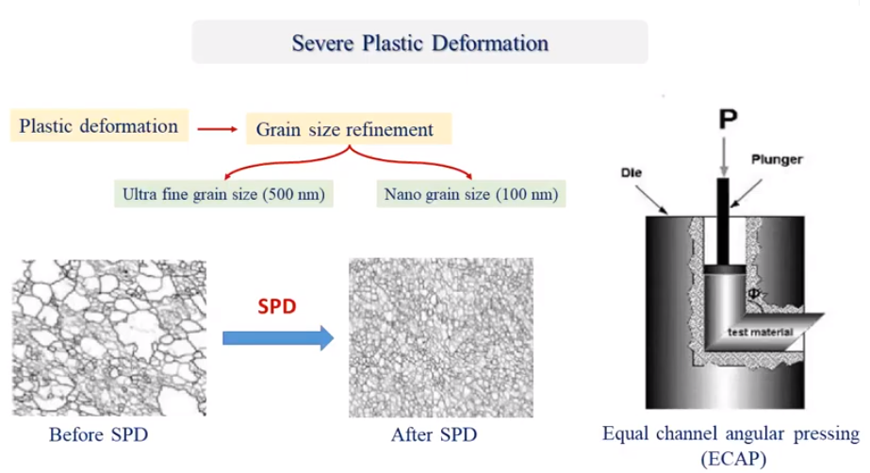
Sever Plastic Deformation (SPD).
We know that the material consists of granules and the granules have a certain grain size. In the plastic deformation molding method, we affect the material with very strong stresses in order to shape it and affect the external shape, but these stresses do not affect the external shape only, but the effect reaches a change in the size of the granules themselves, which makes us get

Slide 8
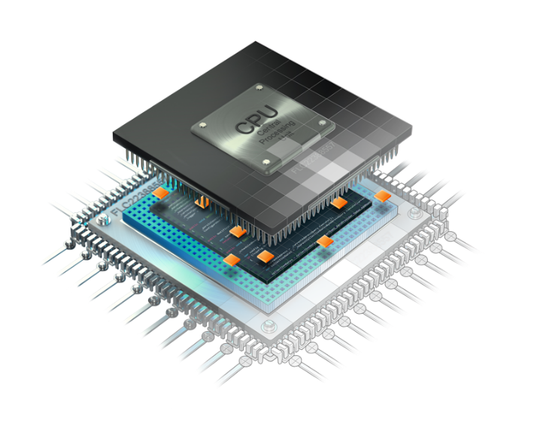
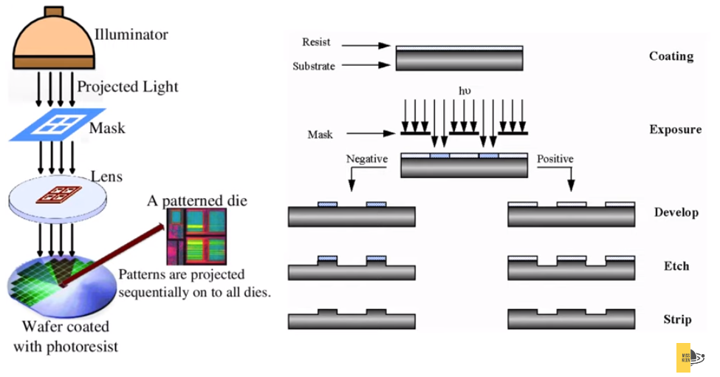
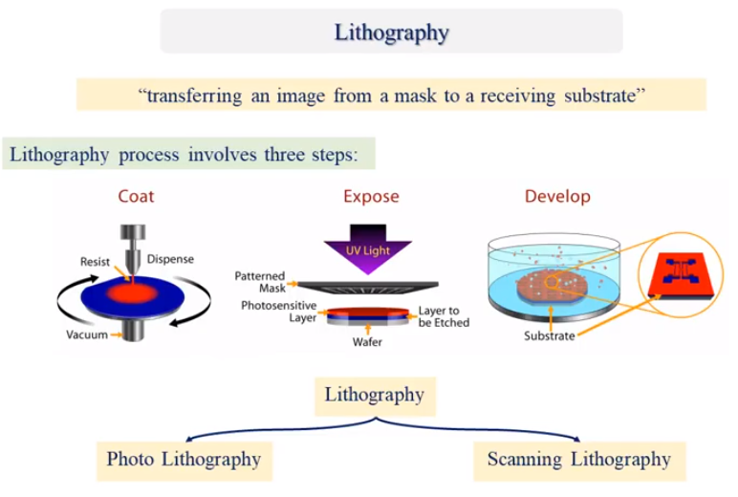
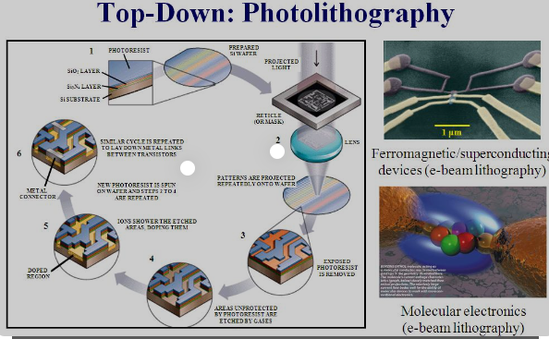
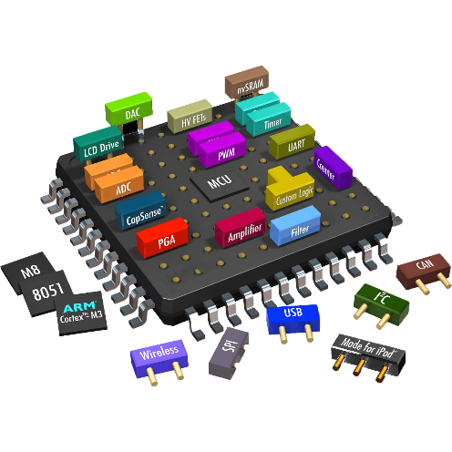
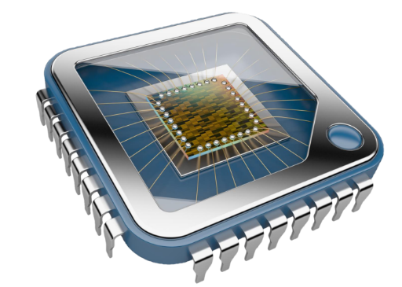
Lithography
lithography where electron beams are light beams with assistance of certain blocking materials called resists are used to very precisely carve starting materials to the desired size and shape this technique grants very specific control over all parameters of the process

Slide 9
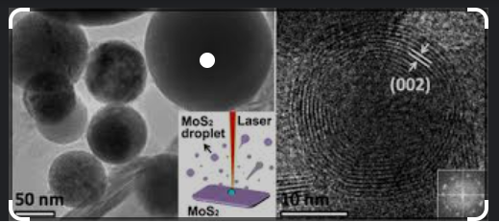
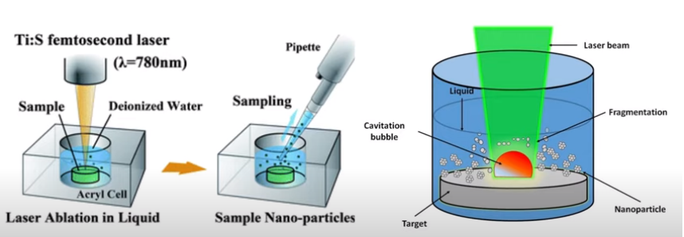
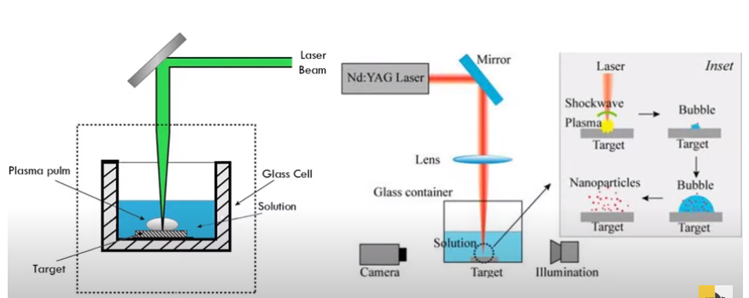
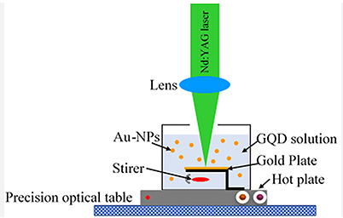
Laser Ablation
laser ablation techniques wherein the staring material is generally submerged in a liquid and is subjected to laser pulses the material vaporizes due to the heat of the laser and the broken down particulate matter immediately cools in the liquid by finally controlling the pulse duration and wavelength of the laser fine control over the product is possible

Slide 10
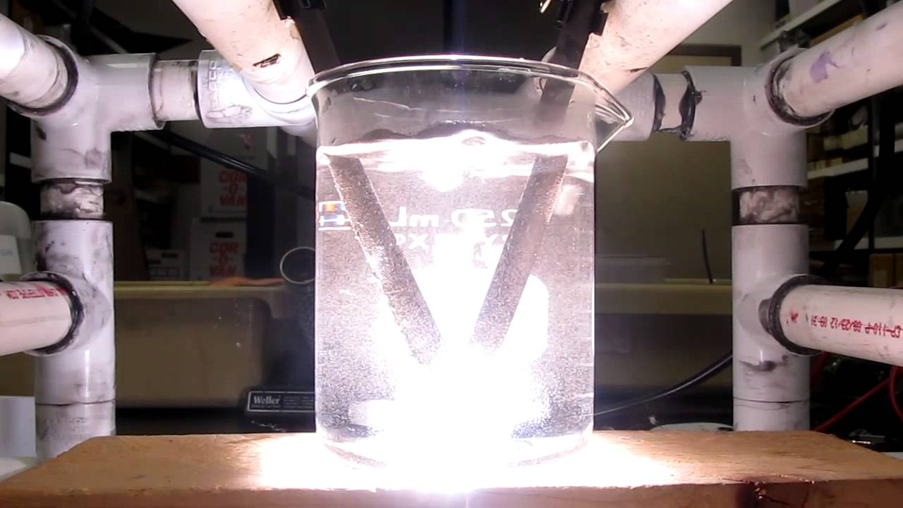
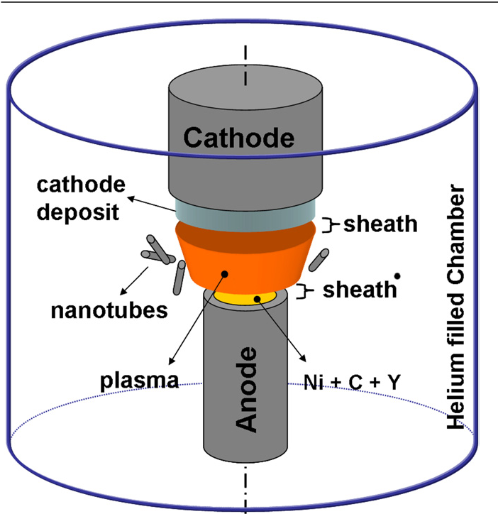
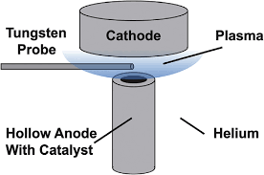
Arc Discharge techniques
in which the star-tin materials take the form of electrodes in an electrolyte a high voltage is applied which causes ions to move through the solution and the gradual breakdown of the electrode material leads to the production of the desired nanomaterials

Slide 11
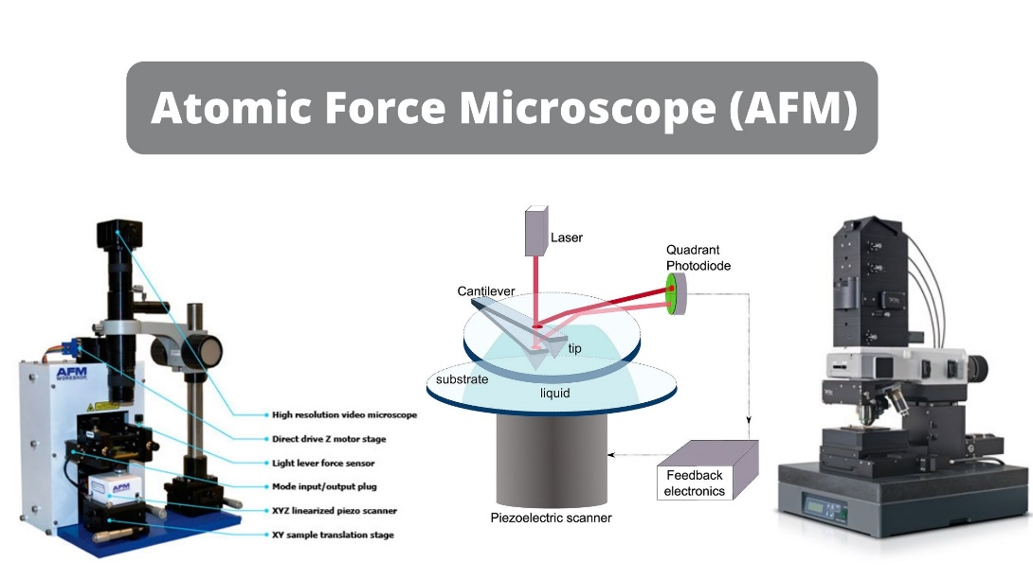
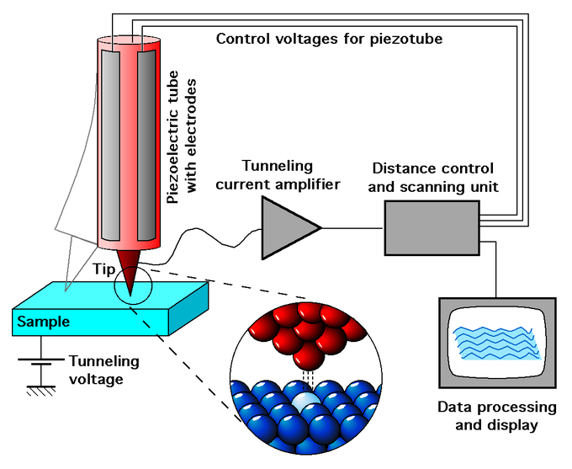

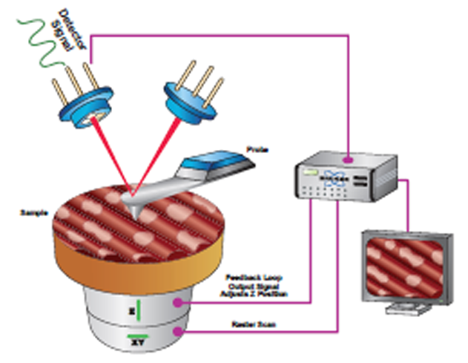
Atomic Force Microscopes (AFM) and Scanninge Probe Microscopes (SPM)
there have also been some reports wherein the modified tips of atomic force microscopes afm or scanning probe microscopes spm which are generally only used to study nanomaterials have actually been used to synthesize or modify nanomaterials top-down methods are very easy adapt to a variety of synthesis conditions production requirements scalability issues and equipment and are thus considered ideal for mass production without too much loss in quality these techniques perform robustly even in non-laboratory conditions and are thus favored for large-scale manufacturing processe

Slide 12
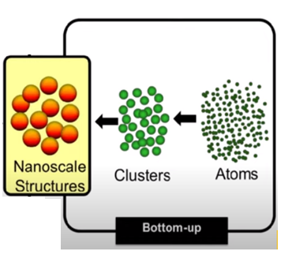
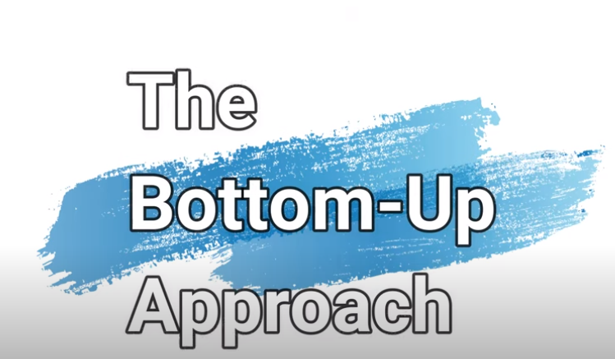

Slide 13
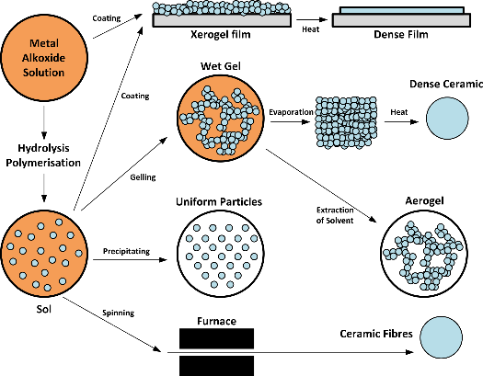
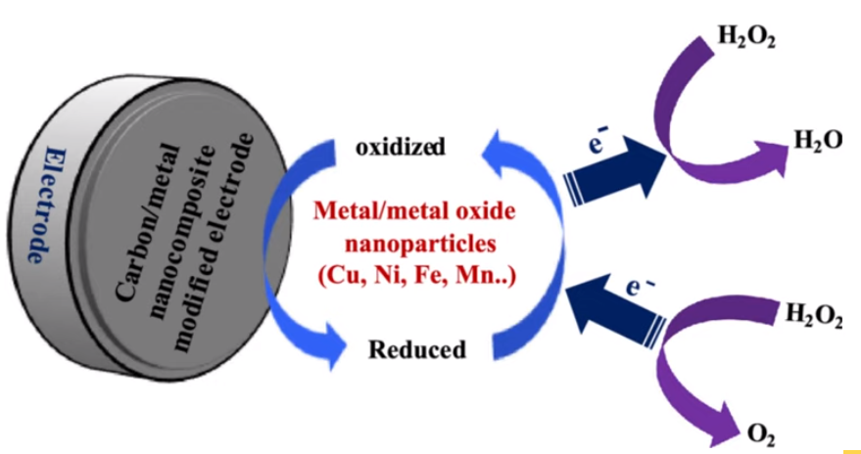
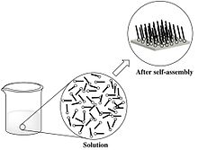
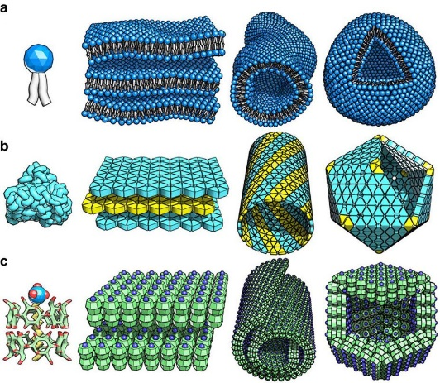
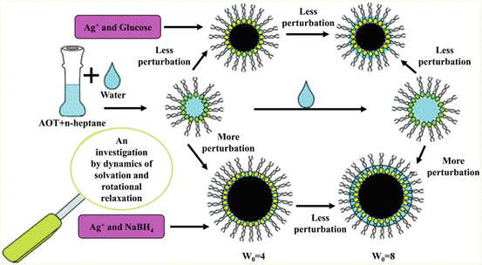
Method Bottom-Up Approach
in the bottom-up approach starting materials are generally chemical reagents that are allowed to react in a variety of experimental conditions until the average size of the units formed by the assembly of atoms molecules or ions is roughly as expected in the nano range some of the common techniques used in bottom-up synthesis of nano-materials are as follows :
1 soul gel processes
2 reduction and oxidation
3 micellization
4 self-assembly
5 directed assembly

Slide 14
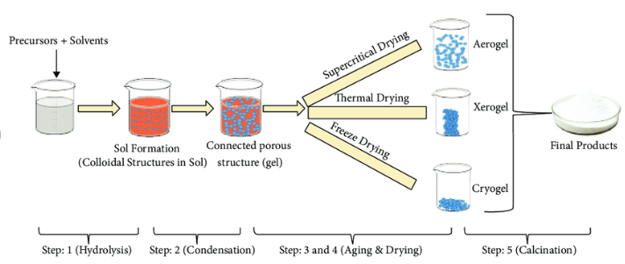

soul gel processes
It is a commonly used, time-tested set of procedures in which a set of reactants are mixed in solution form with appropriate parameters and calibrators such as temperature ratios, pH, molar volume, etc. and heated to allow the liquid to evaporate allowing the reactant particles to aggregate into nanomaterials Desirable under controlled conditions in materials science, the sol-gel process is a method for producing solids from small particles. The method is used to manufacture metal oxides, particularly those of silicon (Si) and titanium (Ti). The process involves converting the monomers into a colloidal solution (colloidal solution) that serves as a precursor to an integrated network (or gel) of the separated particles or network polymers. Typical precursors are metal alkoxides. The Sol-gel process is used to produce ceramic nanoparticles.

Slide 15
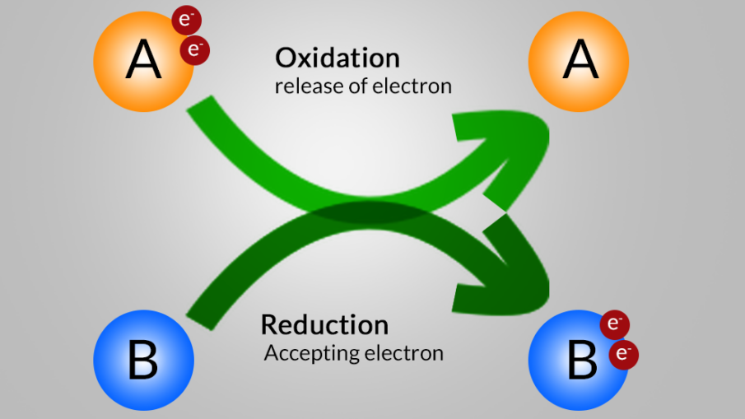
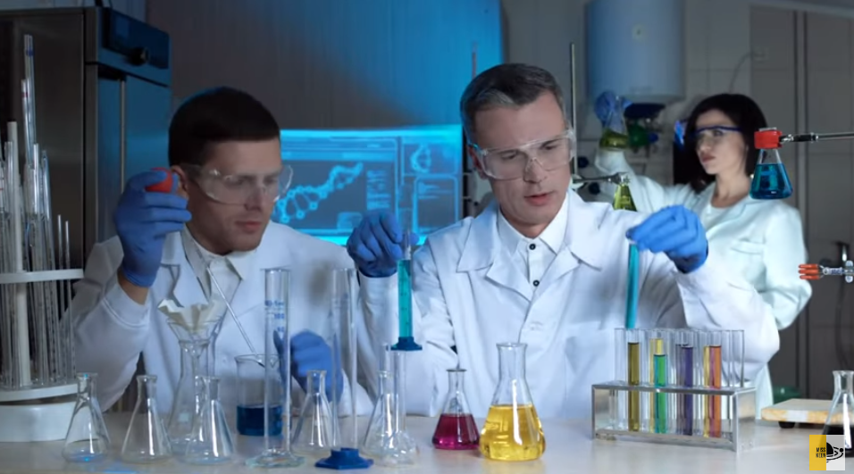
reduction and oxidation
are fundamental concepts and can be readily applied in the bottom up synthesis of nanomaterials as well oxidation generally means addition of an oxygen atom or removal of electrons from a species and reduction can be broadly explained as addition of a hydrogen atom or addition of electrons to a species when either of these processes are applied to ions floating around in a solution controlled synthesis of nano materials becomes possible

Slide 16
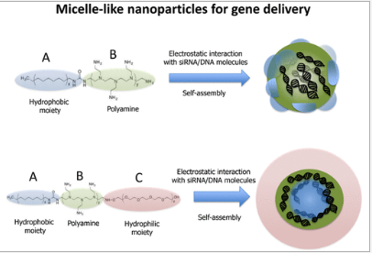
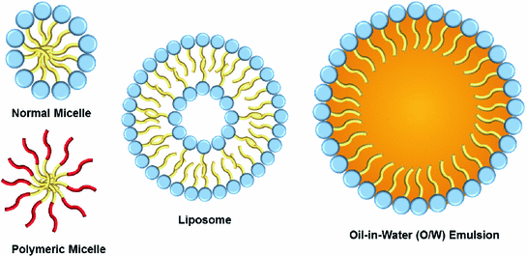
micellization
est une technique innovante qui consiste à utiliser des molécules tensioactives amphiphiles pour isoler des espèces chargées afin de former ensuite des nanostructures assemblées une molécule amphiphile comporte deux parties une partie non polaire non chargée qui a plus d'affinité pour les solvants organiques et une partie polaire chargée qui a plus d'affinité pour solvants polaires lorsque ce concept est utilisé dans le cas d'ions chargés dans des solvants organiques, les molécules amphiphiles entourent les ions avec la partie de charge pointant vers l'intérieur vers l'ion formant un revêtement sphérique isolant autour de lui, créant et isolant simultanément efficacement des nanostructures

Slide 17
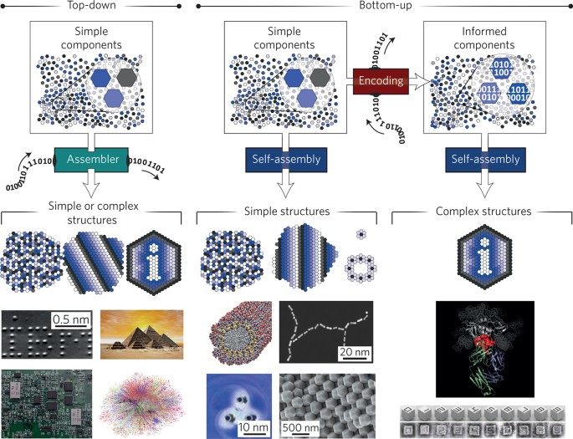
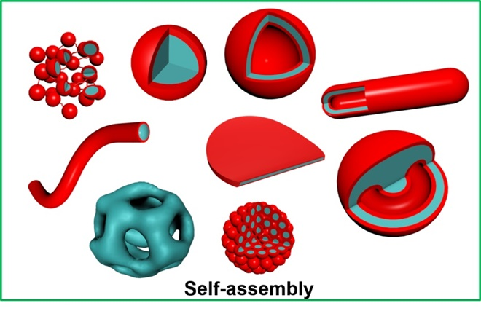
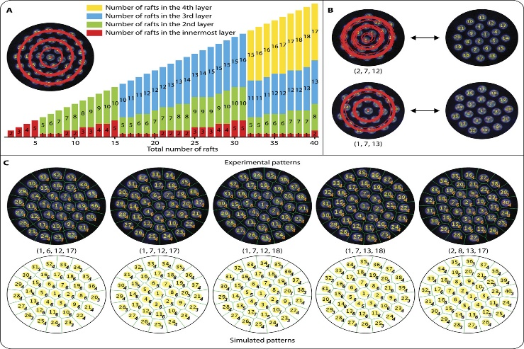

self-assembly
Self-assembly is the process of joining individual units of matter into structures with highly ordered patterns. It imparts unique properties to both organic and inorganic structures, as a result, via non-covalent interactions. Currently self-assembled nanomaterials are finding a variety of applications in nanotechnology, imaging technologies, biosensors, biomedical sciences, etc., due to their simplicity, spontaneity, scalability, versatility, and cheapness. The self-assembly of amphiphiles into nanostructures (micelles, vesicles, hydrogels) occurs due to various physical interactions. Self-assembled nanostructures have shown enormous potential to be used as easy and efficient materials for this purpose. These nanomaterials are highly efficient

Slide 18



directed asemblys
Directed self-assembly (DSA) is a type of directed assembly which utilizes block co-polymer morphology to create lines, space and hole patterns, facilitating for a more accurate control of the feature shapes. Then it uses surface interactions as well as polymer thermodynamics to finalize the formation of the final pattern shapes are methods of mass-producing micro to nano devices and materials. Directed assembly allows the accurate control of assembly of micro and nano particles to form even the most intricate and highly functional devices or materials.To control the surface interactions enabling sub-10 nm resolution, a team consisting of Massachusetts Institute of Technology, University of Chicago, and Argonne National Laboratory developed a way to use vapor-phase deposited polymeric top layer on the block co-polymer film in 2017

