Slide 1

Context-free languages and PDA
University of M’sila
Faculty of Mathematics and informatics
Computer science department
L2
2024/2025
MOHAMED BAHACHE

Slide 2
Introduction
Some languages ​​cannot be described by a regular grammar, and therefore cannot blanguage e recognized by a finite automaton (for example, the
This chapter studies a class of languages ​​that is more general than regular languages: the class of context-free languages, described by context-free grammars and recognized by pushdown automata.

Slide 3
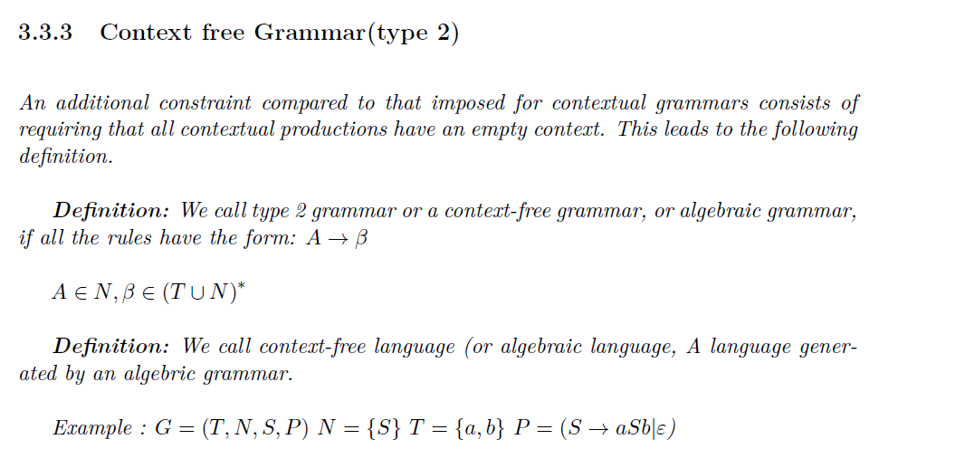
CFG
Recall
Definition
A language is context-free if there exists a context-free grammar that generates that language.

Slide 4
CFL properties
Let L1 and L2 two contexy-free languages then :

Slide 5
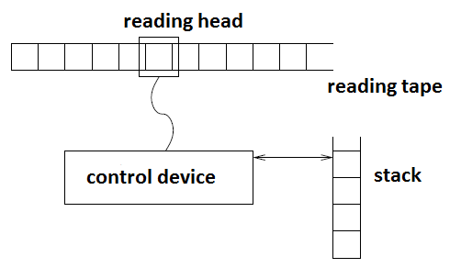
PDA structure
A pushdown automaton has three components:
an input tape,
a control unit, and
a stack with infinite size.
A stack does two operations −
Push − a new symbol is added at the top.
Pop − the top symbol is read and removed.

Slide 6
PDA Formal definition
Formally we define the PDA as a 7-tuple

Slide 7
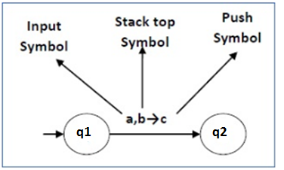
PDA Formal definition
This means at state q₁, if we encounter an input string a and top symbol of the stack is b, then we pop b, push c on top of the stack and move to state q₂.

Slide 8
PDA Formal definition
The PDA is considered as FA+STACK
A transition is as the transition of the FA, with the manupilation of the stack.
(State,Read symbol,top of the stack) → (new state,Action on the stack)
Action on thee stack:
Pop the symbol on the top of the stack
POP, then push string of symnols
Push string of symbols
Do nothing.

Slide 9
PDA acceptability
There are three different ways to define PDA acceptability.
Final State Acceptability
Empty Stack Acceptability
Both two ways.

Slide 10
PDA configuration
word to read
The PDA configuration is 4-tuple :
word already read
Current state
Stack content

Slide 11
PDA configuration

Slide 12
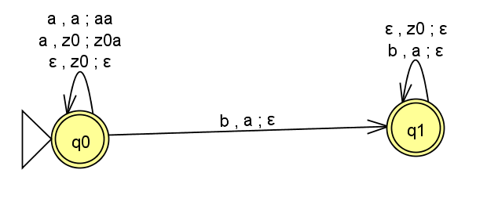
PDA configuration
Example PDA of the language

Slide 13
PDA configuration

