Slide 1

Finite automata
NFA to RE
University of M’sila
Faculty of Mathematics and informatics
Computer science department
L2
2024/2025
MOHAMED BAHACHE

Slide 2
NFA to RE
1-By state reduction procedure
Add an initial state with Є-transition to the old initial state .
Add final state with Є-transition from the old final state.
At each iteration we reduce the automaton by one state according to the following principle:

Slide 3
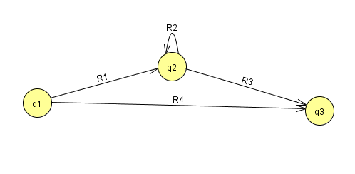
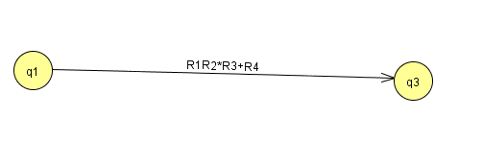
NFA to RE

Slide 4
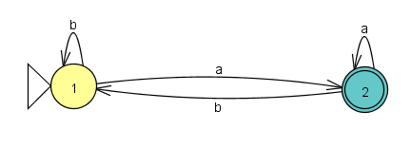
NFA to RE
At the end we obtain an automaton with two states ,initial and final (accept) state, and a transition labeled by the correspondent regular expression.
Example:

Slide 5
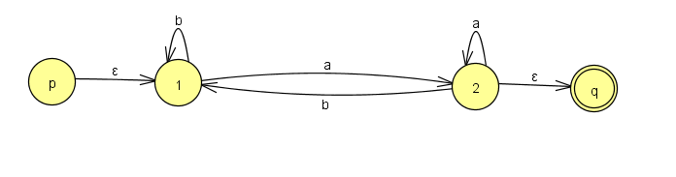
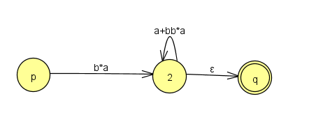
NFA to RE
1)
2)
3)

Slide 6
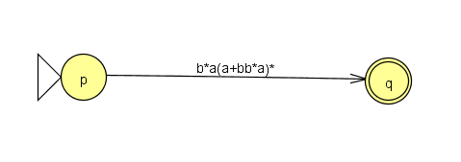
NFA to RE
4)
5)

Slide 7
NFA to RE
2-By Equation system method
Language Lq:
For each state q of the automaton A
We denote by Lq the set of words w such that the calculus of A on w from q reachs to final state.
Means
Lq0=L(A)

Slide 8
NFA to RE
We suppose
And
IF
If

Slide 9
NFA to RE
We denote by Xp the regular expression denotes Lp:
Example:

Slide 10
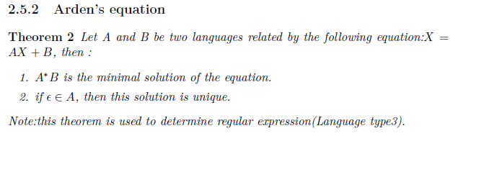
NFA to RE
Recall:

Slide 11
NFA to RE

