Slide 1

Finite automata
Determinization&minimization
University of M’sila
Faculty of Mathematics and informatics
Computer science department
L2
2025/2026
MOHAMED BAHACHE

Slide 2
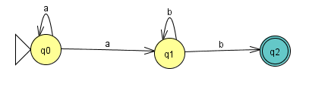
Nondeterministic Finite Automata
A finite automata is said to be nondeterministic, if:
  it has more than one initial state.
  It existes more than one transition from a given state by the same alphabet.
  (in graph theory, this nondeterministic, means that exits more than one edge from one vertex labeled by the same value).
  The state q0 has two transitions by the alphabet a.
  The state q1 has two transitions by the alphabet b.

Slide 3
Nondeterministic Finite Automata
Remark: use non deterministic finite automata (NFA), is considered as non efficient tool, for the word accepting , because it has and contains multi-choices .
For accepting a word of a length n necessite in the worst case 2^{n} transitions

Slide 4
Nondeterministic Finite Automata
To deterministic Finite Automata (NFA to DFA)
Theorem : Any recognized language by a finite automaton is a regular language
Theorem : Any regular language is accepted by a finite automaton.
Theorem : The accepted languages by an NFA are identical the accepred languages by DFA, in other words (NFA and DFA are equivalent).

Slide 5
Nondeterministic Finite Automata
To deterministic Finite Automata (NFA to DFA)
Preliminaries
  State successors
  Let be a finite automaton.
  And let
  We denote by
  All the states can be reached from q, using (a) transition.

Slide 6
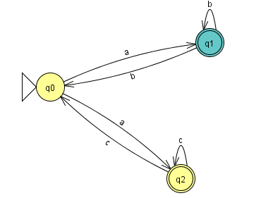
Nondeterministic Finite Automata
To deterministic Finite Automata (NFA to DFA)
  Example(state successors)
  S(q0,a)={q1,q2}
  S(q0,b)=φ
  S(q1,b)={q0,q1}

Slide 7
Nondeterministic Finite Automata
To deterministic Finite Automata (NFA to DFA)
Let , the of the state q
Is all the states can be reached from q using (0,1 or more)
Denoted by

Slide 8
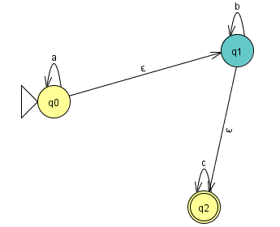
Nondeterministic Finite Automata
To deterministic Finite Automata (NFA to DFA)
Example:
E(q0)={q0,q1,q2}
E(q1)={q1,q2}
E(q2)={q2}

Slide 9
Nondeterministic Finite Automata
To deterministic Finite Automata (NFA to DFA)
  Determinisation (automaton without )
Algorithm
Input: NFA without
Output: correspondent DFA
Draw an empty transition table, with all alphabets
Take the start state of the NFA, and consider it the start state of DFA(s0)
Determine all states that can be reached by each alphabet in one set.
Check if There is a new generated state, if yes GO TO (3), Otherwise go to (5)
All states that contain at least one final state of the NFA, is a final state of the DFA.
Rename the new states as simple states.

Slide 10
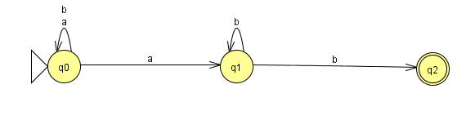
Nondeterministic Finite Automata
To deterministic Finite Automata (NFA to DFA)
  Determinisation (automaton without )
  Example
  This is an NFA
  S(q0,a)={q0,q1}
  S( q1,b)={q1,q2}

Slide 11
Nondeterministic Finite Automata
To deterministic Finite Automata (NFA to DFA)
  Determinisation (automaton without )
  Example
 | a | b
q0

Slide 12
Nondeterministic Finite Automata
To deterministic Finite Automata (NFA to DFA)
  Determinisation (automaton without )
  Example
 | a | b
q0 | {q0,q1} | q0

Slide 13
Nondeterministic Finite Automata
To deterministic Finite Automata (NFA to DFA)
  Determinisation (automaton without )
  Example
 | a | b
q0 | {q0,q1} | q0
{q0,q1} | {q0,q1} | {q0,q1,q2}

Slide 14
Nondeterministic Finite Automata
To deterministic Finite Automata (NFA to DFA)
  Determinisation (automaton without )
  Example
 | a | b
q0 | {q0,q1} | q0
{q0,q1} | {q0,q1} | {q0,q1,q2}
{q0,q1,q2} | {q0,q1} | {q0,q1,q2}

Slide 15
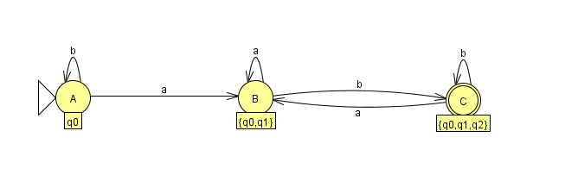
Nondeterministic Finite Automata
To deterministic Finite Automata (NFA to DFA)
  Determinisation (automaton without )
  Example
 | a | b
q0 | {q0,q1} | q0
{q0,q1} | {q0,q1} | {q0,q1,q2}
{q0,q1,q2} | {q0,q1} | {q0,q1,q2}

Slide 16
Nondeterministic Finite Automata
To deterministic Finite Automata (NFA to DFA)
  Determinisation (automaton with )
  Remark:
  The idea is the same but rather we take a state we take
  The of that state.

Slide 17
Nondeterministic Finite Automata
To deterministic Finite Automata (NFA to DFA)
  Determinisation (automaton with )
Algorithm
Input: NFA without
Output: correspondent DFA
Draw an empty transition table, with all alphabets
Take the of the start state of the NFA, and consider it the start state of DFA
Determine all states that can be reached by each alphabet in one set.then replaced it by its
Chek if There is a new generated state, if yes GO TO (3), Otherwise go to (5)
All states that contain at least one final state of the NFA, is a final state of the DFA.
Rename the new states as simple states.

Slide 18
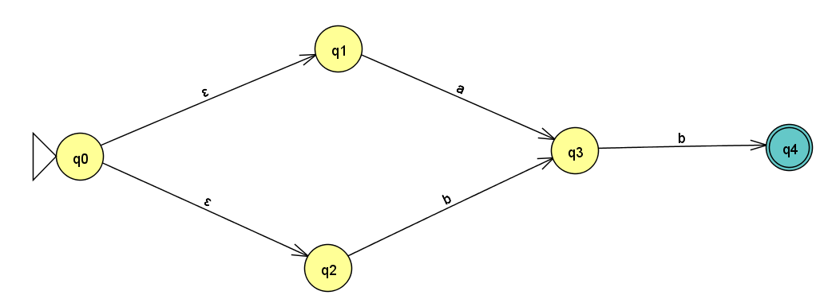
Nondeterministic Finite Automata
To deterministic Finite Automata (NFA to DFA)
  Determinisation (automaton with )
ε-closure {q0} = {q0, q1, q2}
ε-closure {q1} = {q1}
ε-closure {q2} = {q2}
ε-closure {q3} = {q3}
ε-closure {q4} = {q4}

Slide 19
Nondeterministic Finite Automata
To deterministic Finite Automata (NFA to DFA)
  Determinisation (automaton with )
ε-closure {q0} = {q0, q1, q2}
ε-closure {q1} = {q1}
ε-closure {q2} = {q2}
ε-closure {q3} = {q3}
ε-closure {q4} = {q4}
 | a | b
{q0, q1, q2} | {q3} | q3

Slide 20
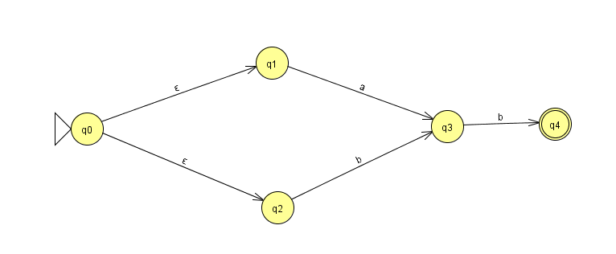
Nondeterministic Finite Automata
To deterministic Finite Automata (NFA to DFA)
  Determinisation (automaton with )
ε-closure {q0} = {q0, q1, q2}
ε-closure {q1} = {q1}
ε-closure {q2} = {q2}
ε-closure {q3} = {q3}
ε-closure {q4} = {q4}
 | a | b
{q0, q1, q2} | {q3} | {q3}
{q3} | / | {q4}

Slide 21
Nondeterministic Finite Automata
To deterministic Finite Automata (NFA to DFA)
  Determinisation (automaton with )
ε-closure {q0} = {q0, q1, q2}
ε-closure {q1} = {q1}
ε-closure {q2} = {q2}
ε-closure {q3} = {q3}
ε-closure {q4} = {q4}
 | a | b
{q0, q1, q2} | {q3} | {q3}
{q3} | / | {q4}
{q4} | / | /

Slide 22
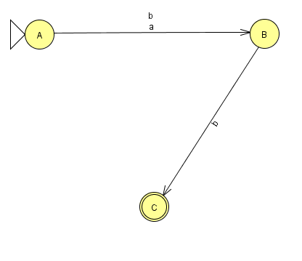
Nondeterministic Finite Automata
To deterministic Finite Automata (NFA to DFA)
  Determinisation (automaton with )
Equivalent DFA
 | a | b
{q0, q1, q2} | {q3} | {q3}
{q3} | / | {q4}
{q4} | / | /

Slide 23
Nondeterministic Finite Automata
To deterministic Finite Automata (NFA to DFA)
  Remark:
  It is not easy (sometimes) to convert regular expression to DFA,but the following path is easy:

Slide 24
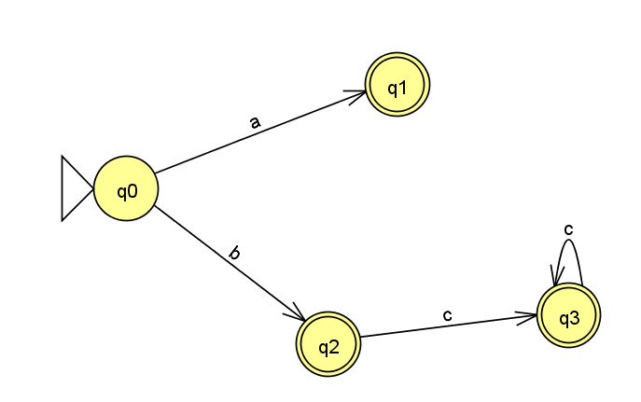
Minimized Deterministic Finite Automata
(Minimized DFA)
Theorem (Myhill-Nirode)
Let L be a rational language, among all the NFAs, that recognize L, there exist one and only one automaton has a minimal number of states.
Before to minimize a DFA ,the DFA should be completed.
Example : the following DFA is not
complete , there exist missing
Transitions (there are some
alphabets not used in transitions by each state).
The state q0 no transition with the alphabet c
The state q1 no transition by a,b,and c
The state q2 no transition with a and b
The state q3 no transition with a and b

Slide 25
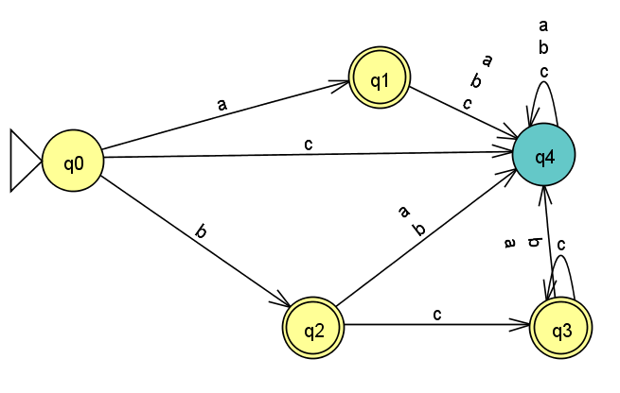
Minimized Deterministic Finite Automata
(Minimized DFA)
To complete a DFA , do the follow:
we add an additional state R called Trash state
Then we add all the missing transitions, in other words we add
For each state q has not x- transition
Example : the previous not complete DFA, become :

Slide 26
Minimized Deterministic Finite Automata
(Minimized DFA)
Now the minimization process is described by the following Algorithm:
1-If the given DFA (A) is not complete , then complete it.
2-Construct the initial partition(seperation), that contains two sets:
the set (I): contains the terminal states (ACCEPTED STATES).
the set (II): contains non terminal states(OTHER STATES).
3-For each state of A.
  Check all the transitions
  If the states of the same class have different destination , then
Separate them, and build a new class.
4-Repeat 3.
5-the new generated classes of are the states of the minimized DFA.
6-All classes that contain at least one final state of the DFA, is a final
state of the MINIMIZED DFA.

Slide 27
Minimized Deterministic Finite Automata
(Minimized DFA)
 | a | b | c
q0 | q1 | q2 | q4
q1 | q4 | q4 | q4
q2 | q4 | q4 | q3
q3 | q4 | q4 | q3
q4 | q4 | q4 | q4
Example :
Initial separation
I={q1,q2,q3}, II={q0,q4} check q1q2
The same with b . But with c:
Then q1 and q2 should be separated q1q2 (X)
Now check q1q3
The same should be separeted q1q3 (X)
We observe that q2q3 are equivalent q2q3 (ok)
The new separation is
I={q1},II={q0,q4},III={q2,q3}

Slide 28
Minimized Deterministic Finite Automata
(Minimized DFA)
 | a | b | c
q0 | q1 | q2 | q4
q1 | q4 | q4 | q4
q2 | q4 | q4 | q3
q3 | q4 | q4 | q3
q4 | q4 | q4 | q4
Example :
I={q1},II={q0,q4},III={q2,q3}
Now check q0q4
Then q0q4(X) should be seperated
The new partition (seperation) is
I={q1},II={q0},IV={q4},III={q2,q3}

Slide 29
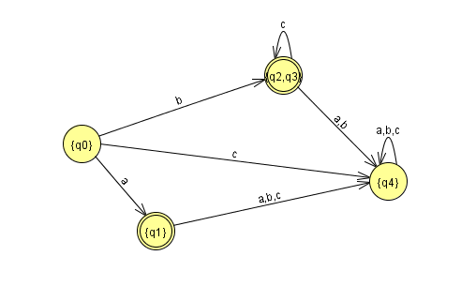
Minimized Deterministic Finite Automata
(Minimized DFA)

Slide 30
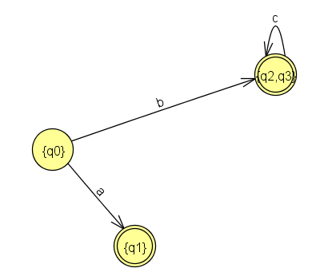
Minimized Deterministic Finite Automata
(Minimized DFA)

Slide 31
Regular grammar to NFA
Theorem
We can associate for each regular grammar G , a DFA that recognize L(G).
The same thing , for each DFA, we associate a regular grammar that generates the language recognized by this DFA.
Proposition
Each regular grammar is equivalent to a regular grammar where their rewriting rules are of the form :

Slide 32
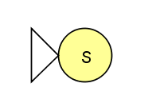
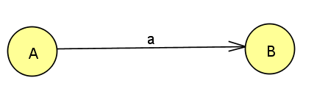

Regular grammar to NFA
Algorithm
Input : regular grammar
Output: correspondent NFA
1-Modify G if necessary such as all the rewriting rules are of the form:
2-Non terminal symbols become the NFA states
3-the rewriting rules represent the NFA transitions.
Means
The axiom S represents the unique NFA initial state.

Slide 33
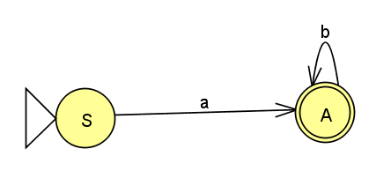
Regular grammar to NFA
Example :

