Slide 1

Finite automata
Transformation
University of M’sila
Faculty of Mathematics and informatics
Computer science department
L2
2025/2026
MOHAMED BAHACHE

Slide 2
Є-transition elemination
Algorithm
Determine all the states can be reached by Є-transitions
Use this information to build an equivalent automaton without Є-transitions
1-Є-closure(p)=
P
If

Slide 3
Є-transition elemination
2-
The equivalent automaton B without Є-transitions defined as

Slide 4
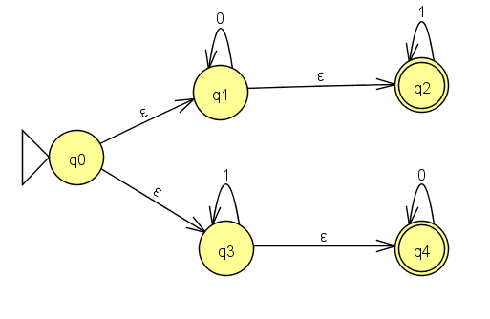
Є-transition elemination
Proposition
B is an automaton witout Є-transitions

Slide 5
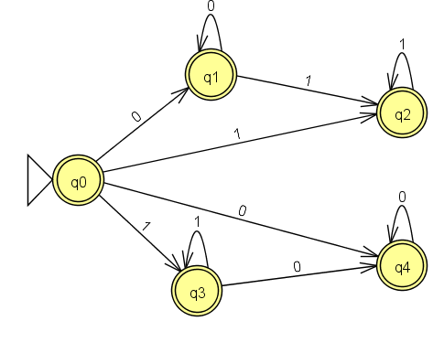
Є-transition elemination

