Slide 1

Finite automata
Operations
University of M’sila
Faculty of Mathematics and informatics
Computer science department
L2
2025/2026
MOHAMED BAHACHE

Slide 2
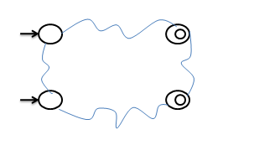
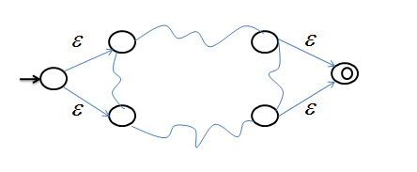
Equivalent Finite Automata
Proposition : for each fininte automaton A it exists a fnite automaton B with:
  an uniq starting state wthout input transitions.
  an uniq fininal state(acceptence state) without output transitions
  Equivalent to A.
Automaton A
Automaton B

Slide 3
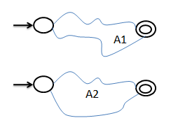
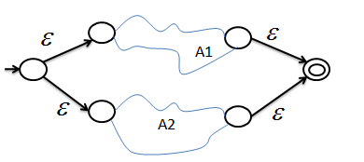
Automata union
Let A1,A2 be two finite automaton
A1
A2
The automaton that recognizes

Slide 4
Automata union
Formally if

Slide 5
Automata concatination
Let A1,A2 be two finite automaton
A1
A2

Slide 6
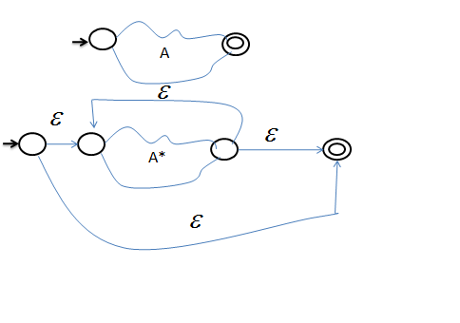
Iterated concatenation
Let A1,A2 be two finite automatons

