Slide 1

Finite automata
University of M’sila
Faculty of Mathematics and informatics
Computer science department
L2
2024/2025
MOHAMED BAHACHE

Slide 2
Introduction
Automata theory bases on mathematical concepts,
Automata allow to create models.
  One model, called the (Finite automaton)->Regular grammar:
is used in text processing, compilers, and hardware design.
  Another model, called the (Push down automaton)->Context-free grammar , is used in programming languages and artificial intelligence.

Slide 3
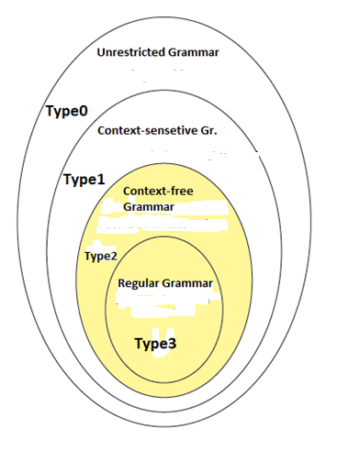
Introduction
As shown in the previous chapters we have used the formal grammar
To generate languages using productions or rewriting rules.

Slide 4
Automata
Language recognition system (Accepting system)
Automata
Turing machine
Linear Bounded Automaton
Push Down Automaton
Finite State Automaton

Slide 5
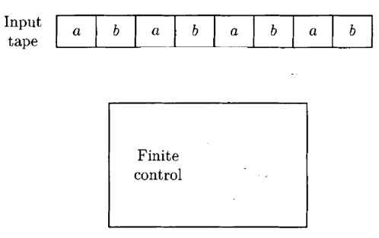
Finite automata
FINITE STATE MACHINE (FINITE AUTOMATA)
The simplest scheme of automata
Memory less machine
Characterized by a finite input tape.
Left to right reading(scanning).
Reading head
Start state

Slide 6
Introduction
FINITE STATE AUTOMATA
The simplest scheme of automata
Memory less machine
characterized by a finite input tape.
Left to right reading(scanning).
Reading head
State 1

Slide 7
Introduction
FINITE STATE AUTOMATA
The simplest scheme of automata
Memory less machine
characterized by a finite input tape.
Left to right reading(scanning).
Reading head
State 2

Slide 8
Introduction
FINITE STATE AUTOMATA
The simplest scheme of automata
Memory less machine
characterized by a finite input tape.
Left to right reading(scanning).
Reading head
State 3

Slide 9
Introduction
FINITE STATE AUTOMATA
The simplest scheme of automata
Memory less machine
characterized by a finite input tape.
Left to right reading(scanning).
Reading head
State 4

Slide 10
Introduction
FINITE STATE AUTOMATA
The simplest scheme of automata
Memory less machine
characterized by a finite input tape.
Left to right reading(scanning).
Reading head
State 5

Slide 11
Introduction
FINITE STATE AUTOMATA
The simplest scheme of automata
Memory less machine
characterized by a finite input tape.
Left to right reading(scanning).
Reading head
State 6

Slide 12
Introduction
FINITE STATE AUTOMATA
The simplest scheme of automata
Memory less machine
characterized by a finite input tape.
Left to right reading(scanning).
Reading head
Final Stat

Slide 13
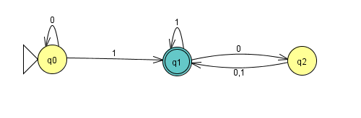
Finite automaton
FINITE AUTOMATON-example
State diagram
State diagram
Three states, labeled q0, q1,and q2
transition.
Outputs
Initial state: denoted by the arrowpointing at it
Final state(accept state): deboted by doube circles.
ACCEPT
REJECT

Slide 14
Finite automaton
FINITE AUTOMATON-example
State diagram
Directed Graph (simple/multi graph)
The vertices are states of the finite automaton
Each edge is a transition from one state to another by reading an alphabet.

Slide 15
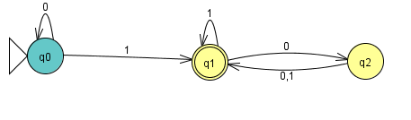
Finite automaton
0 | 1 | 1 | 0 | 1
1.Start in state q0.
2. Read 0, follow transition fromq0 to q0.
Finite control

Slide 16
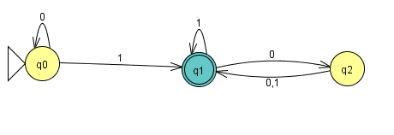
Finite automaton
0 | 1 | 1 | 0 | 1
3. Read 1, follow transition from q0 to q1.
Finite control

Slide 17
Finite automaton
0 | 1 | 1 | 0 | 1
4. Read 1, follow transition fromq1 to q1.
Finite control

Slide 18
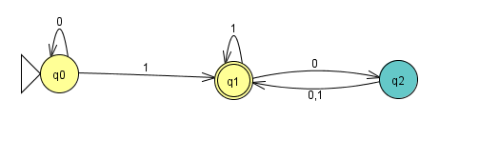
Finite automaton
0 | 1 | 1 | 0 | 1
5. Read 0, follow transition fromq1 to q2.
Finite control

Slide 19
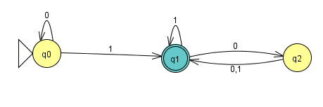
Finite automaton
0 | 1 | 1 | 0 | 1
5. Read 1, follow transition fromq2 to q1.
6. Accept because M is in an accept state q2 at the end of the input string (01101)
Finite control

Slide 20
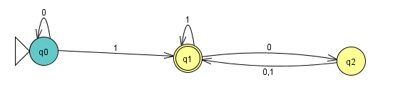
Finite automaton
0 | 1 | 0
1. Read 0, follow transition from q0 to q1.
Finite control

Slide 21
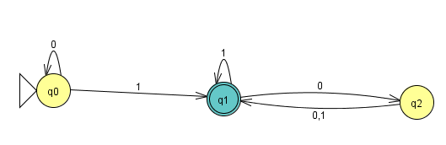
Finite automaton
0 | 1 | 0
2. Read 1, follow transition and stay in q1.
Finite control

Slide 22
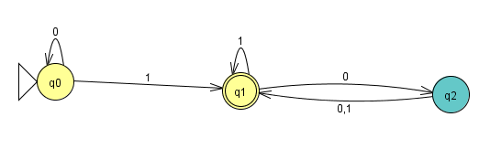
Finite automaton
0 | 1 | 0
3. Read 0, follow transition from q1 to q2.
4. The whole string is consumed and does not reach automaton Accept state.(not accepted string)
Finite control

Slide 23
Finite automaton
FORMAL DEFINITION OF A FINITE AUTOMATON
After this short introduction in which we have introduced the finite automaton, by transition diagram, now we present finite automaton formally, (by denoting its components formally).
Definit ion:
A finite automaton is a 5-tuple(quintuple), whre: Is a finite set of states.
  is a finite set of alphabet.
  Is the transition function
  Is the start state.
  Is the set of final states(accept states)

Slide 24
Finite automaton
FORMAL DEFINITION OF A FINITE AUTOMATON
The formal definition of the above finite automaton is:

Slide 25
Finite automaton
FORMAL DEFINITION OF A FINITE AUTOMATON
Transition
Table
The initial state :final (accept)state.
 | 0 | 1
q0 | q0 | q1
q1 | q2 | q1
q2 | q1 | q1

Slide 26
Configuration of finite automaton
A configuration of a finite automaton is an element belongs to
Example
in this situation the actual configuration is : (q0,01101)……..(Initial configuration)
0 | 1 | 1 | 0 | 1
Finite control

Slide 27
Configuration of finite automaton
0 | 1 | 1 | 0 | 1
in this situation the actual configuration is : (q1,1101) ……..(second configuration)
Finite control

Slide 28
Configuration of finite automaton
0 | 1 | 1 | 0 | 1
in this situation the actual configuration is : (q1,101)……(Third configuration)
Finite control

Slide 29
Configuration of finite automaton
0 | 1 | 1 | 0 | 1
in this situation the actual configuration is : (q2,01)….( Fourth configuration)
Finite control

Slide 30

Configuration of finite automaton
0 | 1 | 1 | 0 | 1
in this situation the actual configuration is : (q1,1) ……..(Final configuration)
Finite control
We denote the configuration succession of a finite automaton M by:
We denote the configuration succession of a finite automaton M by:

Slide 31

Configuration of finite automaton
Thus the finite automaton can pass from the configuration to the configuration
and we write
Iff:
And we Say that the configuration yields the configuration
In one step For the above example we write:
We denote the configuration succession of a finite automaton M by:

Slide 32

Recognized Language
We say that a string is accepted by a finit automaton
Iff:
In other words we can reach the state q by certain number
possible zero of transitions (steps).
Or ,also if it exists a path from the initiale state (s) to the final
state(q), using all the alphabet of the string (w).
The accepted language by denoted by is all the strings
(words accepted by )
We denote the configuration succession of a finite automaton M by:

Slide 33
Recognized Language
FORMAL DEFINITION OF A FINITE AUTOMATON
If A is the set of words accepted by the finite state machine (Finite automaton), , this language is formaly denoted by :
And we say that
recognizes

Slide 34
Recognized Language
FORMAL DEFINITION OF A FINITE AUTOMATON
In our above example
We can write where :

Slide 35
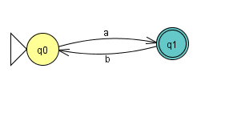
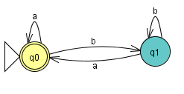
Recognized Language
Definition:
A language is called a regular language if some finite automaton
recognizes it.
Finite Automaton | Regular expression

Slide 36
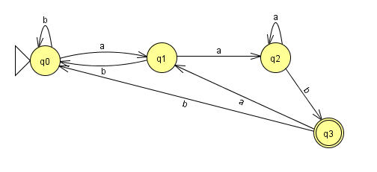
Recognized Language
Definition:
Finite Automaton | Regular language
 | Words end in aab

Slide 37
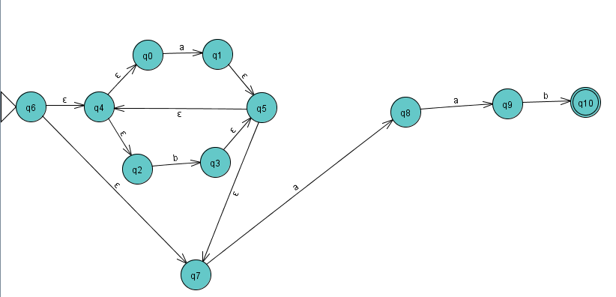
Recognized Language
Finite automaton with
Language of words ending in aab

Slide 38


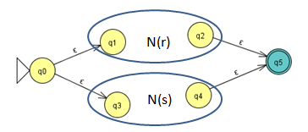
RE to Finite automaton
Regular expression to finite automaton (Thompson’s Algorithm)
Regular expression | Finite automaton

Slide 39
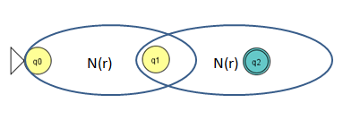
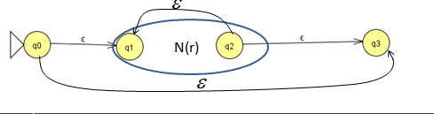
RE to Finite automaton
Regular expression to finite automaton
Regular expression | Finite automaton

Slide 40
RE to Finite automaton
RE->NFA (Example : Language of words ending in aab)

