Slide 1
Web application Development
Chapter 4:
Web Services: Basic Concepts
2025 / 2026

Slide 2
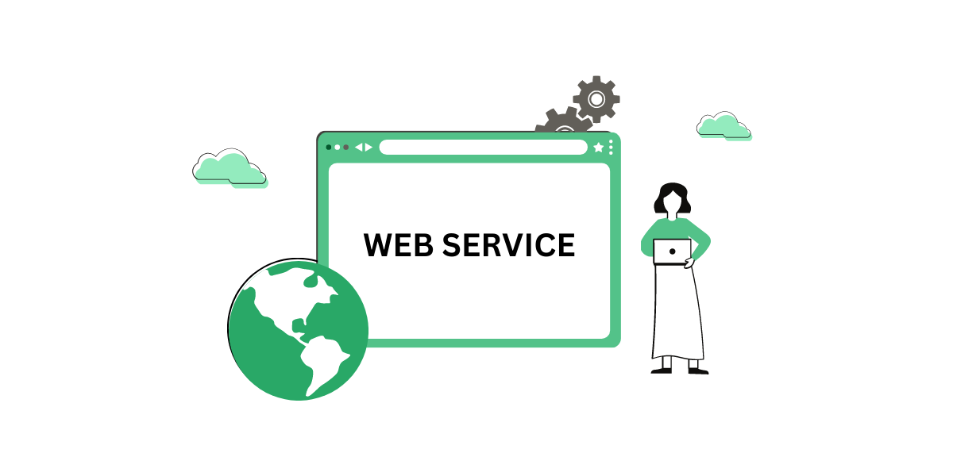

Slide 3

Web :
is a global system of interlinked documents, web pages, and resources accessed through the Internet using a web browser.

Slide 4

Service :
A service is a functionality or task provided by a system, application, or organization to satisfy a user's or another system’s needs.

Slide 5
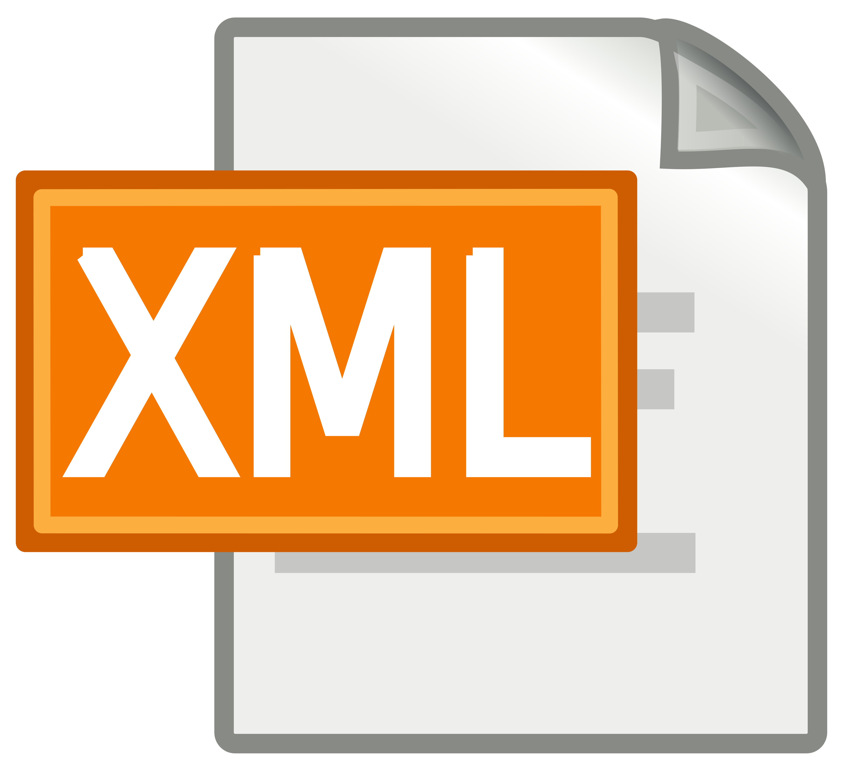



Web Service :
A Web Service is a software system that allows different applications to communicate and exchange data over a network using standard web protocols such as HTTP, XML, SOAP, or JSON.

Slide 6
Web Service :
It enables interaction between systems developed with different programming languages and running on different platforms.

Slide 7
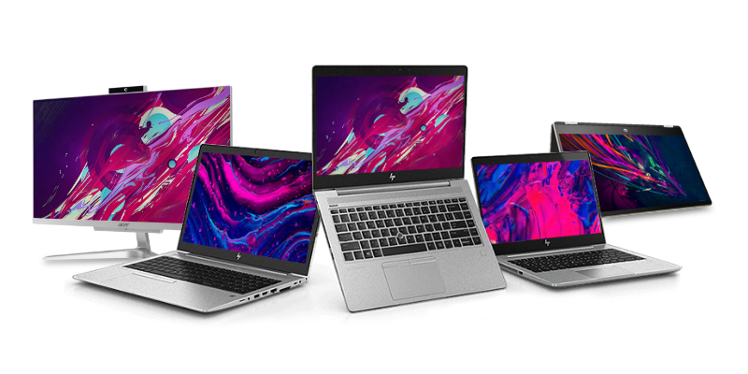
Web Service:
Example
An online store sends a request to a Laptop Price Web Service and receives the current price of a laptop.

Slide 8
Web Service :
Main Purpose
Exchange data between systems
Allow Compatibility
Enable remote access to services

Slide 9
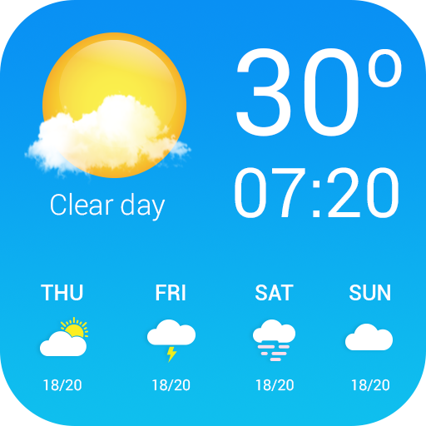
Web Service :
Example 2
A weather application requests temperature data from an online weather server.

Slide 10
Web Service :
Importance of Web Services
Connect different systems
Reuse existing functionalities
Reduce development time
Improve automation
Support distributed applications

Slide 11
Web Service :
Real Examples:
Online payment systems
Google Maps API
Weather APIs
Chatbot

Slide 12
Service-Oriented Architecture (SOA)

Slide 13
SOA : Service-Oriented Architecture
Main Idea:
Each service performs a specific business function.

Slide 14
SOA : Service-Oriented Architecture
SOA is a software design approach where applications are built using independent services communicating through a network.

Slide 15
Components of SOA
1
Service Provider
Creates and publishes the service
2
Service Consumer
Uses the service
3
Service Registry
Stores service descriptions for discovery

Slide 16
Web Service Architecture
Standard Architecture :
Provider hosts the service.
Requester (consumer) calls the service.
Registry stores service metadata.

Slide 17
Web Service Architecture
Operations:
Publish The service provider publishes the web service description in a service registry
Find The service requester (client) searches the registry to find a suitable web service.
Bind After finding the service, the client binds to it and starts communication.

Slide 18
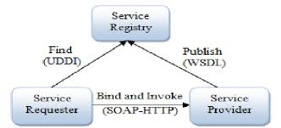
Components of SOA
Service Registry
Find
Publish
Service Consumer
Bind
Service Provider

Slide 19
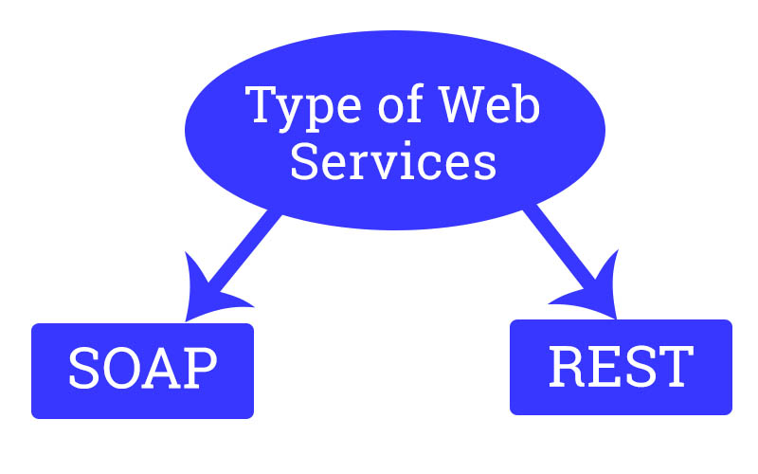
Type of web services

Slide 20
Type of web services
SOAP
REST
WSDL
UDDI

Slide 21
SOAP : Simple Object Access Protocol

Slide 22
SOAP: Simple Object Access Protocol
SOAP is a protocol used to exchange structured information in XML format.

Slide 23
SOAP Features:
XML based
Platform independent
Secure
Standardized

Slide 24
SOAP Message Structure:
Envelope
Header
Body

Slide 25
Example:
<soap:Envelope>
<soap:Body>
<getPrice>
<item>Laptop</item>
</getPrice>
</soap:Body>
</soap:Envelope>
XML

Slide 26
WSDL : Web Services Description Language

Slide 27
WSDL: Web Services Description Language
WSDL is an XML document describing:
          Service name
          Methods Parameters
          Return values
          Service location

Slide 28
WSDL: Web Services Description Language
Purpose
Allows clients to understand how to use the service.

Slide 29
Example
<definitions name="LaptopService" targetNamespace="http://example.com/laptop"
xmlns="http://schemas.xmlsoap.org/wsdl/">
<message name="GetPriceRequest">
<part name="LaptopName" type="xsd:string"/>
</message>
<message name="GetPriceResponse">
<part name="Price" type="xsd:float"/>
</message>
<portType name="LaptopPortType">
<operation name="GetPrice">
<input message="tns:GetPriceRequest"/>
<output message="tns:GetPriceResponse"/>
</operation>
</portType>
</definitions>
XML

Slide 30
UDDI : Universal Description Discovery and Integration

Slide 31

UDDI : Universal Description Discovery and Integration
UDDI is a directory where companies publish and discover web services.

Slide 32
UDDI : Universal Description Discovery and Integration
Functions:
            Register services
            Search services
            Share technical information

Slide 33
UDDI : Universal Description Discovery and Integration
<businessEntity>
<name>Tech Store</name>
<businessService>
<name>Laptop Price Service</name>
<bindingTemplate>
<accessPoint>
http://www.techstore.com/laptopservice
</accessPoint>
</bindingTemplate>
</businessService>
</businessEntity>
XML
Notes:
UDDI is used to publish and discover the service.

Slide 34
REST : Representational State Transfer

Slide 35
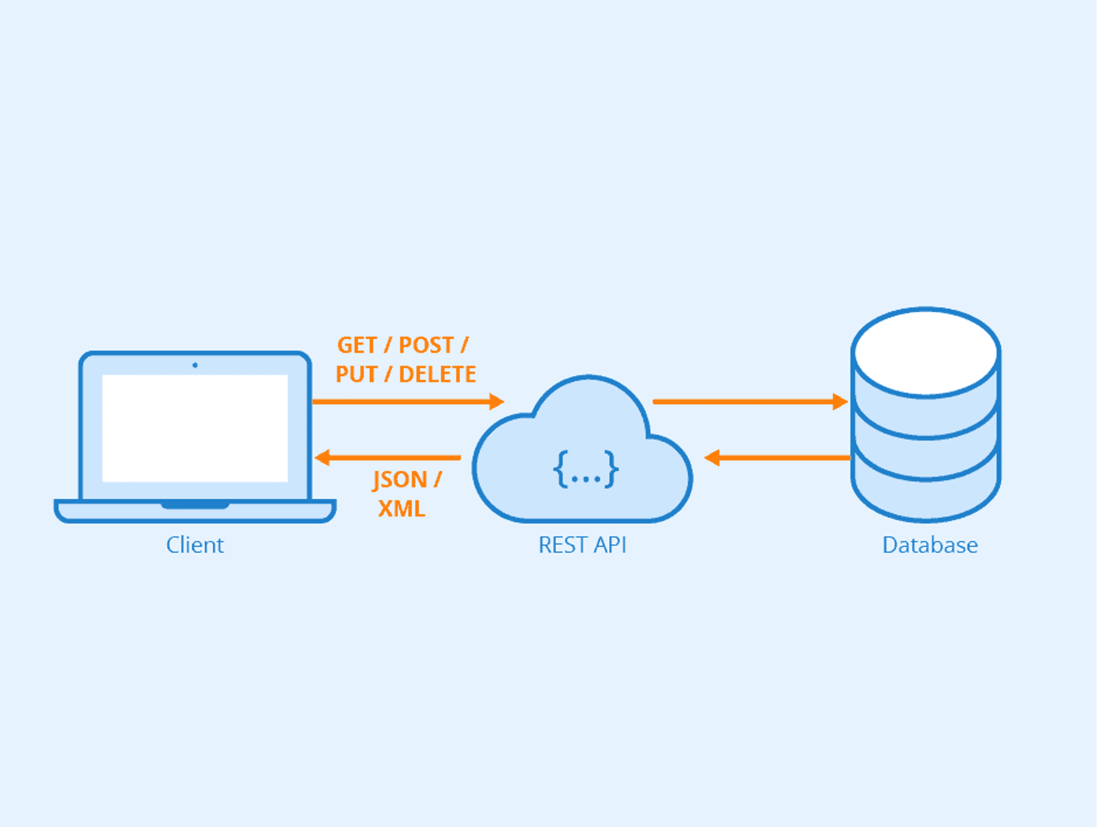
REST : Representational State Transfer
REST (Representational State Transfer) is an architectural style used to design web services and APIs.

Slide 36
REST : Representational State Transfer
REST defines a set of rules that allow systems (like web apps and servers) to communicate over HTTP in a simple, scalable way.
Everything (data or object) is treated as a resource (JSON), and each resource is identified by a URL.

Slide 37
Example SOAP vs REST
In an online store You want product information.

Slide 38
Example SOAP vs REST
SOAP
You send an XML request to a service:
<GetProduct>
<ProductID>10</ProductID>
</GetProduct>
Server responds with XML data.
Notes:
Server responds with XML data.

Slide 39
Example SOAP vs REST
REST
Use URL + HTTP method:
GET /products/10 (it means get product with id 10)
Uses usually JSON.
Notes:
Server responds with XML data.

Slide 40
XML

Slide 41
XML
XML (eXtensible Markup Language) is a markup language used to store, organize, and transport data in a structured and readable format.
It uses custom tags to describe information.
XML = a language for organizing and exchanging data using tags.

Slide 42
XML
Example:
<laptop>
<brand>Dell</brand>
<model>Inspiron 15</model>
<price>85000</price>
</laptop>
XML

Slide 43
JSON

Slide 44
JSON
JSON (JavaScript Object Notation) is a lightweight data format used to store and exchange data between applications.
It is easy for humans to read and easy for machines to process.

Slide 45
JSON
JSON is commonly used in RESTful Web Services to send requests and responses.

Slide 46
JSON
Example:
{
"brand": "Dell",
"model": "Inspiron 15",
"price": 85000
}
JSON

Slide 47
Bootstrap

Slide 48

Bootstrap
Bootstrap is the world’s most popular open-source front-end framework for building responsive, mobile-first websites. Originally developed at Twitter,

Slide 49
Bootstrap
It provides a massive library of pre-written HTML, CSS, and JavaScript components so you don't have to build every button, menu, or grid from scratch.

Slide 50
Bootstrap
<link href="https://cdn.jsdelivr.net/npm/bootstrap@5.3.0/dist/css/bootstrap.min.css" rel="stylesheet">
<script src="https://cdn.jsdelivr.net/npm/bootstrap@5.3.0/dist/js/bootstrap.bundle.min.js"></script>

Slide 51

Questions ?

Slide 52

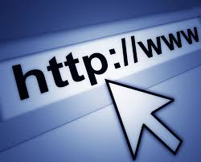
CHAPTER 1

Slide 53
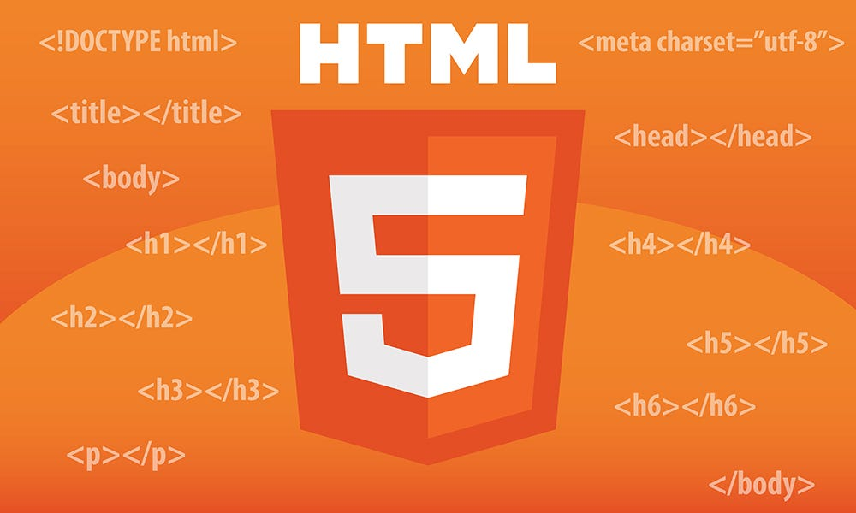
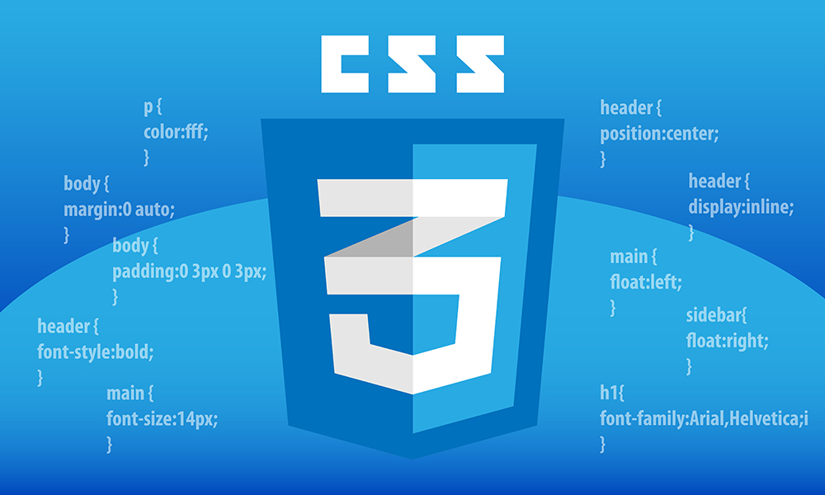

Chapter 2 Web Programming Languages

Slide 54


Server-Side Programming Language (PHP)

Slide 55
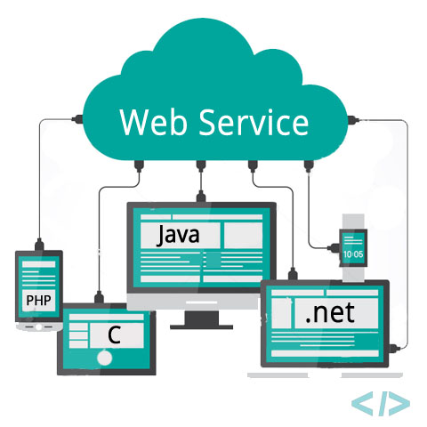
Web Services: Fundamentals

Slide 56

Dr. KIHAL M

