Slide 1
Web application Development
Chapter 3:
Server-side programming language (PHP)
2025 / 2026

Slide 2


Slide 3
PHP
PHP : PHP: Hypertext Preprocessor.
PHP is a server-side programming language used to build dynamic websites and web applications.

Slide 4
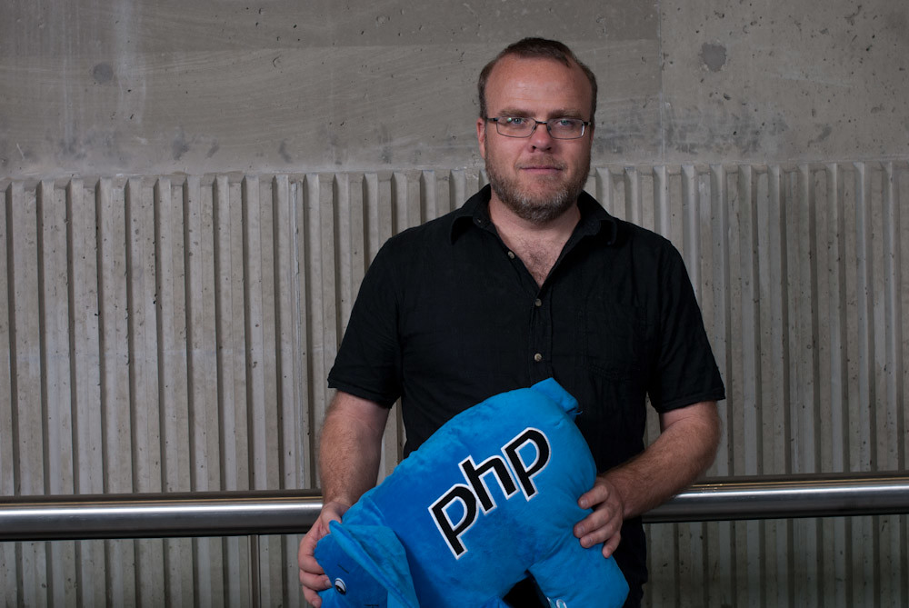
PHP historic
In 1994, Rasmus Lerdorf created PHP

Slide 5
PHP historic
Originally, it was a simple tool to track visits to his personal website It was called “Personal Home Page” (PHP)
Later, it evolved into a powerful programming language

Slide 6
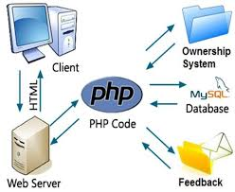
PHP
Runs on server, not browser

Slide 7
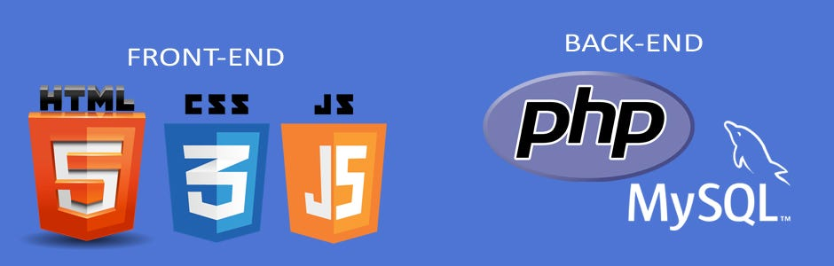
PHP
Works with HTML, CSS, JavaScript

Slide 8
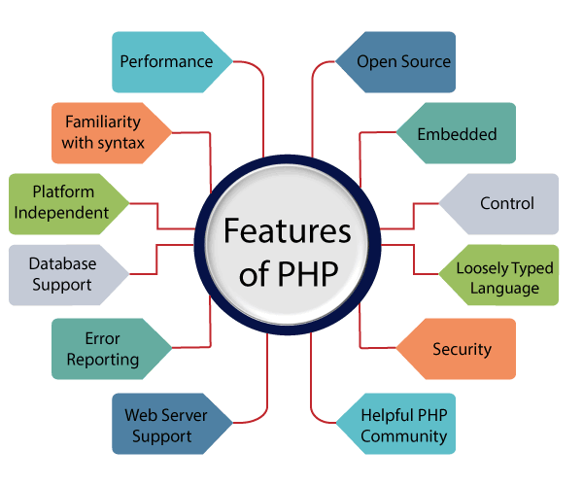
PHP
Easy to learn and widely used

Slide 9
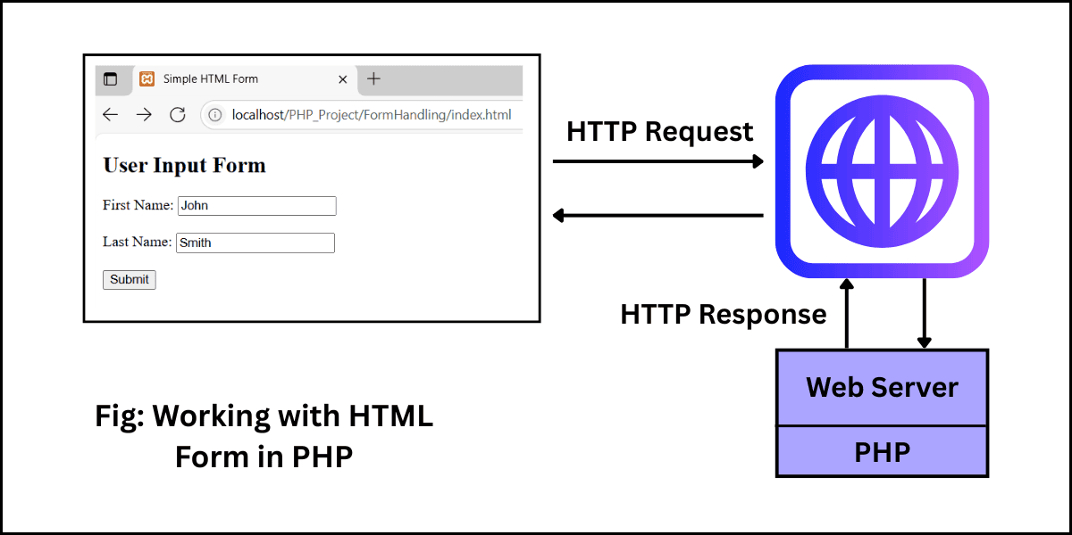
PHP
Process forms

Slide 10
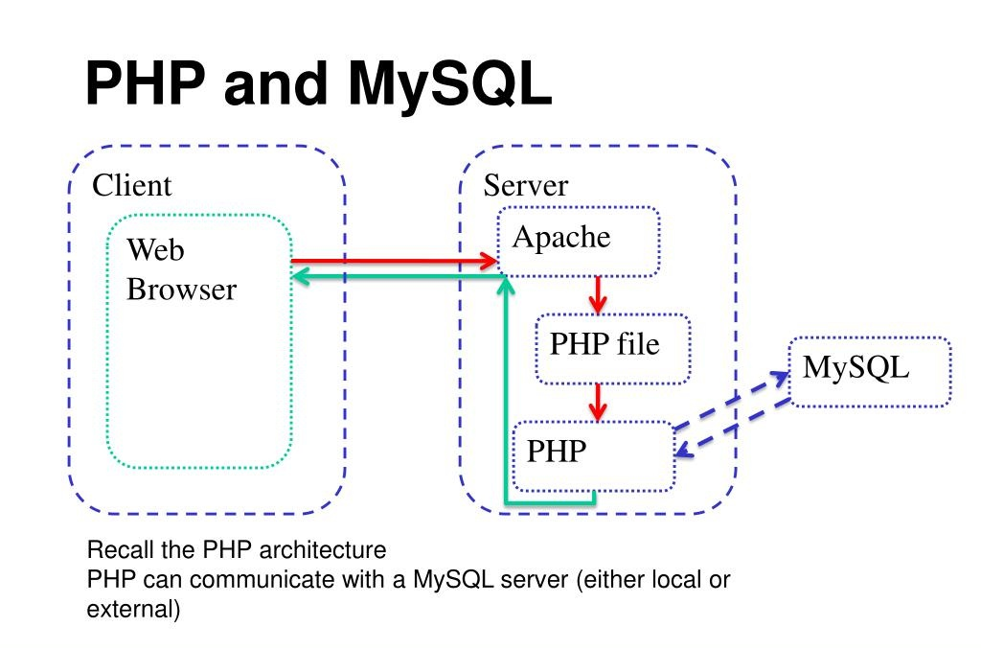
PHP
Connect to databases (MySQL)

Slide 11
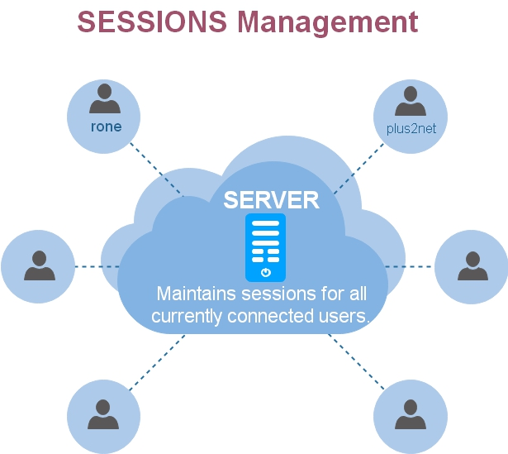
PHP
Manage sessions & login systems

Slide 12
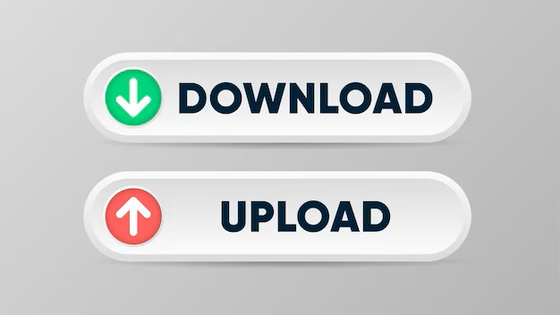
PHP
Handle files (upload, download)

Slide 13

Installing environment:
WampServer is a local development environment for Windows that lets you run PHP + MySQL + Apache on your computer without needing a real web server.

Slide 14

Installing environment:
XAMPP is another popular local server environment very similar to WampServer but it works on
Windows
Linux
and macOS.

Slide 15
We must place our code php File in the Server Folder
WAMP
C:\wamp64\www\
XAMPP
C:\xampp\htdocs\

Slide 16
PHP Syntaxe

Slide 17
PHP Syntaxe
PHP code is written inside special tags:
<?php
// PHP code here
?>

Slide 18
PHP Syntaxe
Each instruction must end with a semicolon (;).
<?php
// PHP code here ;
?>

Slide 19
First project in HTML and PHP

Slide 20
First project in HTML and PHP
<!DOCTYPE html>
<html lang="en">
<head>
<meta charset="UTF-8">
<title>PHP Hello World</title>
</head>
<body>
<h1>My First PHP Page</h1>
<?php
echo "<p>Hello World from PHP!</p>";
?>
</body>
</html>

Slide 21
Note
PHP only executes inside .php files
Run the Server
Open WAMP/XAMPP
Start Apache

Slide 22
Open your browser and go to:
http://localhost/PHPfile_name.php

Slide 23
Comments
Single Line:
// or #
Multiple Lines:
/*……..*/

Slide 24
Output
echo
<?php
echo "Hello World!";
?>

Slide 25
Output
print
<?php
print "Hello World!";
?>

Slide 26
Constants
There are two ways to define constants in PHP:

Slide 27
Constants
1) define() function
<?php
define("PI", "3,14");
?>

Slide 28
Constants
2) const
<?php
const PI = "3,14";
?>

Slide 29
Variables
Variables start with $
No need to declare type (like js)
<?php
$name = “Youcef";
$age = 21;
?>

Slide 30
Operators
<?php
$a = 10;
$b = 5;
echo $a + $b; // addition
echo $a - $b; // subtraction
echo $a * $b; // multiplication
echo $a / $b; // division
echo $a % $b; // modulo
?>

Slide 31
Control Structures
PHP uses standard logic structures found in most programming languages.
<?php
if ($age > 18) {
echo "Adult";
} else {
echo "Minor";
}?>

Slide 32
Loops
Type of loops ?

Slide 33
while Loop
It checks the condition before entering the loop.
$i = 1;
while ($i <= 10) {
echo "The number is: $i <br>";
$i++;
}

Slide 34
Do … while Loop
always execute the code block at least once, then it checks the condition and repeats the loop as long as the condition is true.

Slide 35
Do … while Loop
$i = 1;
do {
echo "This will run at least once. Number: $i";
$i++;
} while ($i > 10);

Slide 36
For Loop
used when you know exactly how many times you want to run a script.
for ($i = 0; $i <= 10; $i++) {
echo "Iteration: $i <br>";
}

Slide 37
For each Loop
Designed to loop through arrays.
<?php
$fruits = ["Apple", "Banana", "melon"];
foreach ($fruits as $x) {
echo "Fruit: $x <br>";
}
?>

Slide 38
PHP and Database

Slide 39
PHP and DB
The relationship follows a simple request-response cycle:

Slide 40
PHP and DB
1
The User fills out a form or clicks a link.
2
PHP receives that data and "talks" to the database using a query.

Slide 41
PHP and DB
3
The Database finds or stores the info and sends a confirmation back to PHP.
4
PHP turns that data into HTML to show the user.

Slide 42

PHP My Admin
phpMyAdmin is the most popular web-based interface for managing MySQL and MariaDB databases.

Slide 43
phpMyAdmin
Instead of typing raw SQL commands in a black terminal window, phpMyAdmin gives you a visual "point-and-click" environment to:

Slide 44
PHP My Admin
Create and Delete: Build new databases or remove old ones.

Slide 45
PHP My Admin
Table Management: Add columns, change data types, or set "Primary Keys."

Slide 46
PHP My Admin
Import/Export: Move your entire database into a .sql file (for backups) or upload a database from a different server.

Slide 47
PHP My Admin
Run SQL: If you do want to write code, there is a dedicated tab to test your queries.

Slide 48
PHP My Admin
User Permissions: Manage who has access to the data and what they are allowed to change.

Slide 49

Exercise

Slide 50
Exercise
Lunch Wamp server and open phpMyAdmin.
Create a new database and new table.
Insert some instances.

