Slide 1
Web application Development
Chapter 2:
Web Programming Languages
2025 / 2026

Slide 2


Slide 3
From HTML and CSS to JS
HTML and CSS create the structure and style of a web page.
JavaScript adds interactivity by allowing the page to respond to user actions and modify content dynamically.

Slide 4
Java Script
JavaScript is a programming language used to make web pages interactive and dynamic.
It allows developers to respond to user actions, manipulate HTML/CSS, and control the behavior of web applications.

Slide 5

Java Script historic
JavaScript was created in 1995 by Brendan Eich at Netscape in only 10 days to make web pages interactive in the browser Netscape Navigator.

Slide 6
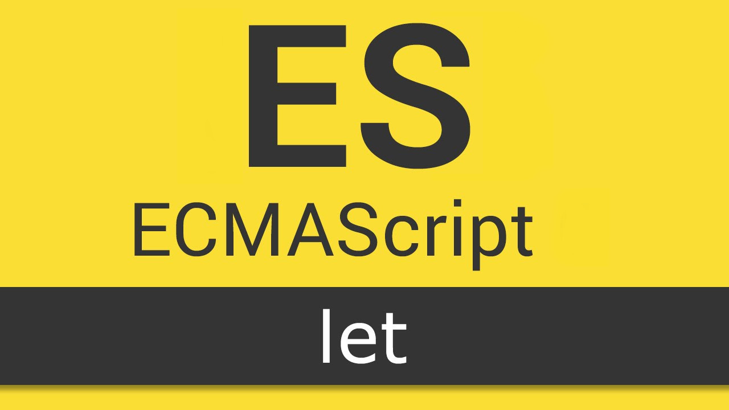
Java Script historic
In 1997, it was standardized by ECMA International under the name ECMAScript, which continues to define the official JavaScript specifications used by modern browsers today.

Slide 7
Difference between Java and JavaScript
Java and JavaScript are different programming languages.
Java is mainly used to build applications, Android apps, and large systems.
JavaScript is mainly used to create interactive web pages in web browsers.

Slide 8
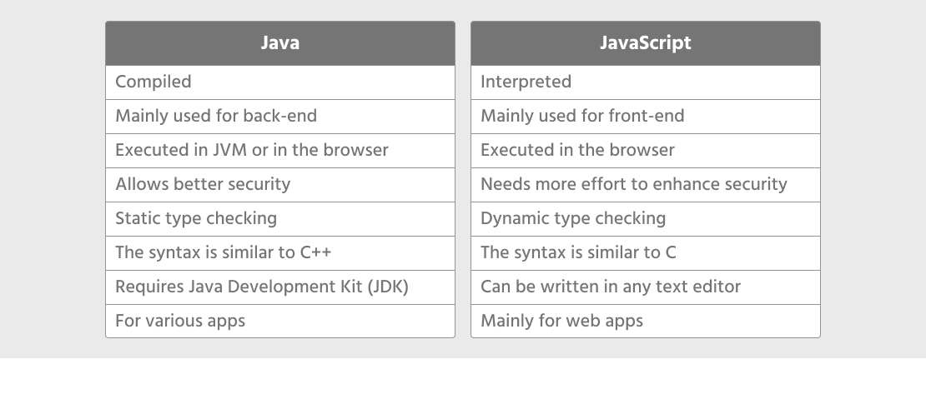
Difference between Java and JavaScript
Java and JavaScript are different programming languages.
Java is mainly used to build applications, Android apps, and large systems.
JavaScript is mainly used to create interactive web pages in web browsers.

Slide 9
Role of JavaScript in web development
User interaction: respond to events like clicks, typing, or mouse movement.
DOM (Document Object Model) manipulation: modify HTML content and CSS styles dynamically.

Slide 10
Role of JavaScript in web development
Form validation: check user input before sending data to the server.
Communication with servers: load or send data without reloading the page (API(Application Programming Interfaces)).

Slide 11
How to add JS to an HTML file?
Inline JS
Internal JS
External JS

Slide 12
Inline JS
inline JavaScript refers to writing JavaScript code directly inside HTML elements using event attributes

Slide 13
Inline JS
Example
<!DOCTYPE html>
<html>
<body>
<button onclick="let name = prompt('Enter your name:'); alert('Hello ' + name)">click me </button>
</body>
</html>

Slide 14
Internal JS
internal JavaScript refers to writing JavaScript code inside a <script> tag in the HTML file, usually within the <head> or <body>

Slide 15
Internal JS
Example
<!DOCTYPE html>
<html>
<head>
<title>Internal JS Example</title>
<script>
function hi() {
let name = prompt("Enter your name:");
alert("Hello " + name + "!"); }
</script>
</head>
<body>
<button onclick="hi()">Click Me</button>
</body>
</html>

Slide 16
External JS
external JavaScript refers to writing JavaScript code in a separate .js file and then linking it to the HTML file using:
<script src="..."></script> tag.

Slide 17
External JS
Example
// script.js
function hi() {
let name = prompt("Enter your name:");
alert("Hello " + name + "!");
}
script.JS

Slide 18
External JS
Example
<!DOCTYPE html>
<html>
<head>
<title>External JS Example</title>
<script src="script.js"></script>
</head>
<body>
<button onclick="hi()">Click Me</button>
</body>
</html>
Main.HTML

Slide 19
How to run the code

Slide 20
How to run the code
To execute JavaScript within an HTML document, the JavaScript code must be placed inside the <script> tag in the HTML file.
Once the code is included, the HTML file can be opened in a web browser to run the JavaScript program.

Slide 21
First project in JS

Slide 22
First project in JS
<!DOCTYPE html>
<html>
<head>
<title>My First JavaScript</title>
</head>
<body>
<h1>My First JavaScript Program</h1>
<script>
JS Code;
</script>
</body>
</html>

Slide 23
Example Hello world
In Terminal

Slide 24
Comment in JS

Slide 25
Comments in JS
A single-line comment starts with //
/* This is a comment in CSS */

Slide 26
Variables and constants in JS

Slide 27
Constants in JS
A constant is a variable whose value cannot be changed after it is assigned.
Constants are declared using the keyword const.
Syntax
const constantName = value;

Slide 28
Constants in JS
Must be initialized when declared.
Cannot be reassigned later.
Usually written in UPPERCASE by convention (for fixed values).

Slide 29
Constants in JS
Example
const constantName = value;
const PI = 3.14;

Slide 30
Variables in JS
A variable is a container used to store data values.
The value stored in a variable can be used or changed during the execution of the program.
Syntax
var variableName = value;
let variableName = value;
let number;

Slide 31
Data Types

Slide 32
Data types in JS
Java script use dynamic typing, which means you do not need to declare the data type of a variable.

Slide 33
Constants in JS
Example 1
let age = 25;
let x = “ramadan";
let isStudent = true;

Slide 34
Constants in JS
Example 2
let x = 10;
x = “ramadan";

Slide 35
Input / Output

Slide 36
Read in JS
prompt() displays a dialog box where the user can enter a value.
Syntax
prompt("message");

Slide 37
Read in JS
Example 1
let name = prompt("Enter your name:");
prompt() returns a string, so if you want a number you must convert it.

Slide 38
Read in JS
Example 2
let age = Number(prompt("Enter your age:"));
We can use input + JavaScript to Read data from an HTML form

Slide 39
Write in JS
console.log() writes output to the browser console.
It is mainly used for testing and debugging.

Slide 40
Write in JS
alert() displays a popup message box.
Example
alert(“Hello");

Slide 41
Write in JS
You can display output inside an HTML element using innerHTML

Slide 42
Arithmetic

Slide 43
Write in JS
Operator | Meaning | Example
+ | Addition | a + b
- | Subtraction | a - b
* | Multiplication | a * b
/ | Division | a / b
% | Modulus (remainder) | a % b
** | Exponentiation (power) | a ** b

Slide 44
Conditions in JS

Slide 45
If/else statment in JS
let temp = 25;
if (temp <= 0) {
console.log("It's freezing! ");
} else if (temp > 0 && temp < 20) {
console.log("It's a bit chilly. ");
} else if (temp >= 20 && temp < 30) {
console.log("Perfect weather! ");
} else {
console.log("It's a heatwave! ");
}

Slide 46

Exercise

Slide 47
Exercise
Read two numbers, a and b, then calculate their addition, subtraction, multiplication, division, a modulo b, and a to the power of b.

Slide 48
Solution
// Read two numbers from the user
let a = Number(prompt("Enter the first number (a):"));
let b = Number(prompt("Enter the second number (b):"));

Slide 49
Solution
// Perform arithmetic operations
let addition = a + b;
let subtraction = a - b;
let multiplication = a * b;
let division = a / b;
let modulus = a % b;
let power = a ** b;

Slide 50
Solution
// Display the results
console.log("Addition: " + addition);
console.log("Subtraction: " + subtraction);
console.log("Multiplication: " + multiplication);
console.log("Division: " + division);
console.log("Modulus (a % b): " + modulus);
console.log("Power (a^b): " + power);

Slide 51


