Slide 1
Web application Development
Chapter 2:
Web Programming Languages
2025 / 2026

Slide 2
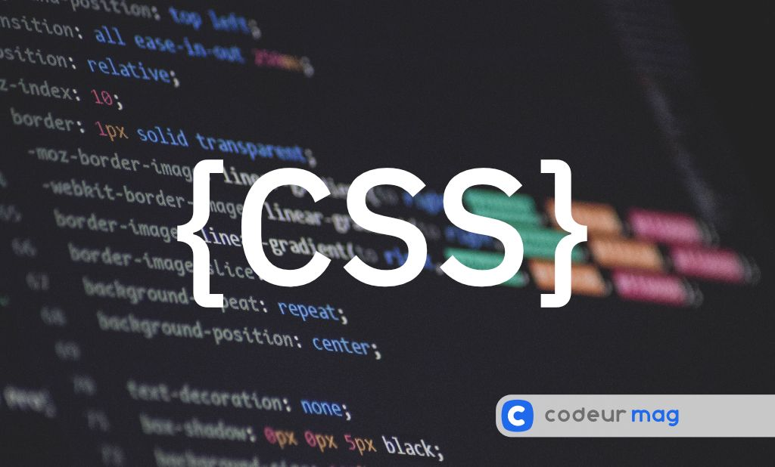

Slide 3
CSS
CSS (Cascading Style Sheets) is a style sheet language used to describe the visual presentation of web pages.
It allows the separation of presentation from content, which makes web pages easier to maintain and update.

Slide 4
How to add CSS to an HTML file?
Inline CSS
Internal CSS
External CSS

Slide 5
Type of selectors in CSS :
Basic Selectors in CSS are:
Universal Selector (*)
Class Selector (.className)
Element Selector (tag name)
ID Selector (#idName)

Slide 6
Comment in CSS

Slide 7
Comments in CSS
/* This is a comment in CSS */

Slide 8
Styling text in CSS

Slide 9
CSS for Styling Text
CSS Property | Description | Example
color | Sets the text color | color: red;
font-family | Sets the font type | font-family: Arial, sans-serif;
font-size | Sets the size of text | font-size: 16px;
font-weight | Sets the boldness of text | font-weight: bold;
font-style | Makes text italic or normal | font-style: italic;

Slide 10
CSS for Styling Text
CSS Property | Description | Example
text-align | Aligns text left, right, center, or justify | text-align: center;
text-decoration | Adds underline, line-through, overline, or none | text-decoration: underline;
text-transform | Changes text to uppercase, lowercase, capitalize | text-transform: uppercase;
letter-spacing | Sets space between letters | letter-spacing: 2px;
word-spacing | Sets space between words | word-spacing: 5px;
text-shadow | Adds shadow to text | text-shadow: 2px 2px 3px gray;

Slide 11
Links in CSS

Slide 12
CSS for Links:
HTML links can be styled with many CSS properties, like: color, text-decoration, background-color, font-size, font-weight, font-family, etc.). a { color: red; background-color: yellow; font-weight: bold;
}

Slide 13
CSS for Links:
In addition, links can be styled differently depending on what state they are in.
The four link states are:
:link - a normal, unvisited link
:visited - a link the user has visited
:hover - a link when the user mouses over it
:active - a link the moment it is clicked
Pseudo-class !

Slide 14
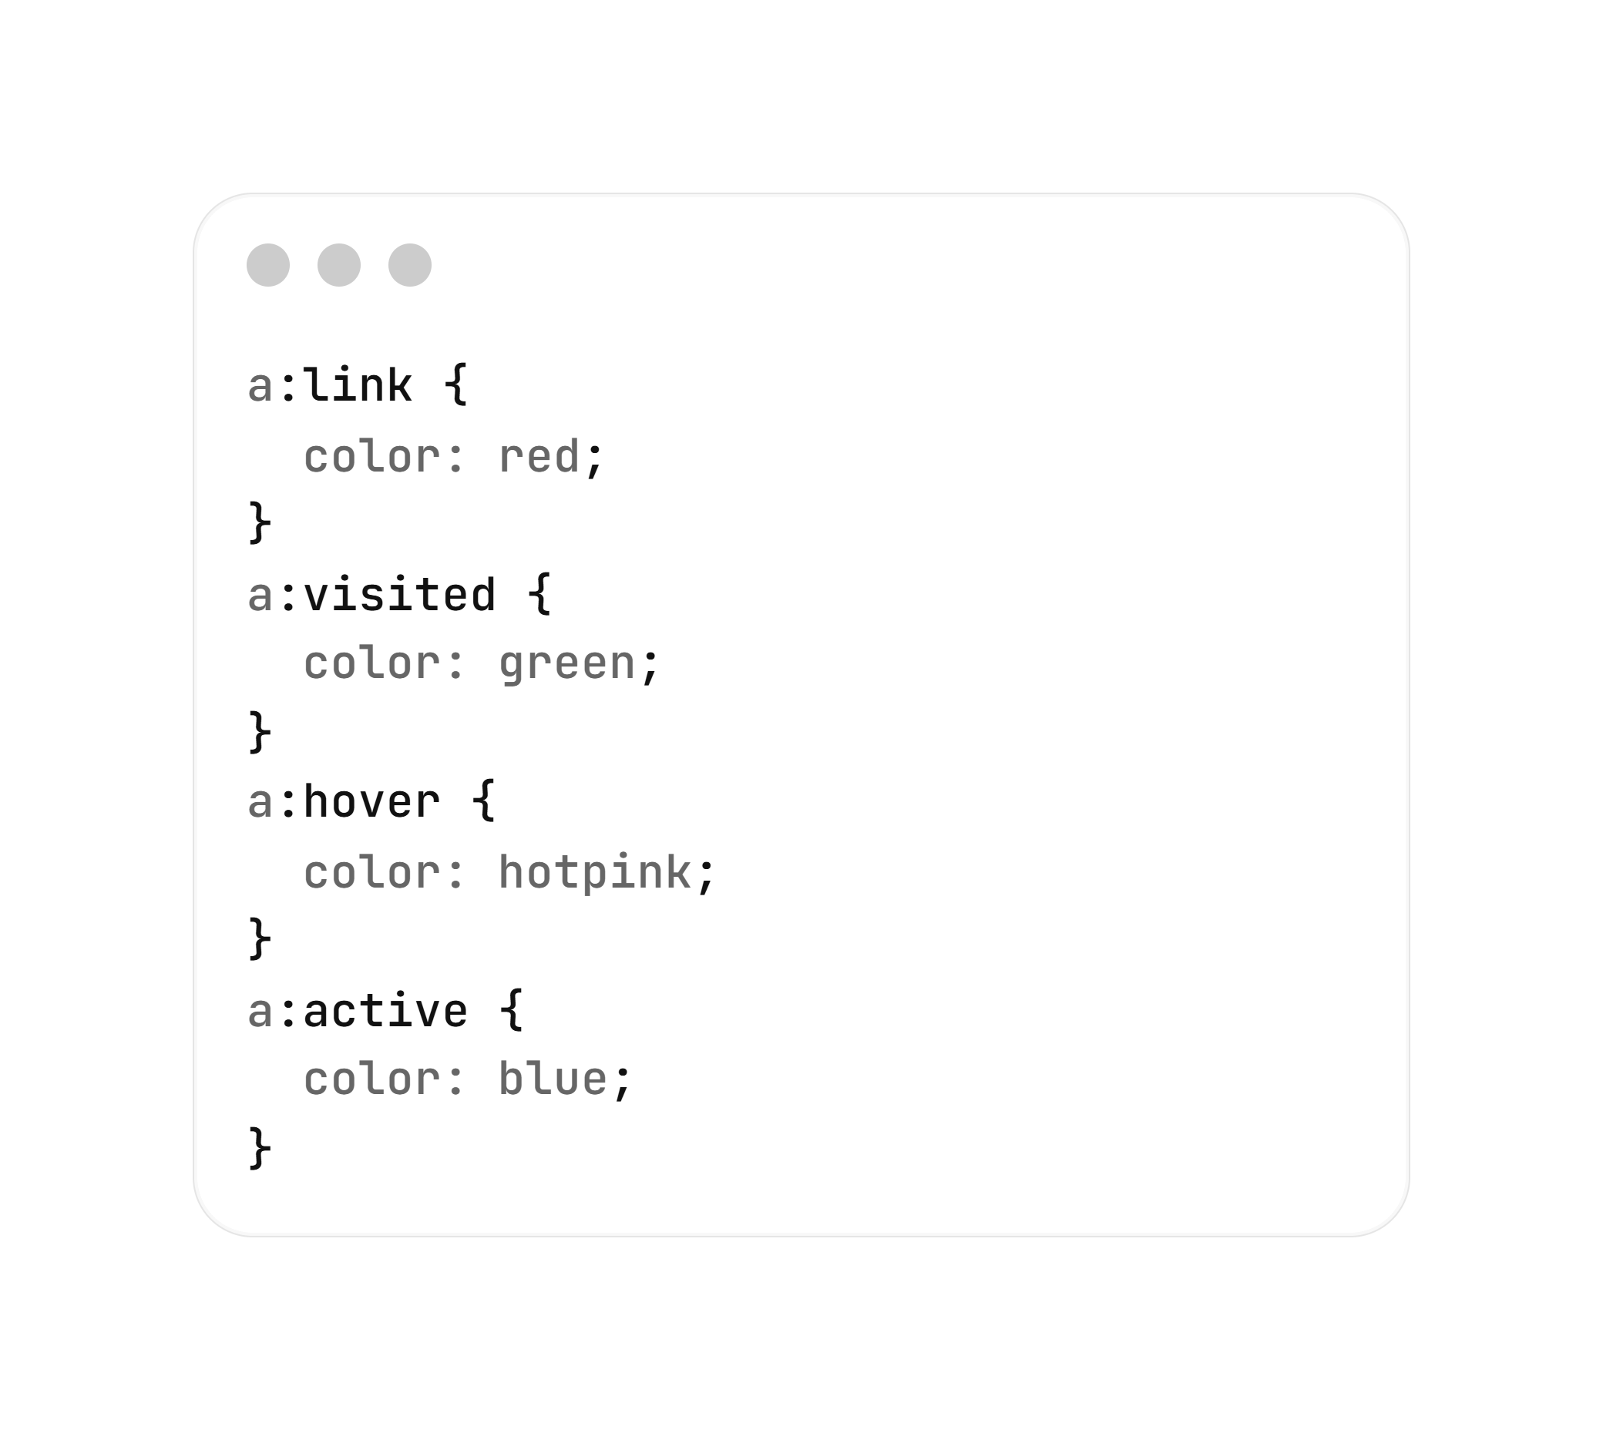
CSS for Links:
exampels\Links on CSS.html

Slide 15
Images in CSS

Slide 16
CSS for Image:
Image Width & Height:
img {
width: 300px;
height: 200px;
}
img {
max-width: 100%;
height: auto;
}

Slide 17
CSS for Image:
Hover Effect
img:hover {
transform: scale(1.1);
transition: 0.5s;
}

Slide 18
CSS for Image:
Opacity
img {
opacity: 0.8;
}
exampels\image opacity.html

Slide 19
Borders in CSS

Slide 20
CSS for border:
Basic Border
div {
border: 2px solid black;
}
border: width style color;

Slide 21
CSS for border:
Basic Border
Common styles:
solid
dashed
dotted
double
groove
ridge
inset
outset
none
border: width style color;
exampels\border.html

Slide 22
CSS for border:
Rounded corners
div {
border-radius: 10px;
}
border: width style color;

Slide 23
Layout and positioning in CSS

Slide 24
CSS for layout:
Block
display: block;
Elements take up the full width available and stack vertically (e.g., <div>, <h1>, <p>).

Slide 25
CSS for layout:
Inline
display: inline;
Elements only take up as much width as necessary and sit side-by-side (e.g., <span>, <a>).
They don't respect top/bottom margins or height.

Slide 26
CSS for layout:
Inline-Block:
display: inline-block
Elements sit side-by-side like inline elements but can have a defined width, height, and padding.

Slide 27
CSS for layout:
Flexbox
display: flex;
Designed for one-dimensional layouts either a row or a column.
It’s perfect for distributing space and aligning items within a container, even when their size is unknown.

Slide 28
CSS for layout:
Grid
display: grid;
the powerhouse of CSS. Unlike Flexbox, it is two-dimensional, meaning it handles both rows and columns simultaneously.

Slide 29
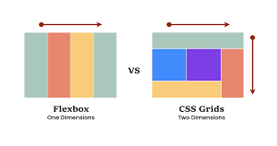
CSS for layout:

Slide 30
CSS for layout:
Positioning
Sometimes we need to pull an element out of the natural flow of the page entirely.

Slide 31
CSS for position:
1) Static
position: Static;
Every element is static by default. It follows the normal document flow.
top to bottom, left to right.

Slide 32
CSS for position:
2) Relative
position: relative;
The element stays in its usual spot, but you can nudge it slightly without pushing other items around.
If you move it down by N px, it shifts, but it leaves a gap where it used to be.
The other parts of the page don't move to fill that gap.

Slide 33
CSS for position:
3) Absolute
position: absolute;
The element is removed off the page.
It no longer takes up any room,
other items will move up to fill the gap as if it disappeared.

Slide 34
CSS for position:
4) Fixed
position: fixed;
Like absolute, it’s removed from the flow, but it is relative to the browser viewport (the screen).
It stays in the exact same spot even when you scroll.

Slide 35
CSS for position:
5) Sticky
position: sticky;
A hybrid of relative and fixed.
The element acts like relative until the user scrolls to a specific point, at which it sticks like it's fixed.
exampels\position css.html

Slide 36
Button in CSS

Slide 37
CSS for Button
Pseudo class:
:hover Triggered when the user mouses over the button.
:active Triggered the moment the button is clicked.

Slide 38


Slide 39

Quiz
What does CSS stand for ?
A) Computer Style Sheets
B) Creative Style System
C) Cascading Style Sheets
D) Colorful Style Syntax

Slide 40
Quiz
Which of the following is the correct way to write a comment in CSS?
A) // This is a comment
B) /* This is a comment */
C) <-- This is a comment -->
D) # This is a comment

Slide 41
Quiz
Which layout tool is described as the "powerhouse of CSS" because it handles both rows and columns simultaneously?
A) Flexbox
B) Grid
C) Block

Slide 42
Quiz
Which positioning value keeps an element in the exact same spot on the screen even when scrolling?
A) Relative
B) Absolute
C) Static
D) Fixed

Slide 43
Quiz
What does the border-radius property do?
A) Adds a shadow to the border
B) Creates rounded corners
C) Changes the border color
D) Makes the border dashed

Slide 44
Quiz
What does the img:hover { transform: scale(1.1); } rule do?
A) It makes the image transparent
B) It changes the image opacity
C) It slightly enlarges the image when the mouse moves over it
D) It adds a border to the image

Slide 45
Quiz
Which layout tool is best for "one-dimensional" layouts (either a row or a column)?
A) Grid
B) Flexbox
C) Static
D) Absolute

Slide 46
MINI Projet
..\..\Project\DAW mini project 2025-2026.pdf

Slide 47


