Slide 1
Web application Development
Chapter 2:
Web Programming Languages
2025 / 2026

Slide 2


Slide 3
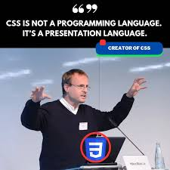
CSS
CSS was proposed in 1994 by Håkon Wium Lie to separate the presentation from HTML content and improve web page styling.

Slide 4
CSS
CSS (Cascading Style Sheets) is a style sheet language used to describe the visual presentation of web pages.
It allows the separation of presentation from content, which makes web pages easier to maintain and update.

Slide 5
CSS
By using CSS, you can define styles for different HTML elements, such as colors, fonts, margins, borders, backgrounds, and much more.
You can also define styles for different states of an element, such as hover, click (active), and focus.

Slide 6
The main advantages of using CSS with HTML compared to using HTML alone:
Separation of content and design
Easy maintenance
Responsive design
Better layout control

Slide 7
How to add CSS to an HTML file?

Slide 8
How to add CSS to an HTML file?
There are several ways to add CSS styles to a web page.
Inline CSS:
Using the style attribute directly inside an HTML tag.

Slide 9
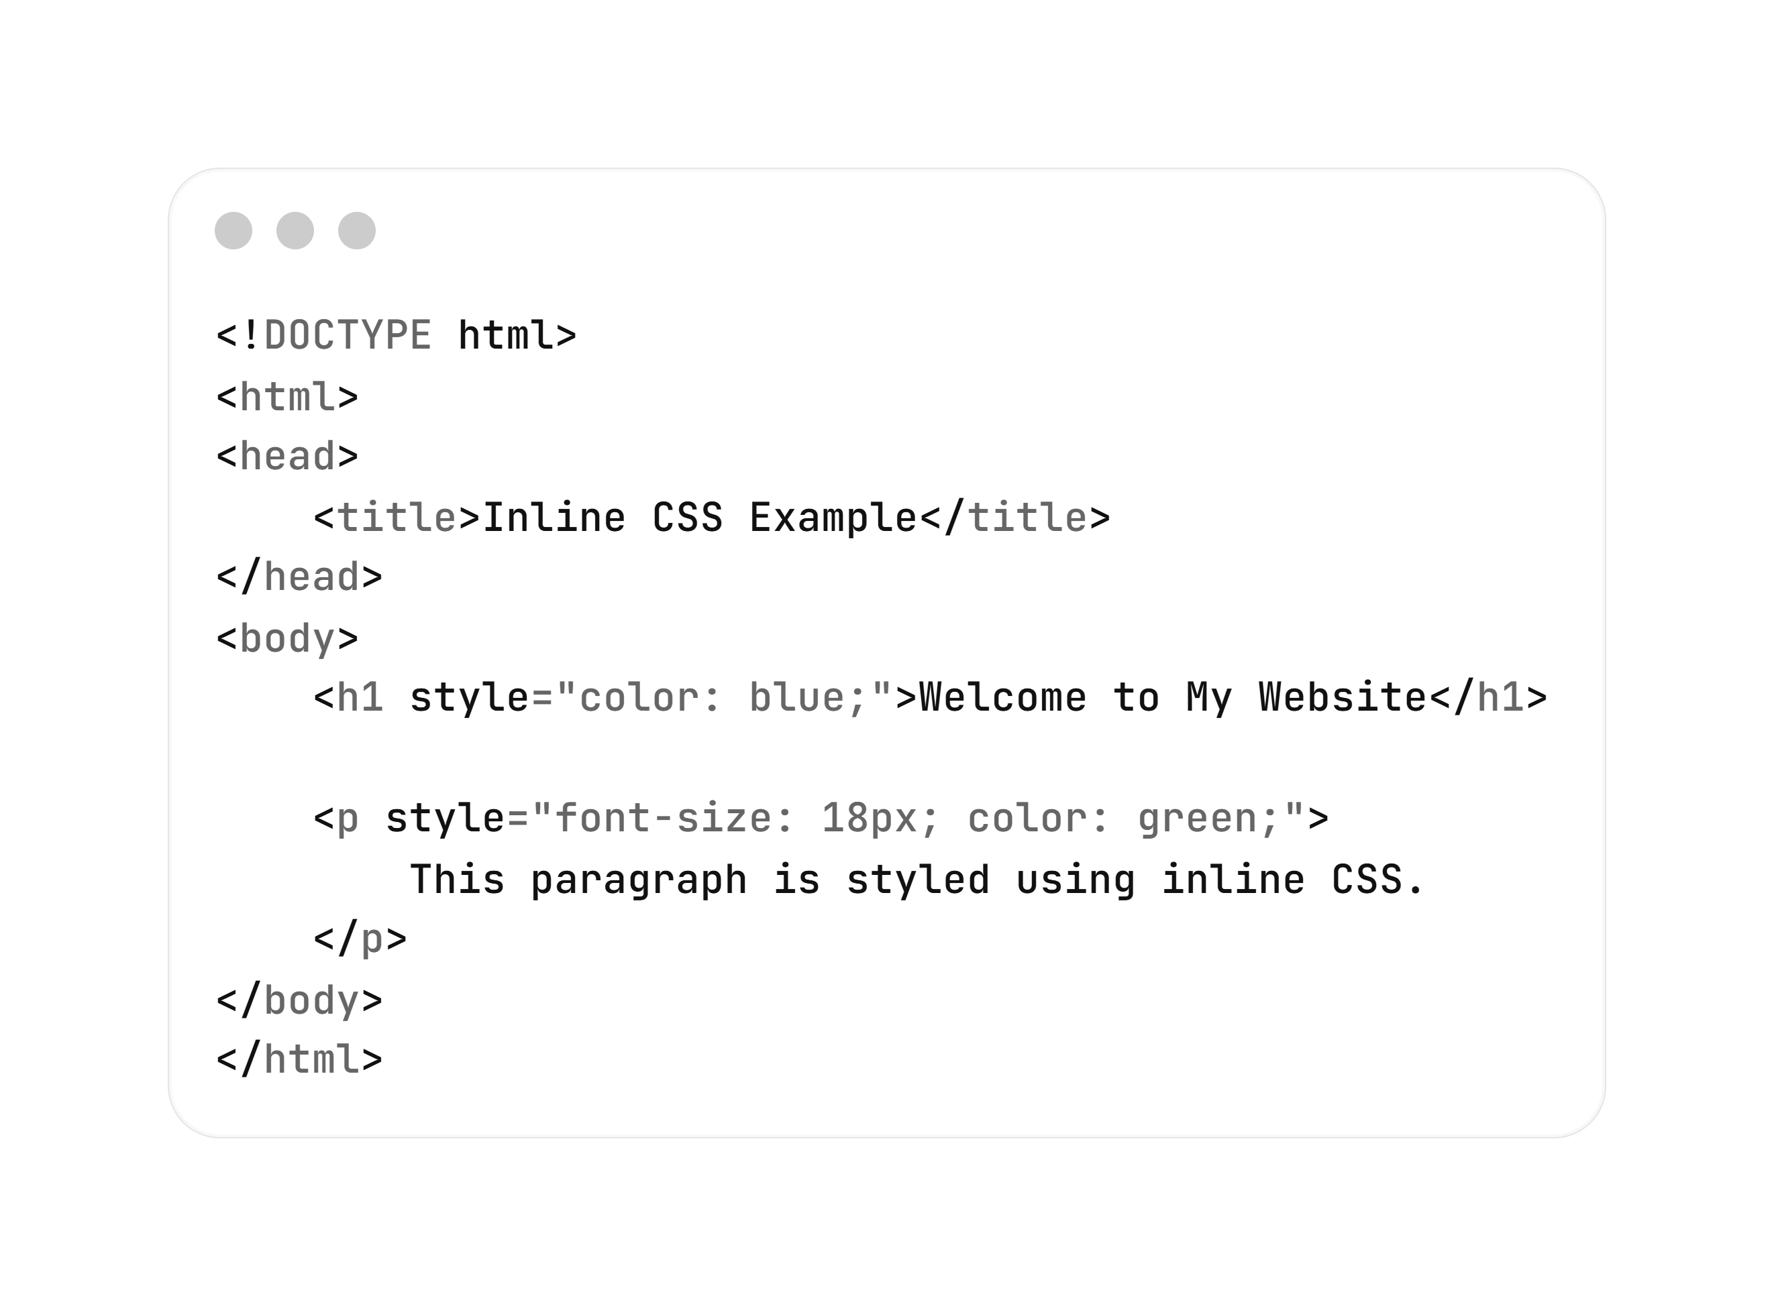

How to add CSS to an HTML file?
Example
Inline CSS:

Slide 10
CSS :
There are several ways to add CSS styles to a web page.
Internal CSS:
Include them inside a <style> tag in the HTML file,

Slide 11
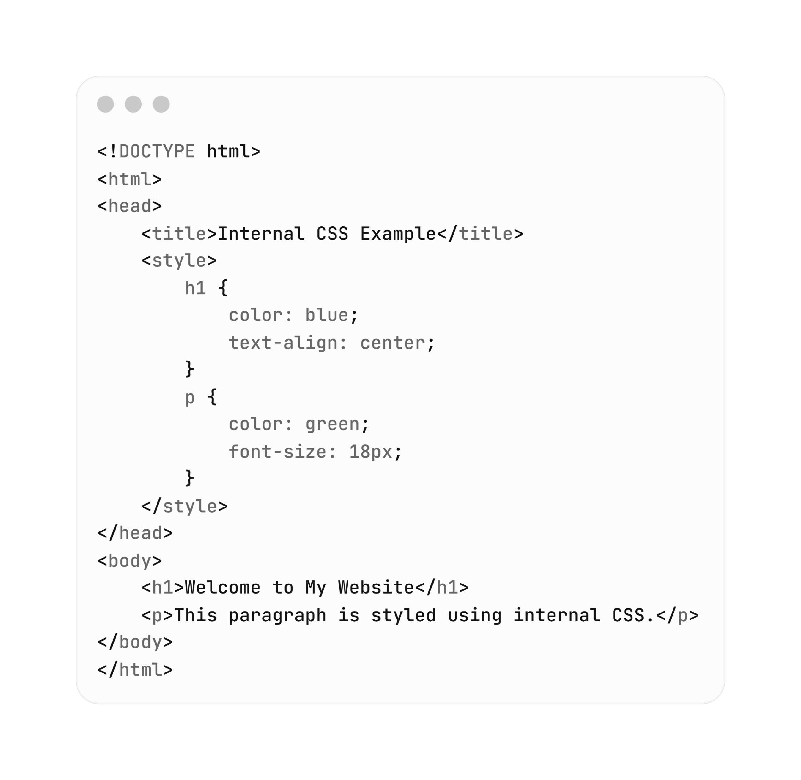

CSS :
Internal CSS:
Example

Slide 12
CSS :
There are several ways to add CSS styles to a web page.
External CSS:
Place them in a separate CSS file and link it to the HTML page using a <link> tag.

Slide 13
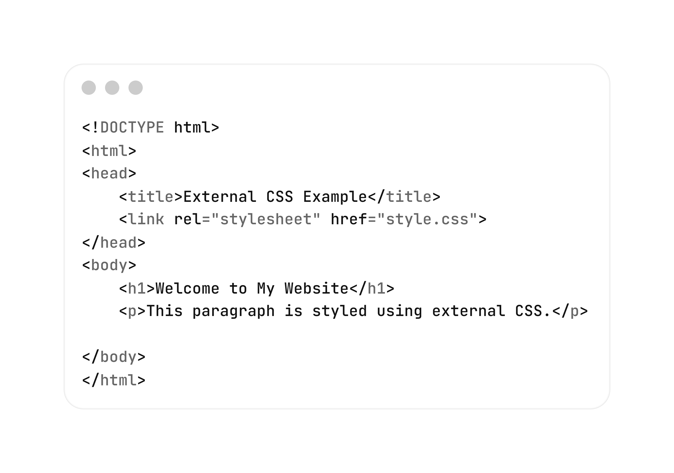
CSS :
test.HTML
External CSS:
Example

Slide 14
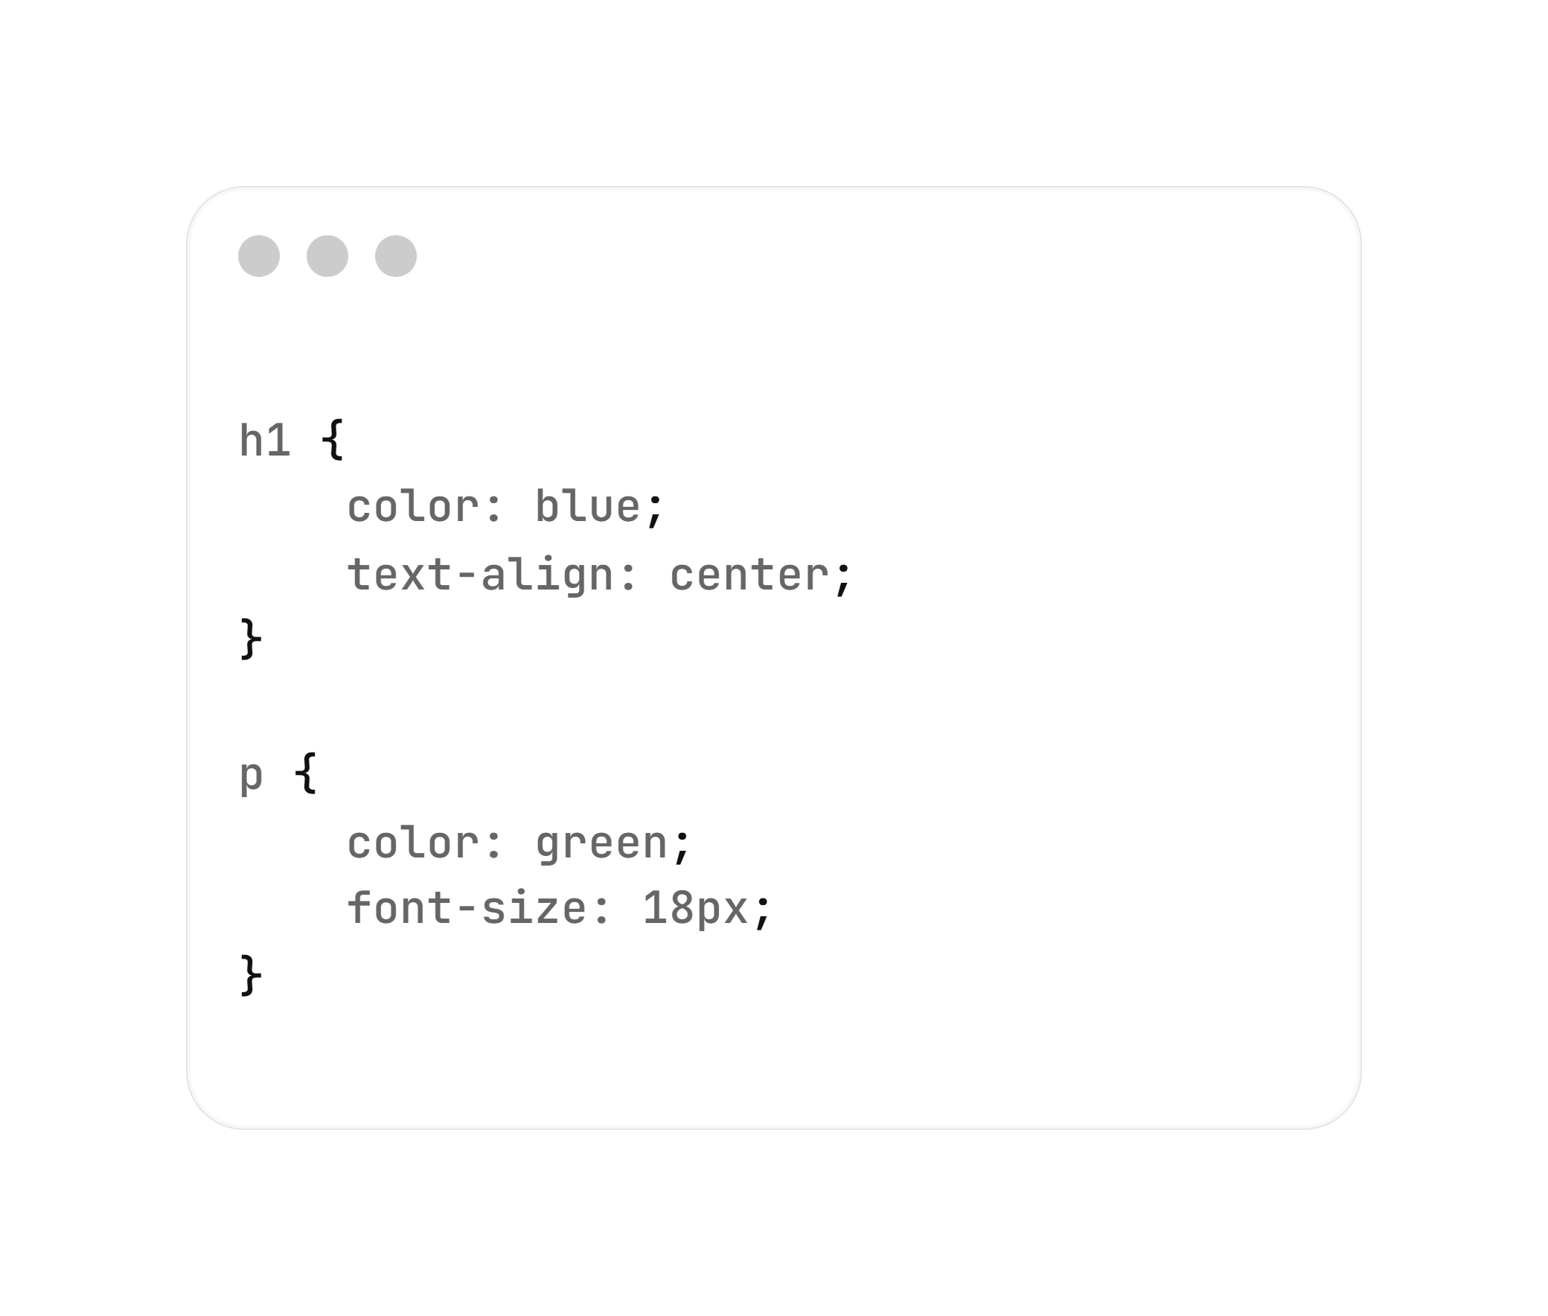
CSS :
style.CSS
External CSS:
Example

Slide 15
CSS :
CSS also provides advanced features such as class selectors, ID selectors, element selectors, group selectors, attribute selectors, and pseudo-classes.
These selectors allow you to target specific elements more precisely and apply different styles to them.

Slide 16
CSS :
A CSS rule is an instruction that defines the style of an HTML element or a group of HTML elements. It consists of a selector and a declaration block.

Slide 17
Example :
Div{
Background-color: blue;
}
In this code, the selector is div, which means that this rule will be applied to all div elements on the page.
The declaration block is within the curly braces { } and contains a background-color property with the value blue, which sets the background color of the element.

Slide 18
Type of selectors in CSS :
Basic Selectors in CSS are:
Universal Selector (*)
Written using the * symbol. It selects all HTML elements on the page.

Slide 19
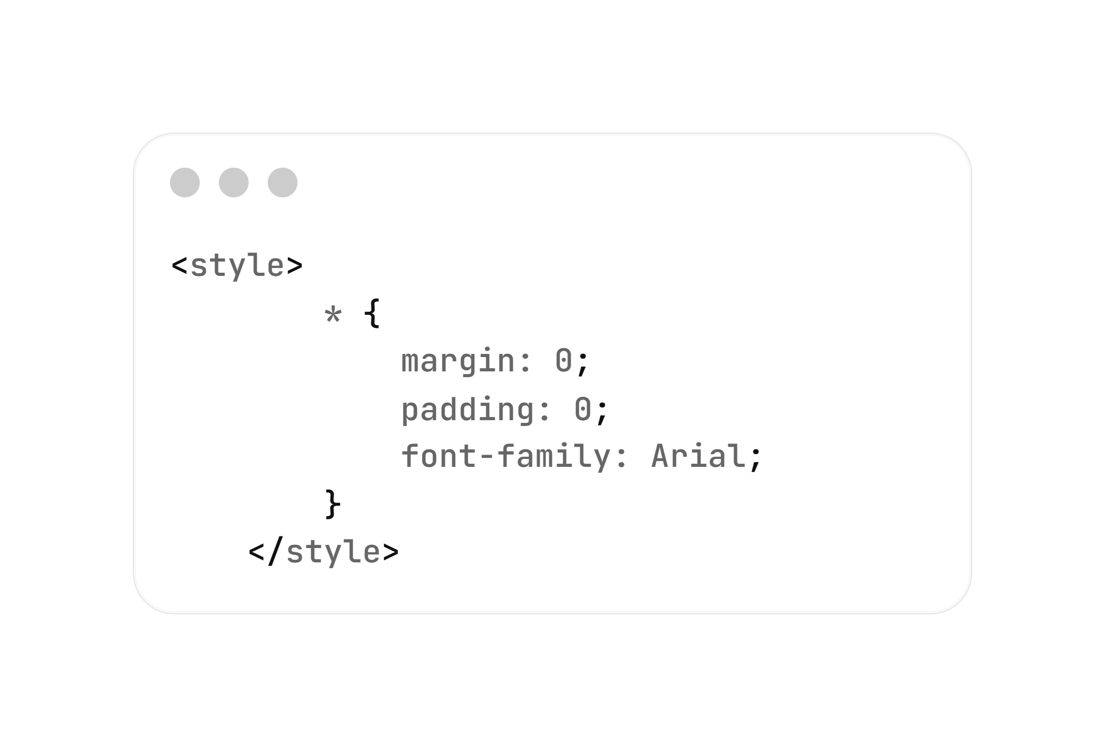
Type of selectors in CSS :
Basic Selectors in CSS are:
Universal Selector (*)
Example

Slide 20
Type of selectors in CSS :
Basic Selectors in CSS are:
Element Selector (type)
Select all elements of a specific HTML tag.

Slide 21
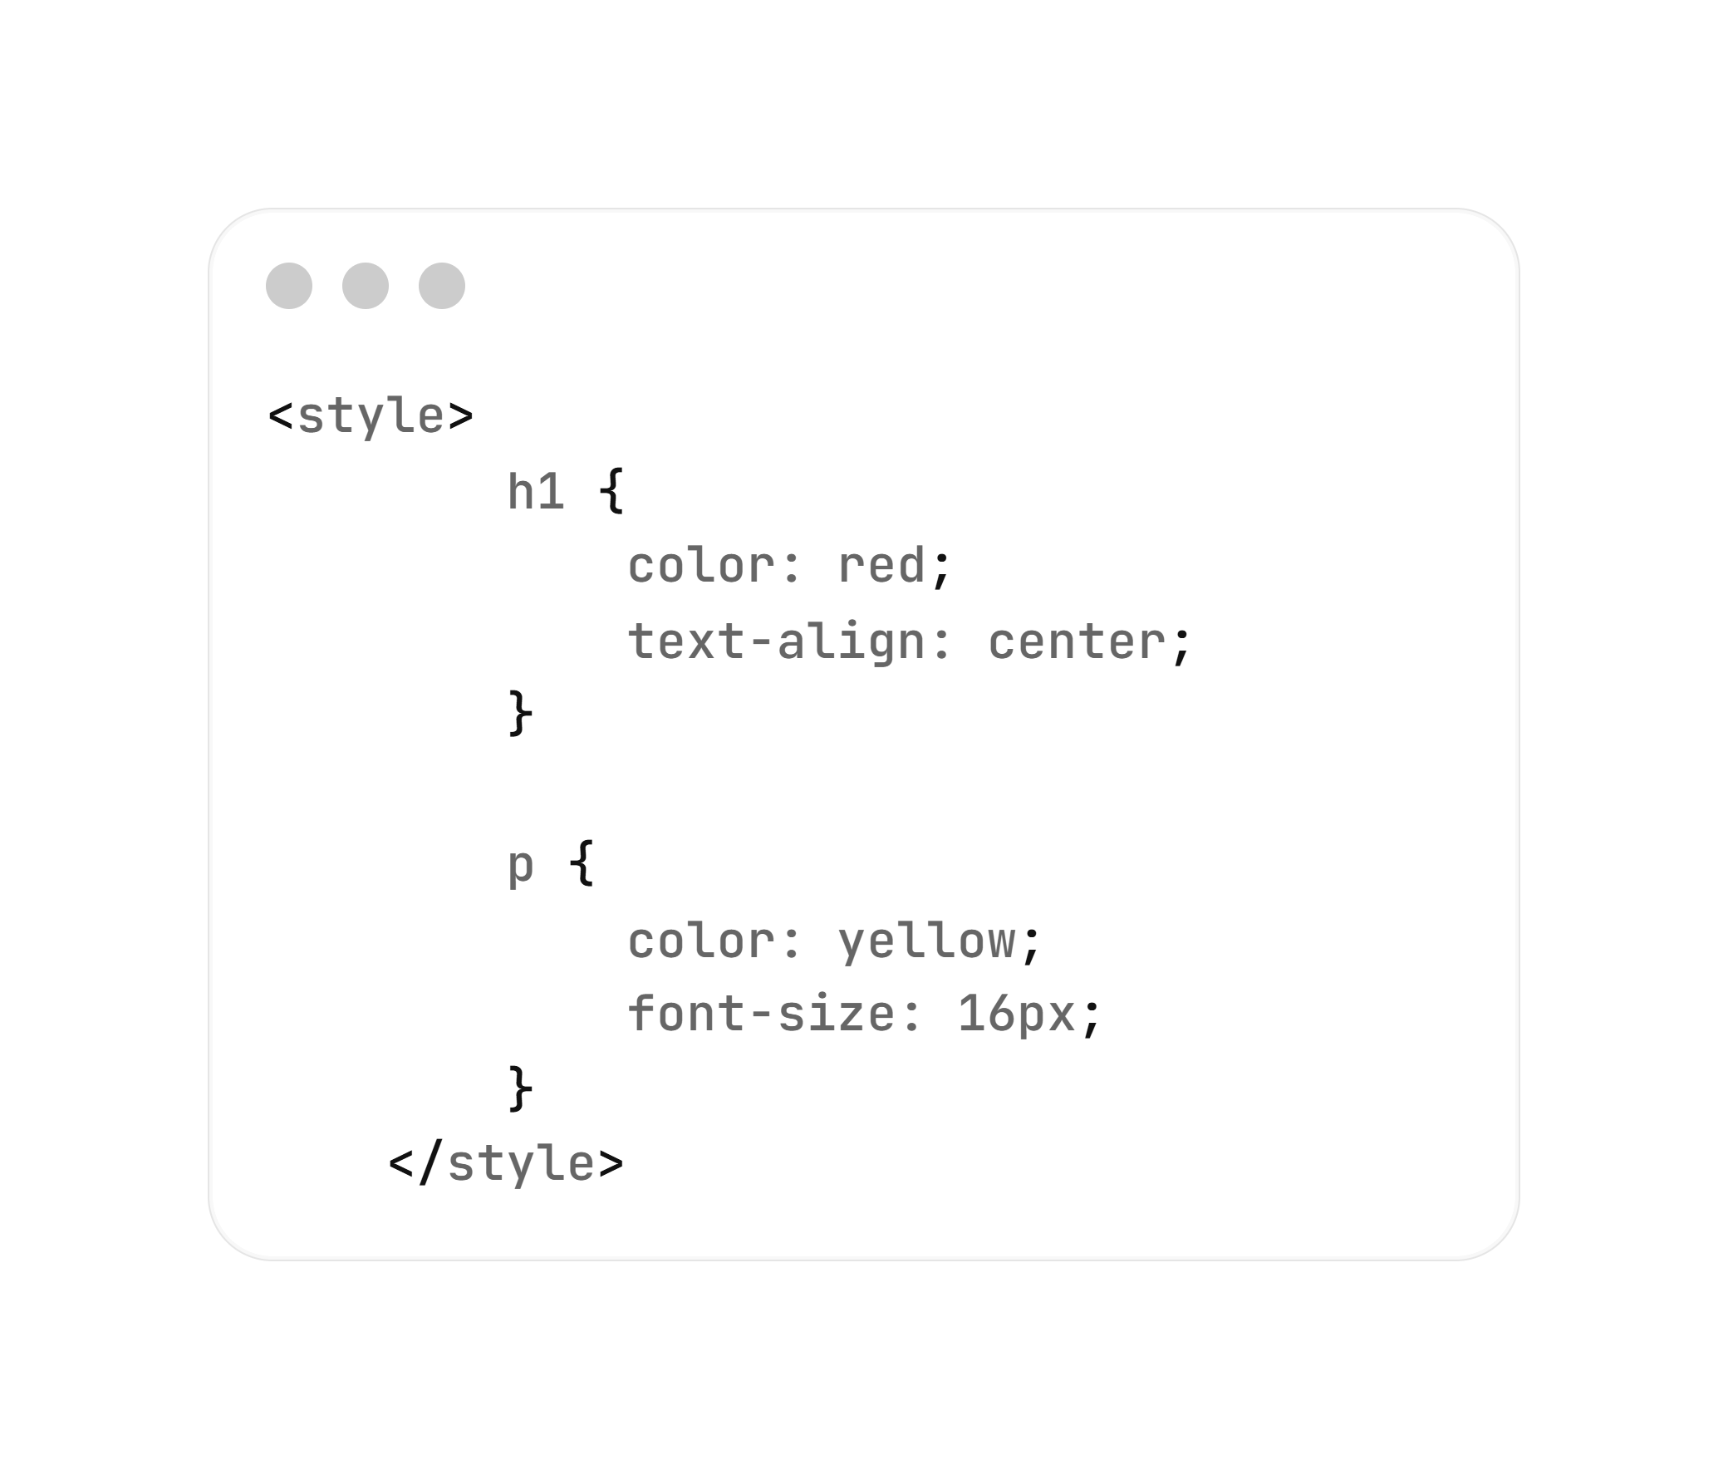
Type of selectors in CSS :
Basic Selectors in CSS are:
Element Selector (type)
Example

Slide 22
Type of selectors in CSS :
Basic Selectors in CSS are:
Class Selector (.className)
Starts with a dot . followed by the class name.
It select all elements that have a specific class.

Slide 23
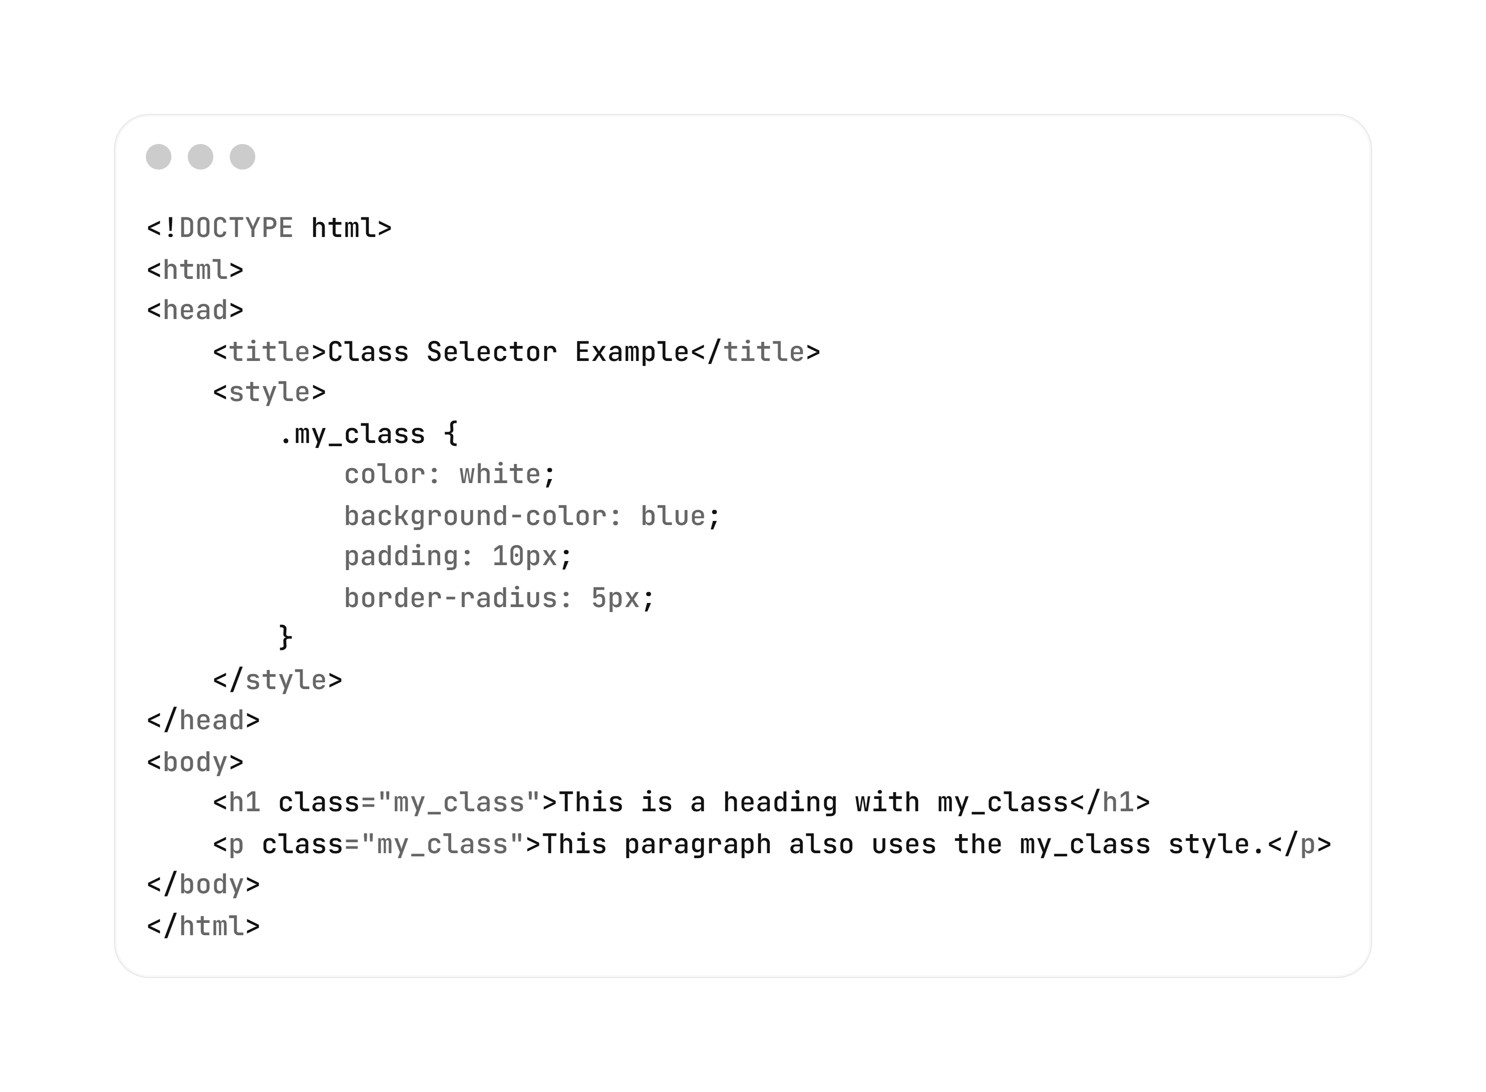
Type of selectors in CSS :
Class Selector
(.className)
Example

Slide 24
Type of selectors in CSS :
Basic Selectors in CSS are:
ID Selector (#idName)
An ID selector is used to select a single, unique element on a page. It starts with a # followed by the ID name.

Slide 25
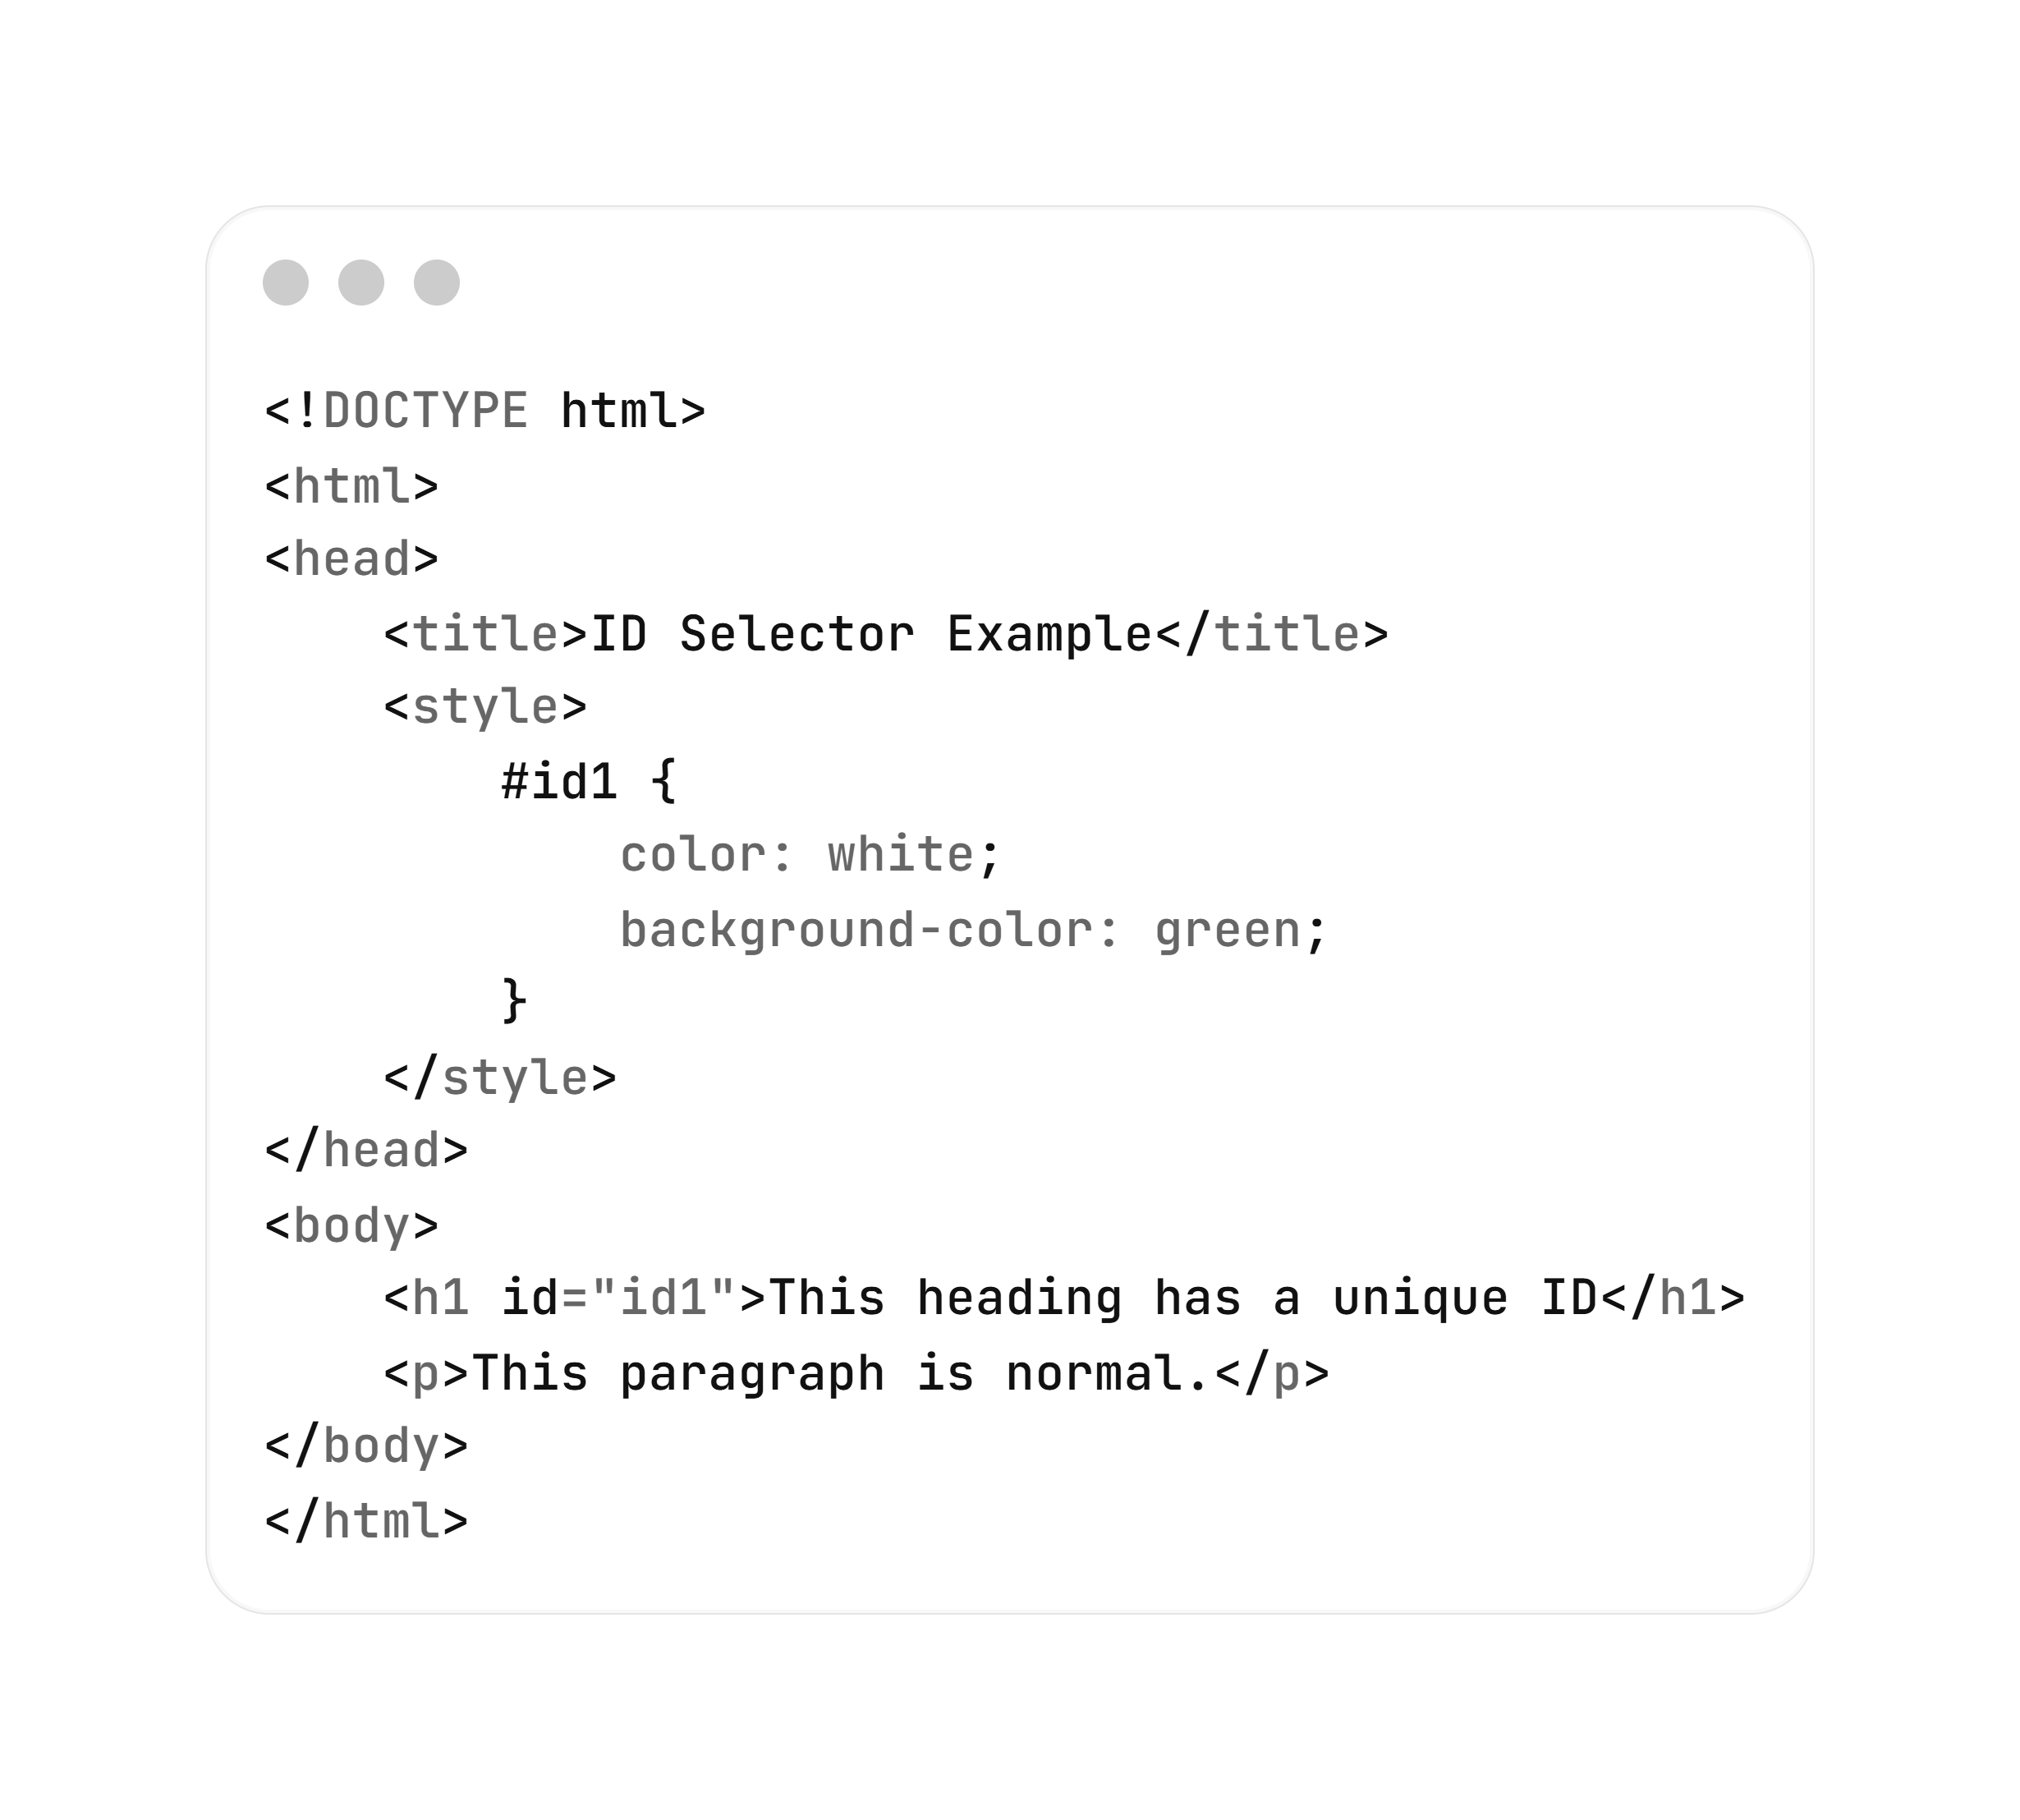
Type of selectors in CSS :
Basic Selectors in CSS are:
ID Selector (#idName)
Example

Slide 26
CSS for Styling Text
CSS Property | Description | Example
color | Sets the text color | color: red;
font-family | Sets the font type | font-family: Arial, sans-serif;
font-size | Sets the size of text | font-size: 16px;
font-weight | Sets the boldness of text | font-weight: bold;
font-style | Makes text italic or normal | font-style: italic;

Slide 27
CSS for Styling Text
CSS Property | Description | Example
text-align | Aligns text left, right, center, or justify | text-align: center;
text-decoration | Adds underline, line-through, overline, or none | text-decoration: underline;
text-transform | Changes text to uppercase, lowercase, capitalize | text-transform: uppercase;
letter-spacing | Sets space between letters | letter-spacing: 2px;
word-spacing | Sets space between words | word-spacing: 5px;
text-shadow | Adds shadow to text | text-shadow: 2px 2px 3px gray;

Slide 28
CSS for Links:
HTML links can be styled with many CSS properties, like: color, text-decoration, background-color, font-size, font-weight, font-family, etc.). a { color: red; background-color: yellow; font-weight: bold;
}

Slide 29
CSS for Links:
In addition, links can be styled differently depending on what state they are in.
The four link states are:
:link - a normal, unvisited link
:visited - a link the user has visited
:hover - a link when the user mouses over it
:active - a link the moment it is clicked
Pseudo-class !

Slide 30
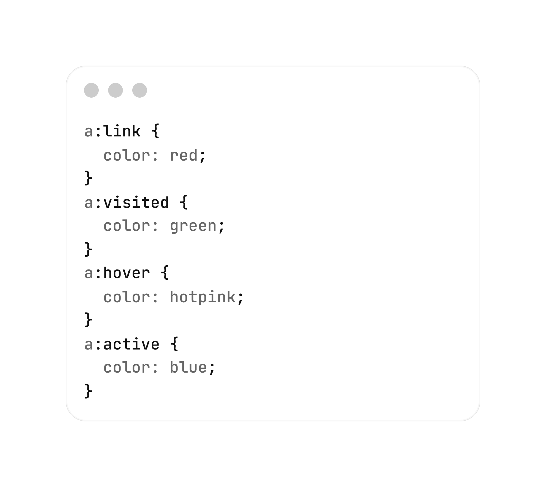
CSS for Links:

Slide 31


Slide 32

Quiz
What does CSS stand for ?
A) Computer Style Sheets
B) Creative Style System
C) Cascading Style Sheets
D) Colorful Style Syntax

Slide 33
Quiz
What is the main purpose of CSS?
A) To structure the content of a webpage
B) To describe the visual presentation of a webpage
C) To create backend
D) To connect to a server

Slide 34
Quiz
Which of the following are advantages of using CSS with HTML ?
A) Separation of content and design
B) Easier maintenance
C) Connected backend
D) Faster database queries

Slide 35
Quiz
Where is Inline CSS written?
A) Inside a separate .css file
B) Inside the <style> tag
C) Inside the style attribute of an HTML element
D) Inside the <script> tag

Slide 36
Quiz
A CSS rule consists of?
A) A selector
B) A declaration block
C) A function
D) A selector and a declaration block

Slide 37
Quiz
Which selector is used to select elements by class?
A) #className
B) .className
C) *className
D) className

Slide 38
Quiz
Which of the following are CSS text styling properties?
A) color
B) font-size
C) font-weight
D) text-align

Slide 39


