Slide 1
Web application Development
Chapter 2:
Web Programming Languages
2025 / 2026

Slide 2
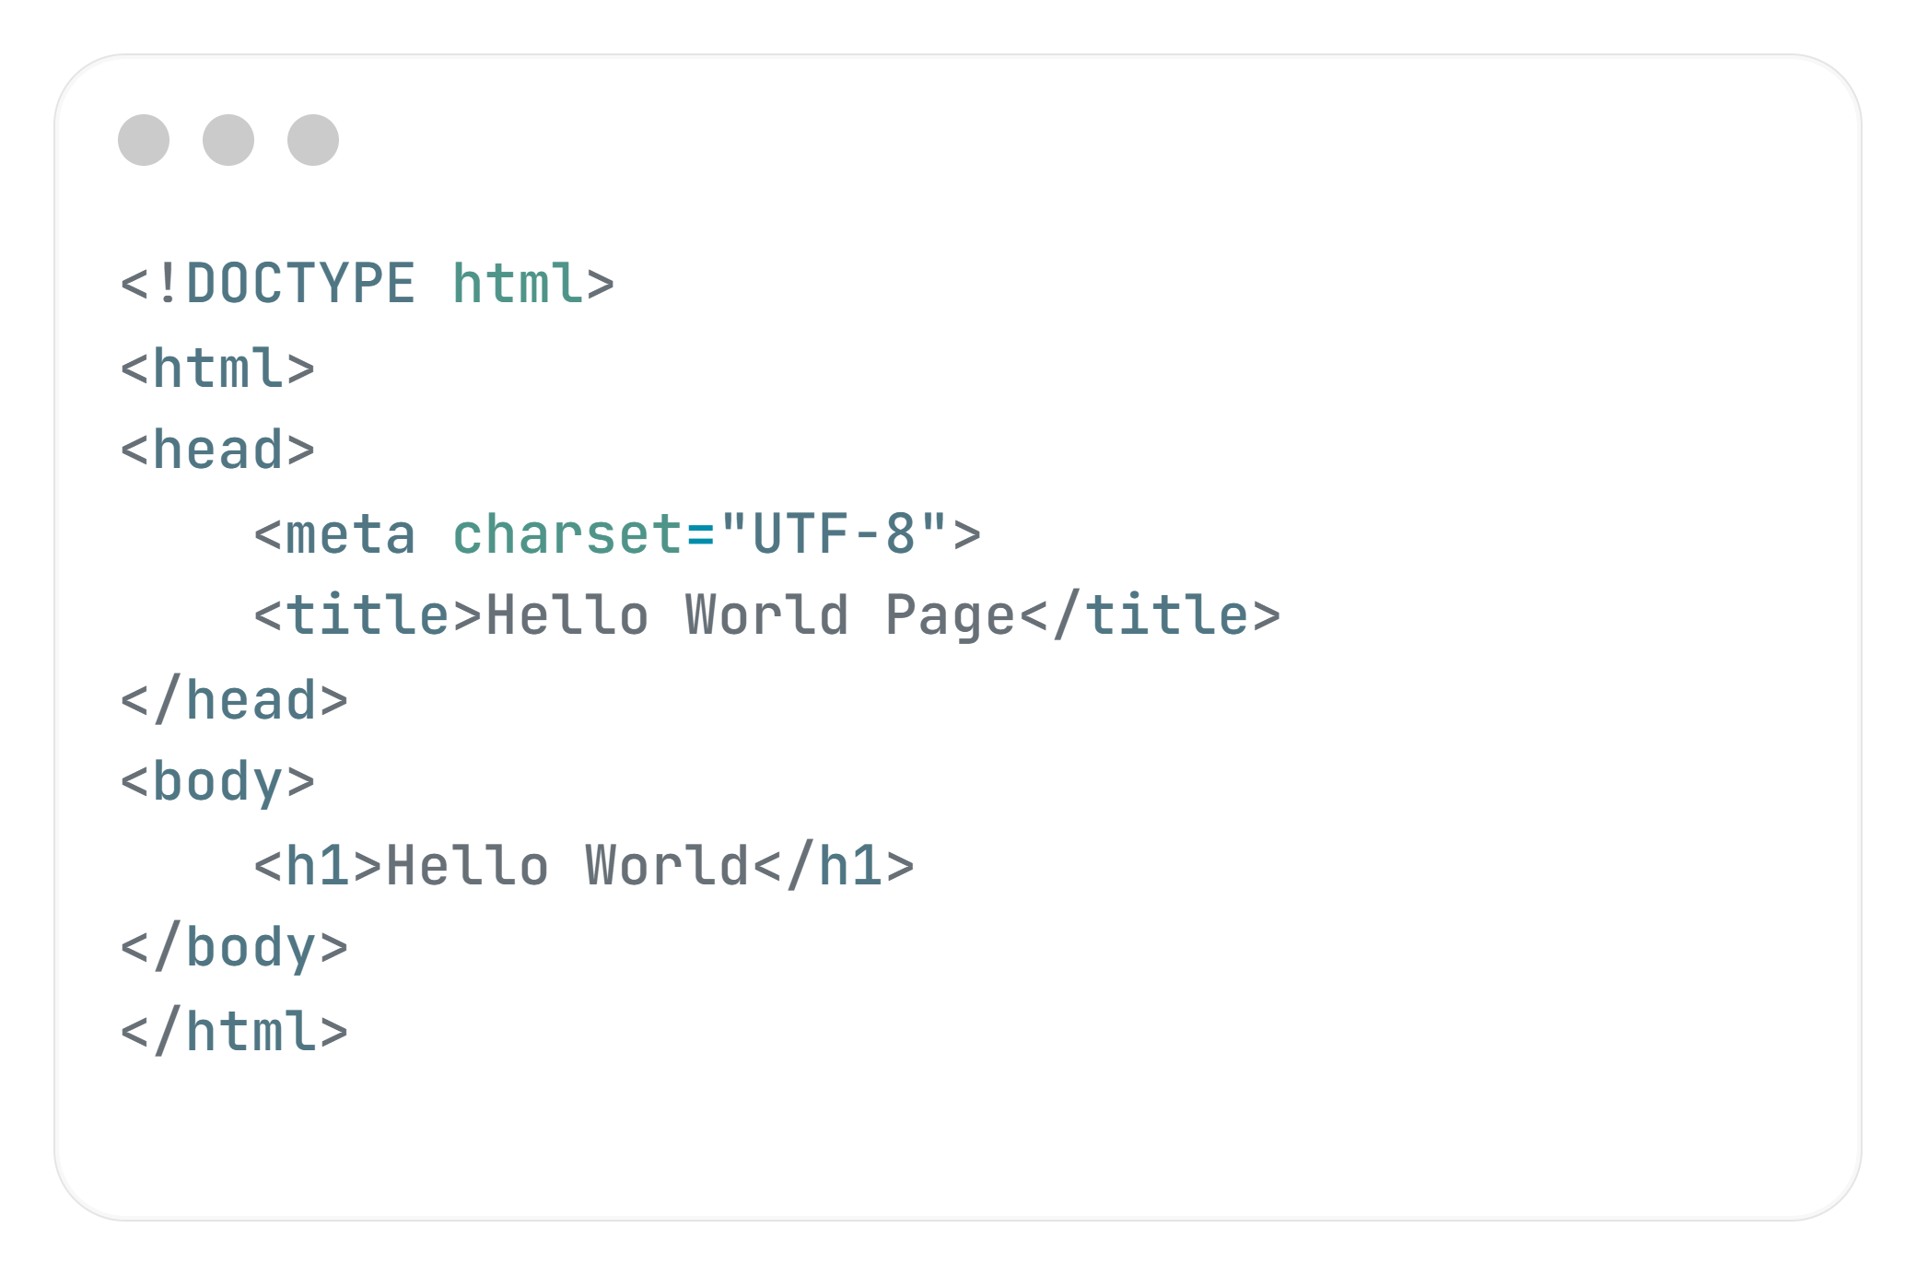
First HTML Code

Slide 3
Basic HTML
Tag | Description
<!DOCTYPE> | Defines the document type
<html> | Defines an HTML document
<head> | Contains metadata/information for the document
<title> | Defines a title for the document
<body> | Defines the document's body

Slide 4
Basic HTML
Tag | Description
<h1> to <h6> | Defines HTML headings
<p> | Defines a paragraph
<br> | Inserts a single line break
<hr> | Defines a thematic change in the content
<!– Here comment --> | Defines a comment

Slide 5
Formatting

Slide 6
Formatting
Tag | Description
<abbr> | Defines an abbreviation or an acronym
<address> | Defines contact information for the author/owner of a document/article
<b> | Defines bold text

Slide 7
Formatting
Tag | Description
<blockquote> | Defines a section that is quoted from another source
<center> | Not supported in HTML5. Use CSS instead. Defines centered text
<cite> | Defines the title of a work
<code> | Defines a piece of computer code
<del> | Defines text that has been deleted from a document

Slide 8
Formatting
<em> | Defines emphasized text
<font> | Defines font, color, and size for text
<i> | Defines a part of text in an alternate voice or mood
<kbd> | Defines keyboard input

Slide 9

Formatting
<mark> | Defines marked/highlighted text
<meter> | Defines a scalar measurement within a known range
<pre> | Defines preformatted text
<progress> | Represents the progress of a task

Slide 10
Formatting
<q> | Defines a short quotation
<s> | Defines text that is no longer correct
<samp> | Defines sample output from a computer program
<small> | Defines smaller text

Slide 11
Formatting
<strong> | Defines important text
<sub> | Defines subscripted text
<sup> | Defines superscripted text
<time> | Defines a specific time (or datetime)

Slide 12
Formatting
<u> | Defines some text that is unarticulated and styled differently from normal text
<var> | Defines a variable

Slide 13
Lists

Slide 14
Lists on HTML :
In HTML, there are two main types of lists: unordered and ordered.

Slide 15
Lists on HTML :
Unordered List
Uses the <ul> tag, and each item uses <li>.

Slide 16
Lists on HTML :
Unordered List
<ul>
<li>Algiers</li>
<li>Oran</li>
<li>Msila</li>
<li>Bejaia</li>
</ul>

Slide 17
Lists on HTML :
Ordered List
Uses the <ol> tag, and each item uses <li>.
type="A"
type="a"
type="I"
type="i"
Attributes

Slide 18
Lists on HTML :
Ordered List
<ol type="A">
<li>Apple</li>
<li>Banana</li>
<li>Orange</li>
</ol>

Slide 19
Images

Slide 20
Images
Image from the same folder
<img src="photo.png" alt="photo1">
Image from the internet
<img src="https://example.com/image.jpg" alt="Online Image">

Slide 21
Link

Slide 22
Links :
They are introduced by the <a> ... </a> tag.
To create a link, the href attribute of the <a> tag is used, and its content will form the link
Example:
<a href="http://www.google.com/"> Google </a>
<a href="page.html">click here</a>

Slide 23
Links to a page section
Anchors are used to navigate to a specific location within the document.
Example:
<h2 id="id1">Tutorials</h2>
Then, we link to this anchor:
<a href="page.html#id1">Go to Tutorials</a>

Slide 24
Colors in HTML

Slide 25
Colors in HTML
In HTML, colors can be defined using several different methods:
Named Colors:
You can specify a color by using its predefined name.
Examples include: orange, purple, red…etc

Slide 26
Colors in HTML
In HTML, colors can be defined using several different methods:
Hexadecimal Colors:
Hex colors are written using six hexadecimal characters (0–9 and A–F) preceded by a hash symbol (#).
Each pair of characters represents the intensity of red, green, and blue.

Slide 27
Colors in HTML
In HTML, colors can be defined using several different methods:
RGB Colors:
A color can also be defined using the rgb() function, which specifies the intensity of red, green, and blue on a scale from 0 to 255.

Slide 28
Colors in HTML
In HTML, colors can be defined using several different methods:
RGBA Colors:
RGBA works like RGB but includes an additional alpha value to control transparency.
The alpha value ranges from 0 (fully transparent) to 1 (fully opaque).

Slide 29
Colors in HTML
Example:
color: blue;
background-color: #ADD8E6;
border-color: rgb(0, 0, 139);
box-shadow: 0 0 8px rgba(0, 0, 255, 0.4);

Slide 30
Table

Slide 31
HTML Table
An HTML table is used to organize and display data in rows and columns on a web page.
<table border="1">

Slide 32
Table
<table border="1">
<tr>
<th>Header 1</th>
<th>Header 2</th>
</tr>
<tr>
<td>Data 1</td>
<td>Data 2</td>
</tr>
</table>
<table> → Defines the table <tr> → Table row
<th> → Table header cell (bold by default)
<td> → Table data cell

Slide 33
HTML Table
It is possible to customize tables using different attributes.
Some of the most commonly used attributes:
border:
This attribute specifies the thickness of the table border.
cellspacing:
This attribute specifies the space between the cells of the table.

Slide 34
HTML Table
cellpadding:
This attribute specifies the space between the cell content and its border.
width:
This attribute specifies the width of the table.
height:
This attribute specifies the height of the table.

Slide 35
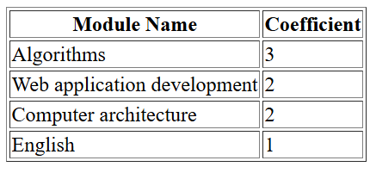
Exemple:
Create an HTML table that displays the following university modules and their coefficients:

Slide 36
Solution:
<table border="1">
<tr>
<th>Module Name</th>
<th>Coefficient</th>
</tr>
<tr>
<td>Algorithms</td>
<td>3</td>
</tr>

Slide 37
Solution:
<tr>
<td>Web application development</td>
<td>2</td>
</tr>
<tr>
<td>Computer architecture</td>
<td>2</td>
</tr>
<tr>
<td>English</td>
<td>1</td>
</tr>
</table>

Slide 38
colspan / rowspan
In HTML tables, we sometimes need a cell to cover more than one column or more than one row.

Slide 39
colspan
The colspan attribute is used to make a cell span across multiple columns.
It is written inside <td> or <th>.
Example:
colspan="2" : means the cell will take the space of 2 columns.

Slide 40
rowspan
The rowspan attribute is used to make a cell span across multiple rows.
Example:
rowspan="2" : means the cell will take the space of 2 rows.

Slide 41
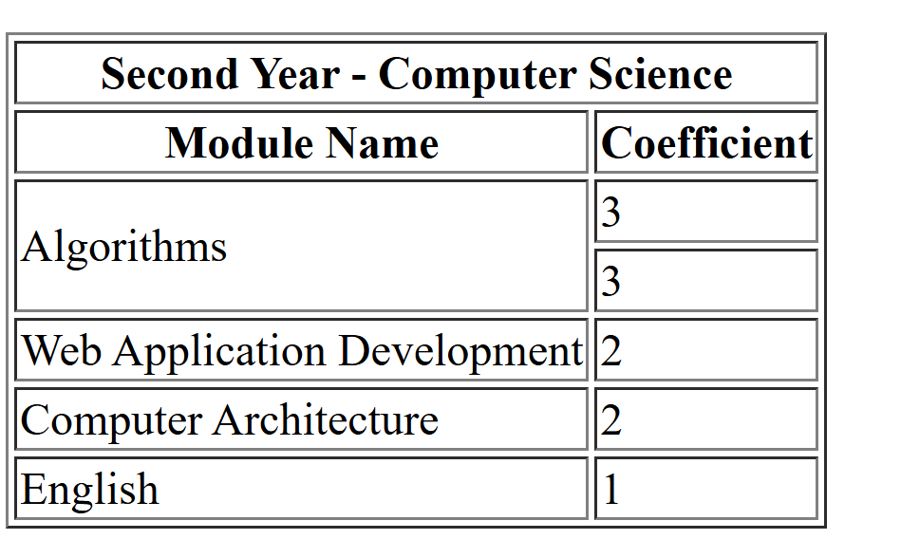
Exemple:
Create an HTML table that displays the following table:

Slide 42
Solution:
<table border="1">
<tr><th colspan="2">First Year - Computer Science</th></tr>
<tr><th>Module Name</th>
<th>Coefficient</th></tr>
<tr>
<td rowspan="2">Algorithms</td>
<td>3</td>
</tr>
<tr>
<td>3</td>
</tr>

Slide 43
Solution:
<tr>
<td>Web Application Development</td>
<td>2</td>
</tr>
<tr>
<td>Computer Architecture</td>
<td>2</td>
</tr>
<tr>
<td>English</td>
<td>1</td>
</tr>
</table>

Slide 44
Audio / Video
Tag | Description
<audio> | Defines sound content
<source> | Defines multiple media resources for media elements (<video>, <audio> and <picture>)
<video> | Defines a video or movie

Slide 45
Links
Tag | Description
<a> | Defines a hyperlink
<link> | Defines the relationship between a document and an external resource (most used to link to style sheets)

Slide 46
Frame
frame
Tag | Description
<frame> | Not supported in HTML5. Defines a window (a frame) in a frameset
<iframe> | Defines an inline frame

Slide 47
Form

Slide 48
Form
An HTML form is used to collect user input and send it to a server for processing.
Forms are created using the <form> element.
<form>
.
form elements
.
</form>

Slide 49
Form
The <form> element is a container for different types of input elements, such as:
Text fields, checkboxes, radio buttons, submit buttons, etc.

Slide 50
The <input> Element
The HTML <input> element is the most used form element.
An <input> element can be displayed in many ways, depending on the type attribute:

Slide 51
The <input> Element
<input type="text"> | Displays a single-line text input field
<input type="radio"> | Displays a radio button (for selecting one of many choices)
<input type="checkbox"> | Displays a checkbox (for selecting zero or more of many choices)
<input type="submit"> | Displays a submit button (for submitting the form)
<input type="button"> | Displays a clickable button

Slide 52
The <label> Element
<form>
<label for="fname">First name:</label><br>
<input type="text" id="fname" name="fname"><br>
<label for="lname">Last name:</label><br>
<input type="text" id="lname" name="lname">
</form>

Slide 53
The <select> Element
The <select> element is used to create a drop-down list in a form.
The <option> element defines an option that can be selected.

Slide 54
The <select> Element
<label for="cars">Choose a car:</label>
<select id="cars" name="cars">
<option value="volvo">Volvo</option>
<option value="saab">Saab</option>
<option value="fiat">Fiat</option>
<option value="audi">Audi</option>
</select>

Slide 55
The <select> Element
By default, the first item in the drop-down list is selected.
To define a pre-selected option, add the selected attribute to the option:
<option value="fiat" selected>Fiat</option>

Slide 56
The <textarea> Element
<textarea name="message" rows="10" cols="30">
here is the text in textarea
</textarea>

Slide 57
The <button> Element
<button type="button" id="myBouton">Delete!</button>

Slide 58
The <fieldset> and <legend> Elements
The <fieldset> element is used to group related data in a form.
The <legend> element defines a caption for the <fieldset> element.

Slide 59


Slide 60

Quiz
Quelle est la balise HTML utilisée pour définir un lien hypertexte ?
a) <a>
b) <Lien>
c) <Link>
d) <div>

Slide 61
Quiz
Quelle balise HTML est utilisée pour définir une zone de texte éditable ?
a) <label>
b) <textarea>
c) <select>
d) <form>

Slide 62
Quiz
Which attribute is required to provide the path to an image file?
a) href
b) alt
c) src
d) link

Slide 63
Quiz
Which attribute is used to make a table cell span across multiple columns?
a) rowspan
b) colspan
c) cellspacing
d) width

Slide 64
Quiz
In the RGBA color method, what does the 'A' (alpha value) control?
a) The intensity of Red
b) The intensity of Blue
c) Transparency (from 0 to 1)
d) The intensity of R, G, and B

Slide 65
Quiz
Which table tag is used to create a header cell that is bold by default?
a) <tr>
b) <td>
c) <th>
d) <thead>

Slide 66
Quiz
If you want a single cell to occupy two vertical lines, which attribute do you use?
a) colspan="2"
b) rowspan="2"
c) height="2"
d) <p>

