Slide 1
Web application Development
Chapter 2:
Web Programming Languages
2025 / 2026

Slide 2
Web Programming Languages
A web application is a computer program that can be accessed through an internet browser and combines front-end (also known as client) and back-end (also known as server) technology.

Slide 3
Web Programming Languages
These apps, which range from content consultation to real-time data management, enable users to interact. Typically, they use server-side languages like PHP , Python, or Node.js to manage user interactions with a database or carry out particular treatments, as well as HTML, CSS , and JavaScript for user interfaces.

Slide 4
Static page
Primary characteristics of static page:
Same content:
The content is predetermined in the source code and remains the same for every visitor.

Slide 5
Static page
Primary characteristics of static page:
Technologies front-end :
Mostly uses HTML for structure, CSS for presentation, and occasionally JavaScript for a few fundamental interactions.

Slide 6
Static page
Primary characteristics of static page:
Facilitated creation:
Because static pages don't require sophisticated settings or server routines, they are easy to develop.

Slide 7
Static page
Primary characteristics of static page:
Charge speed:
Because the data are sent straight from the server to the browser, they appear quickly.

Slide 8
Tag languages: definition and history

Slide 9
Tag languages
Tag languages (or Markup languages) are computer languages designed to structure and organize digital documents.
They use tags special elements enclosed in angle brackets “< >” to define the logical structure of content, such as headings, paragraphs, images, or links.

Slide 10
Tag languages
The main goal is to make content clear and well-structured for both humans and machines.
Unlike styling languages (e.g., CSS), markup languages focus on semantic structure rather than visual appearance.

Slide 11
Tag languages
The most widely used markup language is HTML (HyperText Markup Language), which is essential for building and organizing web pages. These languages help create standardized, accessible, and flexible digital content.

Slide 12

Tag languages
The evolution of markup languages is marked by the move from SGML (Standard Generalized Markup Language) , a complex meta-language created in the 1980s to define document structuring languages, to HTML (HyperText Markup Language) , a simplified version adapted specifically for the web.

Slide 13
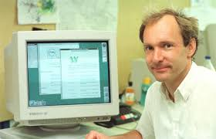
Tag languages
HTML, developed by Tim Berners-Lee in the early 1990s, to enable the creation of hypertext documents accessible via a browser.

Slide 14
Tag languages
Over time, HTML evolved through several versions (HTML 2.0, HTML 4.01…) to incorporate more advanced functionalities, until the arrival of HTML5 , which introduces semantic elements, better support for media, and APIs for dynamic interactions.

Slide 15
Tag languages
This evolution reflects the transition from a generic and rigid standard to a flexible and powerful language, adapted to the modern needs of the web.

Slide 16
HTML

Slide 17
HTML
HTML (HyperText Markup Language) is used to represent and organize the content of web documents.
By defining the semantic elements and their hierarchy, it contributes to a web page and enables the incorporation of media, hypertext links, and other resources through user-interpretable balises.

Slide 18
HTML
The context in which HTML is executed depends on how web browsers interpret it; they analyze HTML code to create and display sites in a visually appealing manner.

Slide 19
HTML
When a user accesses a web page, the browser retrieves the HTML file from a server, parses its contents (including its structure and balises), and then builds a document object model (DOM) that serves as the foundation for graphically restoring the page.

Slide 20
HTML
In order to provide a comprehensive and functional online experience, HTML frequently works with languages like CSS for style and JavaScript.

Slide 21
HTML

Slide 22
Basic HTML

Slide 23
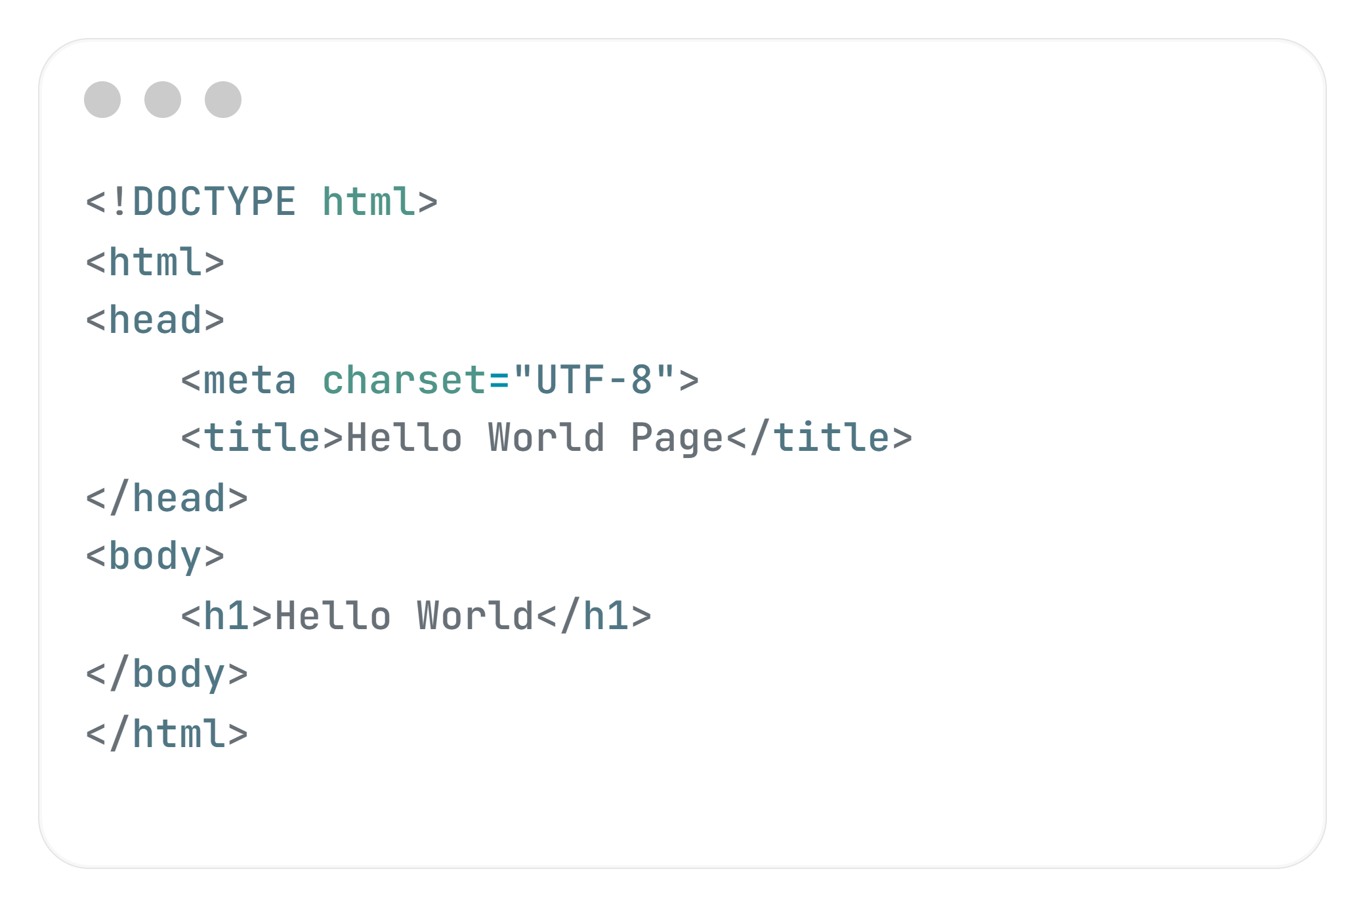
First HTML Code

Slide 24
Basic HTML
Tag | Description
<!DOCTYPE> | Defines the document type
<html> | Defines an HTML document
<head> | Contains metadata/information for the document
<title> | Defines a title for the document
<body> | Defines the document's body

Slide 25
Basic HTML
Tag | Description
<h1> to <h6> | Defines HTML headings
<p> | Defines a paragraph
<br> | Inserts a single line break
<hr> | Defines a thematic change in the content
<!– Here comment --> | Defines a comment

Slide 26
Formatting

Slide 27
Formatting
Tag | Description
<abbr> | Defines an abbreviation or an acronym
<address> | Defines contact information for the author/owner of a document/article
<b> | Defines bold text

Slide 28
Formatting
Tag | Description
<blockquote> | Defines a section that is quoted from another source
<center> | Not supported in HTML5. Use CSS instead. Defines centered text
<cite> | Defines the title of a work
<code> | Defines a piece of computer code
<del> | Defines text that has been deleted from a document

Slide 29
Formatting
<em> | Defines emphasized text
<font> | Defines font, color, and size for text
<i> | Defines a part of text in an alternate voice or mood
<kbd> | Defines keyboard input

Slide 30

Formatting
<mark> | Defines marked/highlighted text
<meter> | Defines a scalar measurement within a known range
<pre> | Defines preformatted text
<progress> | Represents the progress of a task

Slide 31
Formatting
<q> | Defines a short quotation
<s> | Defines text that is no longer correct
<samp> | Defines sample output from a computer program
<small> | Defines smaller text

Slide 32
Formatting
<strong> | Defines important text
<sub> | Defines subscripted text
<sup> | Defines superscripted text
<time> | Defines a specific time (or datetime)

Slide 33
Formatting
<u> | Defines some text that is unarticulated and styled differently from normal text
<var> | Defines a variable

Slide 34
Lists

Slide 35
Lists on HTML :
In HTML, there are two main types of lists: unordered and ordered.

Slide 36
Lists on HTML :
Unordered List
Uses the <ul> tag, and each item uses <li>.

Slide 37
Lists on HTML :
Unordered List
<ul>
<li>Algiers</li>
<li>Oran</li>
<li>Msila</li>
<li>Bejaia</li>
</ul>

Slide 38
Lists on HTML :
Ordered List
Uses the <ol> tag, and each item uses <li>.
type="A"
type="a"
type="I"
type="i"
Attributes

Slide 39
Lists on HTML :
Ordered List
<ol type="A">
<li>Apple</li>
<li>Banana</li>
<li>Orange</li>
</ol>

Slide 40
Images

Slide 41
Images
Image from the same folder
<img src="photo.png" alt="photo1">
Image from the internet
<img src="https://example.com/image.jpg" alt="Online Image">

Slide 42


Slide 43

Quiz
Which technologies are mainly used for the front-end of a web application?
PHP, Python, Node.js.
C, C++, Java
HTML, CSS, JavaScript
MySQL, Oracle, MongoDB

Slide 44
Quiz
Which of the following is a characteristic of a static web page?
Requires server-side processing
Same content for all visitors.
Uses databases

Slide 45
Quiz
Who developed HTML??
Bill Gates
Steve Jobs
Tim Berners-Lee
Mark Zuckerberg

Slide 46
Quiz
When a browser reads HTML, what structure does it build??
DOM
COM
URL
WWW

Slide 47
Quiz
Why are static web pages generally faster than dynamic ones??
They require server-side computation.
They use modern APIs
The content is sent directly without processing

Slide 48
Quiz
Which of the following best explains the purpose of a markup language?
To define program logic.
To control visual styling
To structure content using semantic tags

Slide 49
Quiz
Which tag MUST be inside <ul> or <ol>?
<item>.
<li>
<il>

Slide 50
Quiz
Which tag creates a line break WITHOUT starting a new paragraph?
<p>.
<hr>
<br>
<newline>

