Slide 1
Web application Development
2025 / 2026

Slide 2
WAD
Crédits : 4
Coefficient : 2

Slide 3
WAD
Objetives de l’enseignement :
L’objective est d’apprendre comment créer une application web.

Slide 4
WAD
Connaissances préalables recommandées : Notions fondamentales sur l algorithmique et la pogramation. Notions de base sur Internet et Réseaux.

Slide 5
Chapters:
Introduction to the World Wide Web
Web Programming Languages
Server-Side Programming Language (PHP)
Web Services: Fundamentals

Slide 6
Introduction to the World Wide Web
Definition and History
Client/Server Architecture
HTTP Protocol

Slide 7
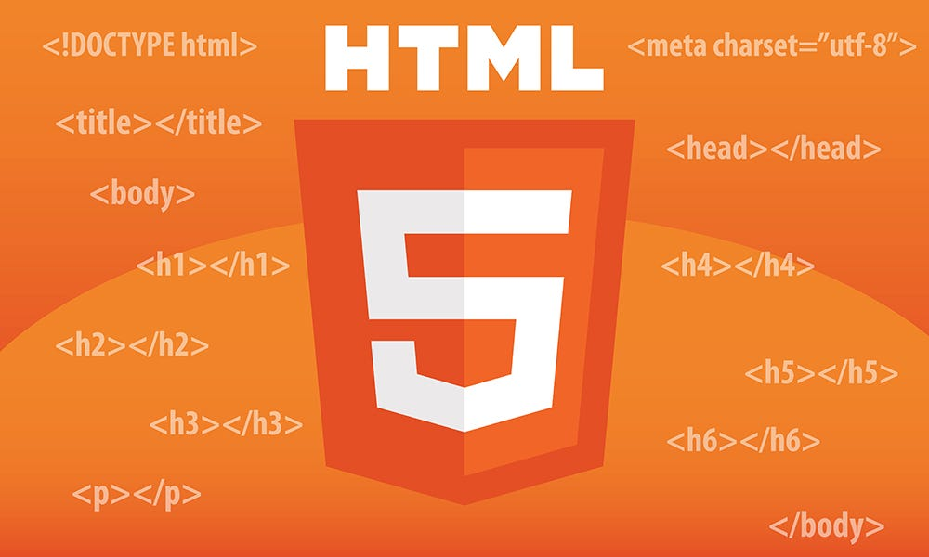
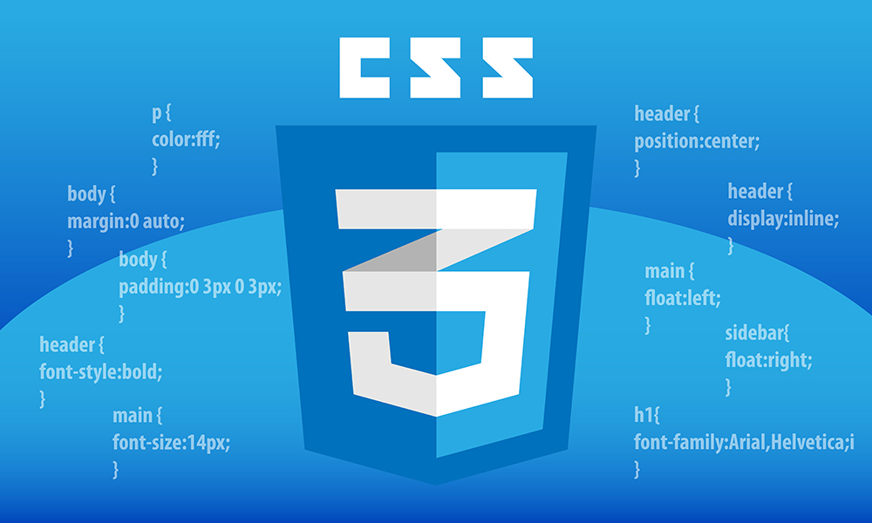

Web Programming Languages

Slide 8

Server-Side Programming Language (PHP)

Slide 9
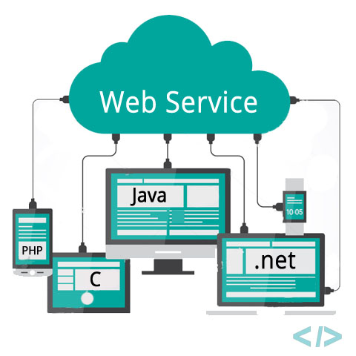
Web Services: Fundamentals

Slide 10
Introduction to the World Wide Web
CHAPTER 1

Slide 11

Introduction to the World Wide Web
The World Wide Web is a global information system that can be accessed through the Internet.

Slide 12
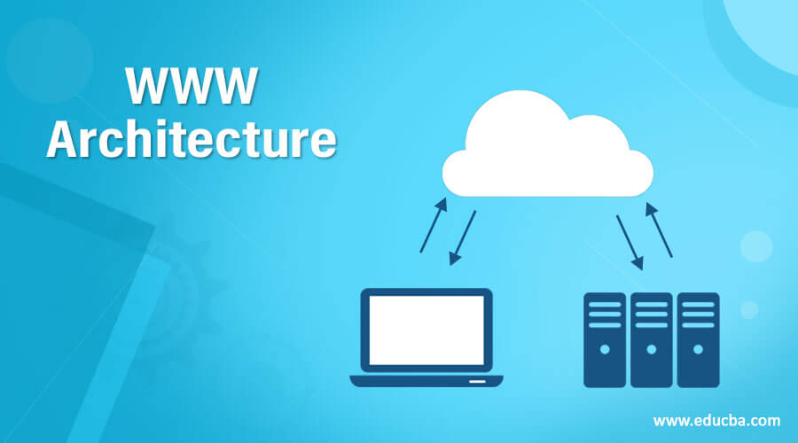
Introduction to the World Wide Web
Its architecture enables the sharing and viewing of digital resources through web pages that are connected by hyperlinks.

Slide 13
Introduction to the World Wide Web
The World Wide Web has greatly changed how people and organizations use information.

Slide 14
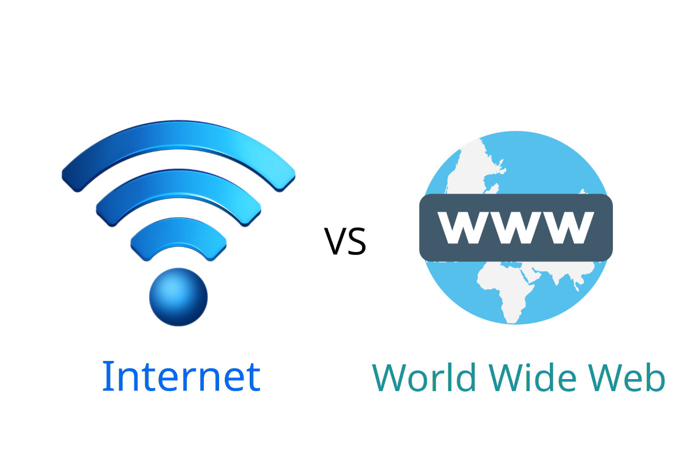
Introduction to the World Wide Web
Although the words ‘Web’ and ‘Internet’ are sometimes used with the same meaning in everyday language, it is important to distinguish between the two.

Slide 15
Introduction to the World Wide Web
The Internet is a massive global computer network made of many connected smaller networks, using standard rules like TCP/IP to allow devices to communicate.

Slide 16
Introduction to the World Wide Web
The Web is just one of the many uses of the Internet, mainly for sharing information through web pages that can be seen in web browsers.

Slide 17
Introduction to the World Wide Web
The Web acts as a virtual, interactive platform where data can be displayed in textual, visual, or multimedia formats, while the Internet provides the underlying hardware and software infrastructure that permits data transmission. This results in a dynamic, changing the way we communicate and interact with information.

Slide 19
History and versions of Web

Slide 20
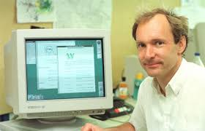
History and versions of Web
The World Wide Web was first created in 1989 when British researcher Tim Berners-Lee, who was employed at CERN (European Organization for Nuclear Research), proposed a novel system aimed at making it easier for scientists to share information.

Slide 21
History and versions of Web
His original plan was to develop a platform that would allow users to access and connect data over the Internet's computer network by relying on documents through hypertext links.
With the launch of the first website in 1991, this project marked the beginning of a significant technological revolution.

Slide 22
History and versions of Web
Since its inception, the Web has undergone several significant stages of development, each of which significantly altered its functions and uses.

Slide 23
Web 1.0
Consisted mostly of static web pages that were primarily designed to disseminate information in a unidirectional manner without requiring meaningful user engagement.

Slide 24
Web 2.0
The online world saw a dramatic change starting in the early 2000s when blogs, social media networks, content sharing platforms, and collaborative tools made websites dynamic and interactive , promoting user engagement.

Slide 25
Web 3.0
Web 3.0 also known as Web semantics has begun to take shape and promises a more intelligent Internet where computers can understand and analyze data material.
In addition to redefining how we create and consume information, this transformation is also redefining how digital systems communicate with one another to deliver experiences that are ever more individualized and intuitive .

Slide 26
Note
Although it is still in the conceptualization and development stages, Web 4.0 is a significant advancement. Their goals are to create a digital ecosystem in which human-machine and system interactions become completely transparent. This future version of the Web is based on the integration of new technology including :

Slide 27

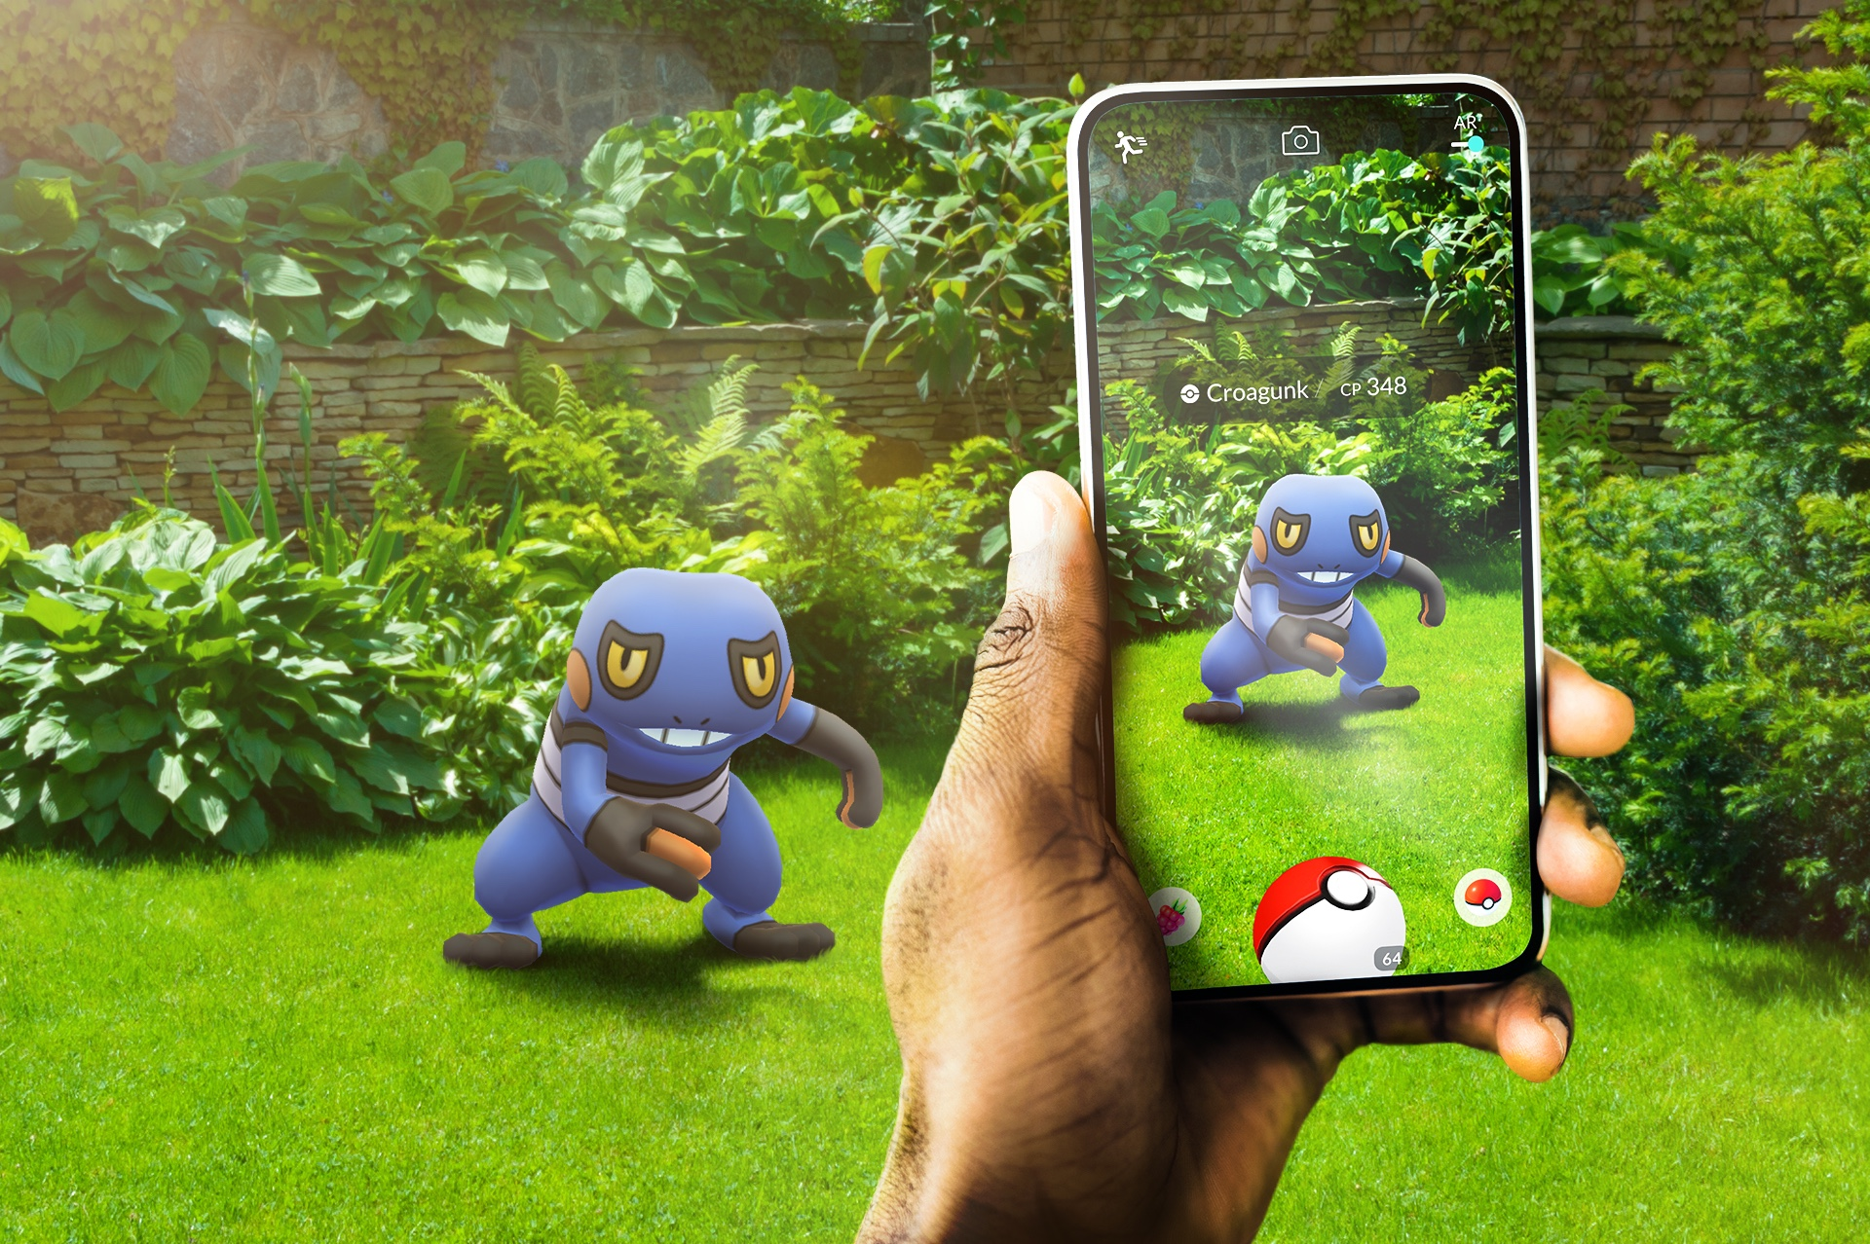
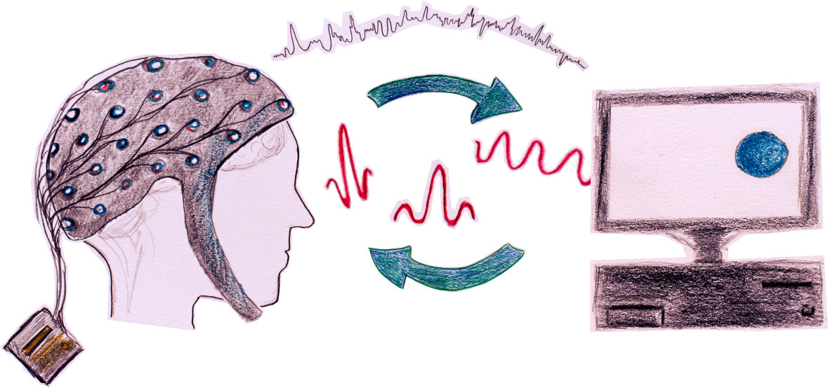
Note
Artificial intelligence (AI )
Augmented Reality (AR)
Virtual Reality (VR)
the Internet of Things (IoT)
Brain-Computer Interfaces(BCI).

Slide 28
Comparison
Features | Web 1.0 | Web 2.0 | Web 3.0
Period | 1990 - early 2000s | Early 2000s - 2010 | 2010 - Today
Content Type | Static pages, read-only | Interactive and collaborative content | Intelligent and personalized content
Interaction & User Experience | Unidirectional, with static and limited content | Bidirectional, encouraging creation, sharing, and a dynamic, social, and engaging experience | Bidirectional, offering an intelligent and personalized experience
Platform Examples | Showcase sites, basic forums | Social networks, blogs, YouTube, collaborative Wikipedia | Blockchain, semantic web, voice assistants

Slide 29
Comparison
Features | Web 1.0 | Web 2.0 | Web 3.0
Technologies Used | HTML, CSS, centralized servers | + JavaScript, AJAX | + Blockchain, RDF, AI, Big Data
Security and Privacy | Low (centralization, no encryption) | Medium (massive data collection) | High (decentralization, cryptography)
Digital Economy | Basic advertising, direct sales | Platform economy, content monetization | Cryptocurrencies, NFT, smart contracts

Slide 30
Client/Server Architecture

Slide 31
Client/Server Architecture
The client-server model is a fundamental paradigm in computer system architecture, especially prevalent on the web. It ensures an efficient distribution of tasks and serves as the foundation for many modern online apps.

Slide 32
Client/Server Architecture
In this model, a client, typically represented by a web browser, submits a request to access particular resources, such as web pages, photos, or data.
This request is sent to a server, which serves as a resource provider by hosting the requested data. The server processes the request, retrieves the relevant resource, and sends the client the appropriate response.

Slide 33
Principle client and server role
The respective roles of the client and server are clearly defined:
The client provides a user interface for initiating and receiving interactions
The server manages, stores and distributes the resources requested.

Slide 34
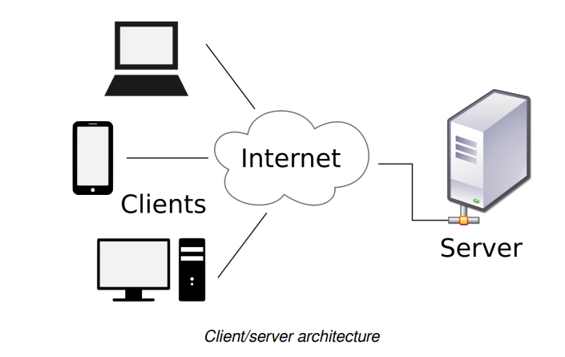
Principle client and server role
clients send requests to the server over the network. The server then processes these requests and sends the corresponding responses back to the clients.

Slide 35
Example client-server
Entering the URL: The user enters a web address (URL) in the browser's address bar.
Sending the request: The browser, acting as a client, sends a request to the server hosting the requested page via the network.
Processing the request: The server receives the request, identifies the resources requested and prepares an appropriate response.

Slide 36
Principle client and server role
Sending the response: The server sends the client the necessary data, such as HTML, CSS or JavaScript code, as well as any additional files (images, videos, etc.).
Display of the web page: The browser interprets the data received and displays the complete web page to the user.

Slide 37
HTTP Protocol
HTTP (HyperText Transfer Protocol) is a communication protocol used for online data transfers. It specifies the rules that allow web browsers and servers to exchange information, including HTML pages, photos, videos, and other resources.
In the client-server model of HTTP, the client (often a browser) sends a request, and the server provides the requested data.

Slide 38
HTTP protocol features
Owing to its ease of use, adaptability, and efficiency, HTTP has emerged as a crucial standard for online communication. Among its features is its fundamental protocol, which makes it easier for users and servers to access and exchange information.

Slide 39
HTTP protocol features
The characteristics of the HTTP protocol include
Stateless protocol: HTTP retains no memory of previous exchanges between client and server. Each request is processed independently, unless additional mechanisms such as cookies or sessions are put in place to ensure a certain persistence.

Slide 40
HTTP protocol features
Request-response model: The interaction between client and server follows a strict pattern where the client sends a request and the server provides a corresponding response.
Text-based: HTTP requests and responses are generally structured in the form of readable text, facilitating analysis and debugging.

Slide 41
Common HTTP methods
Use of standardised methods: HTTP defines several request methods for multiple actions.
the types of actions that a client can perform on a server resource. Among the most common are: GET, POST, PUT, DELETE

Slide 42
GET
Used to retrieve a resource without modifying its state. It is commonly used to load web pages, images or files. Parameters can be passed in the URL, but this method should not be used to send sensitive data, as this will appear unencrypted in the URL.

Slide 43
POST
Used to send data to the server to create a new resource or process a submission (e.g. registration form, sending comments). Unlike GET, the data is sent in the body of the request, offering greater security and flexibility.

Slide 44
PUT
Use this to replace everything in a file or create a new one if it’s missing. No matter how many times you click send, the result will always be the same.

Slide 45
DELETE
Used to remove a specific resource from the server. (if the resource no longer exists, the operation has no additional effect).

Slide 46


Slide 47

Quiz
Which version of the web is often referred to as the 'Read-Only' web, characterized by static pages and limited user interaction?
Web 1.0
Web 2.0
Web 3.0

Slide 48
Quiz
If you send the same request three times in a row, which of these methods would result in three different items being created on the server?
GET
POST
PUT
DELETE

Slide 49
Quiz
What is a major difference between how data is handled in Web 2.0 versus Web 3.0?
In Web 2.0, users own their data; in Web 3.0, corporations own it.
There is no difference in data handling between the two.
In Web 2.0, data is centralized; in Web 3.0, data is decentralized and user-owned.
Web 2.0 does not use databases, while Web 3.0 does.

Slide 50
Quiz
In the client-server model, which entity is responsible for initiating a request for data or services?
Client
Server

Slide 51
Quiz
What is the primary difference between HTTP and HTTPS?
HTTPS uses encryption to secure the data being sent.
HTTP can only be used for text, while HTTPS is for multimedia.
HTTPS does not use the client-server model.

Slide 52
Quiz
Which of these best describes a 'Server' in the context of the web?
A person who fixes computers when they break.
A specialized browser used only by programmers.
A computer program or device that provides functionality for other programs.

Slide 53
How to write the first HTML Code

